Slide 1

2023 Clinical Practice Guidelines Update
Chapter 14
Hypoglycemia
Iliana C. Lega MD MSc FRCPC
Jean-François Yale MD FRCPC
Ayush Chadha PharmD
Breay Paty MD FRCPC
Rob Roscoe BSc Pharm, ACPR, CDE
Melanie Snider MN, NP
Jennifer Steier RN BN CDE
Notes:
1

Slide 2
Key Changes
2023 Diabetes Canada CPG Update – Chapter 14. Hypoglycemia
2023
New definition, harmonized with IHSG
New section on psychosocial complications and fear of hypoglycemia
Availability of intra-nasal glucagon for treatment of Level 3 hypoglycemia

Slide 3
Definition and Classification of Hypoglycemia
2023 Diabetes Canada CPG Update – Chapter 14. Hypoglycemia
2023
 | Glucose Level | Main Characteristic | Comment
Level 1 (Alert Value) | Often between 3.0 and 3.9 mmol/L | Associated with autonomic symptoms | No neuroglycopenic symptoms or changes in mental status
Level 2 | often < 3.0 mmol/L | Associated with neuroglycopenic symptoms | no significant impact on mental status
Level 3 | Glucose level below normal | Requires assistance to treat, altered mental/physical status

Slide 4
Symptoms of Hypoglycemia
2023 Diabetes Canada CPG Update – Chapter 14. Hypoglycemia
2023
Adrenergic (autonomic) | Neuroglycopenic
Trembling | Difficulty Concentrating
Palpitations | Confusion
Sweating | Weakness
Anxiety | Drowsiness
Hunger | Vision Changes
Nausea | Slurred speach
Tingling | Headache
 | Dizziness
Frequent hypoglycemia → Defective glucose counterregulation → Impaired awareness of hypoglycemia
Validated screening tools: Gold or Clarke scores
Notes:
The CDA defines hypoglycemia as the development of autonomic (trembling, palpitations, sweating, anxiety, hunger, nausea, tingling) or neuroglycopenic (difficulty concentrating, confusion, weakness, drowsiness, vision changes, difficulty speaking, headache, dizziness) symptoms, a low plasma glucose, and symptoms responding to the administration of a carbohydrate. In mild to moderate hypoglycemia, blood glucose is <4 mmol/L, autonomic and/or neuroglycopenic symptoms are present, but the patient is able to self-treat. However, patients who maintain a higher blood glucose level may experience hypoglycemia at levels >4.0 mmol/L. Severe hypoglycemia indicates the patient is unable to treat the reaction without outside assistance. He/she may or may not be conscious.
4

Slide 5
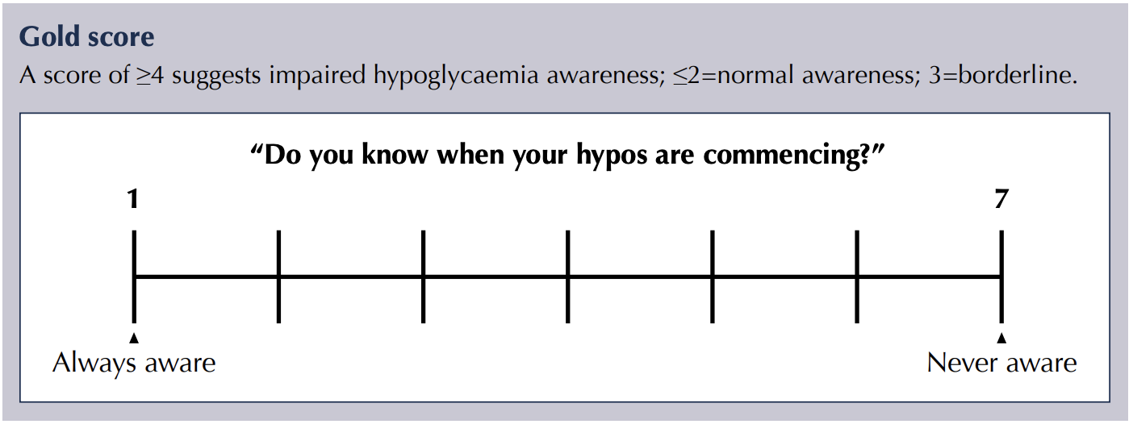
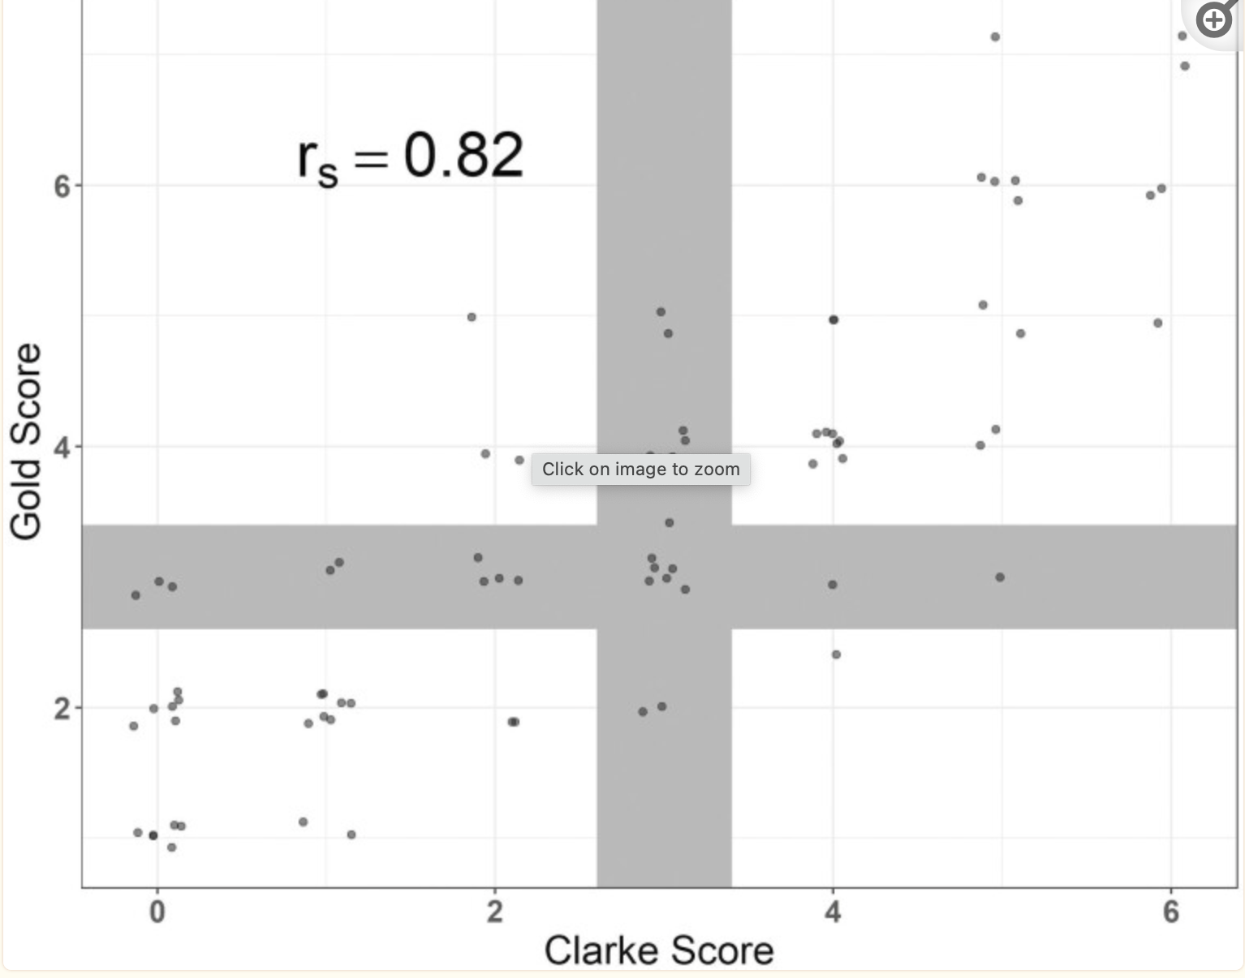
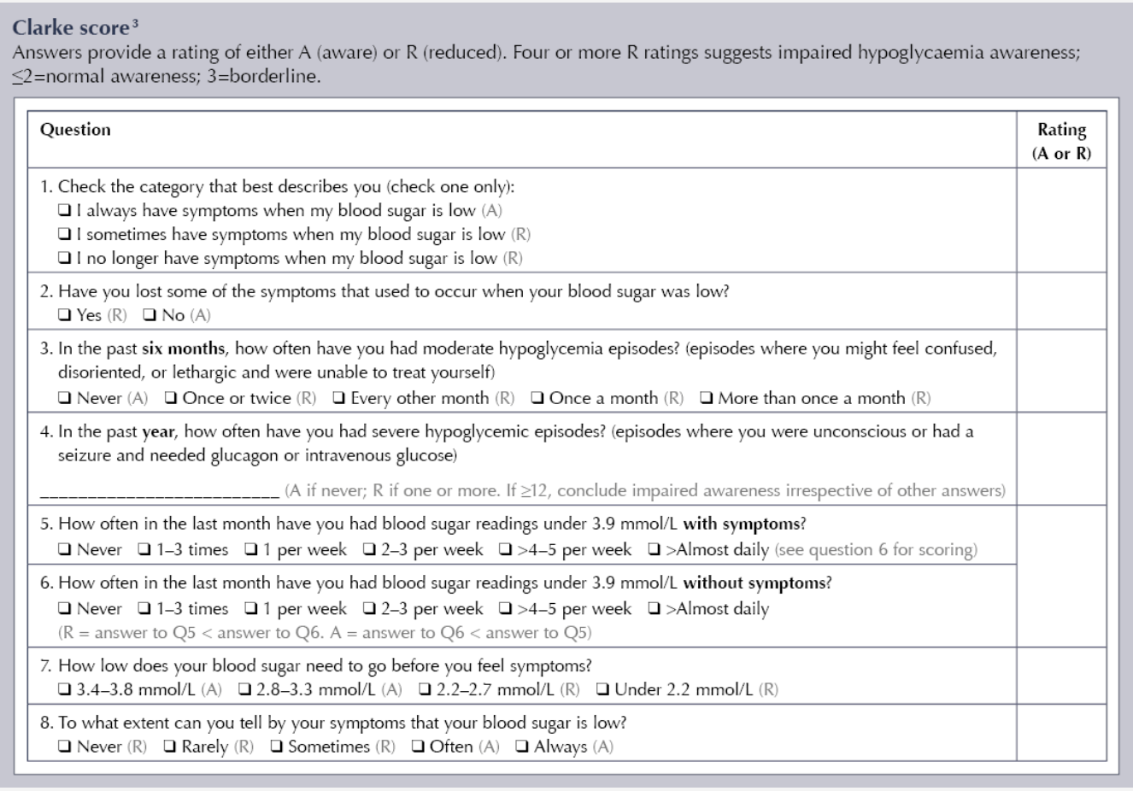
Gold and Clarke Scores for Detection of Impaired Awareness of Hypoglycemia
2023 Diabetes Canada CPG Update – Chapter 14. Hypoglycemia
2023

Slide 6
2023 Diabetes Canada CPG Update – Chapter 14. Hypoglycemia
2023
Risk factors for hypoglycemia in individuals treated with sulfonylureas or insulin
Prior episode of severe hypoglycemia Current low A1C (<7.0%) Hypoglycemia unawareness Long duration of insulin therapy Autonomic neuropathy Chronic kidney disease Low economic status, food insecurity Low health literacy Preschool-aged children unable to detect and/or treat mild hypoglycemia on their own Adolescence Pregnancy Frailty or advanced age Cognitive impairment

Slide 7
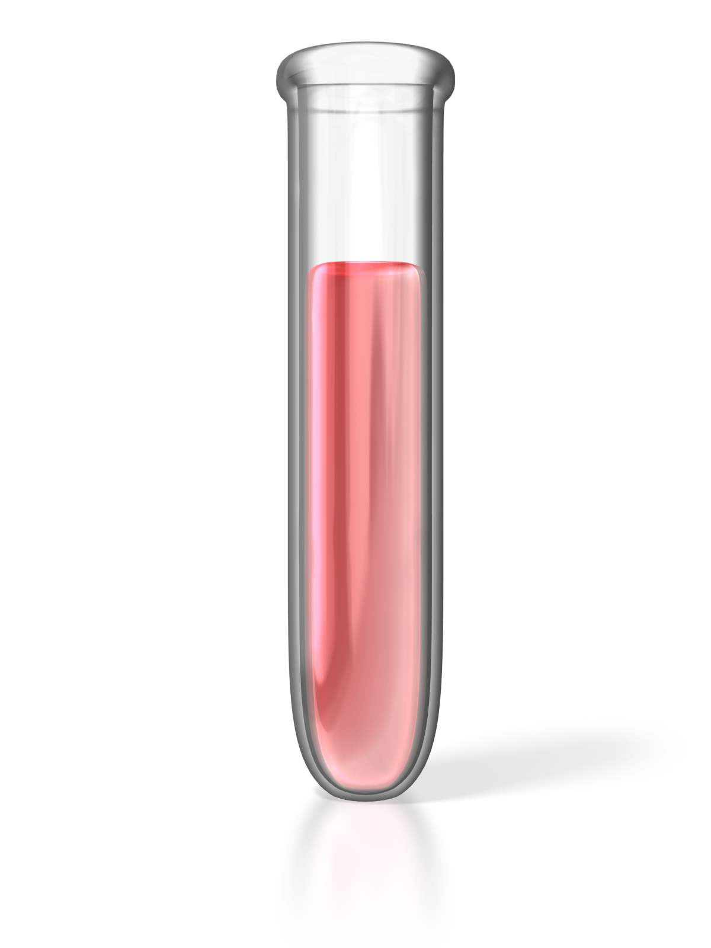
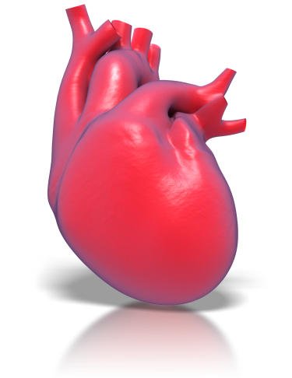
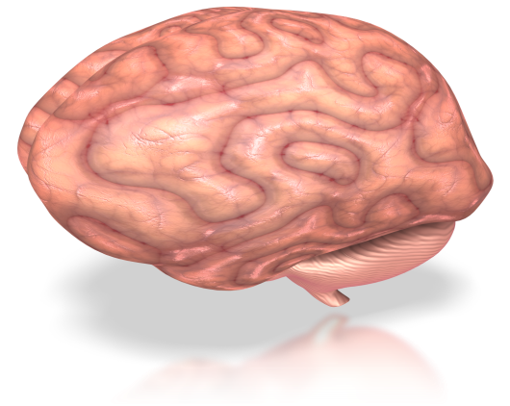

Physical and Psychosocial Complications of Hypoglycemia
2023 Diabetes Canada CPG Update – Chapter 14. Hypoglycemia
2023
6
Confusion
Inadequate behaviour
Missed work
Fall, fractures
Car accident
Coma + Convulsions
Brain Death
Tachycardia
QTc prolongation
Arrhythmias
Myocardial infarct ?
Sudden death
5
Acute
4
3
2
Anxiety
Fear of hypoglycemia
Family concerns
Cognitive dysfunction?
Long-term
1
mmol/L
Notes:
NOTES À L’INTENTION DE L’ANIMATEUR :
But : Montrer les complications et les conséquences importantes de l’hypoglycémie grave. Message à retenir : L’arythmie cardiaque et la neuroglycopénie évolutive peuvent être des complications graves de l’hypoglycémie.
Un certain nombre de complications ont été associées à l’hypoglycémie grave. Landstedt-Hallin et ses collègues ont mené une étude auprès de 13 patients atteints de diabète de type 2 qui suivaient un traitement associant l’insuline à une sulfonylurée pendant leur hypoglycémie; ils ont noté d’importantes modifications dans la repolarisation cardiaque (augmentation significative de l’intervalle QT moyen et de la dispersion du QT) qui indiquaient un risque accru d’arythmie, une complication majeure de l’hypoglycémie.
Cryer laisse entendre que l’atteinte manifeste de la fonction cérébrale peut passer de troubles cognitifs mesurables (au seuil de 2,8 mmol/L) à des comportements anormaux, des convulsions et un coma (entre 2,3 et 2,7 mmol/L). La mort cérébrale exige une hypoglycémie profonde et prolongée qui, chez les primates, est survenue à des concentrations plasmatiques de glucose inférieures à 1,1 mmol/L sur une période de 5 à 6 heures.

Slide 8
Fear of Hypoglycemia
2023 Diabetes Canada CPG Update – Chapter 14. Hypoglycemia
New section
in 2023
Specific and extreme fear evoked by the risk and/or occurence of hypoglycemia
Adaptive = appropriate response to the risk of hypoglycemia
If absent, can increase the risk of hypoglycemia
Excessive
            Anxiety = decrease in quality of life
                Aim for higher glucose levels = chronic complications
                Avoidance behaviours : underdosing insulin, limiting exercise, overeating
                2 questions to detect excessive fear of hypoglycemia
                How worried are you about severe hypoglycemia ?
                How much do your worries about hypoglycemia hinder you in daily life ?

Slide 9
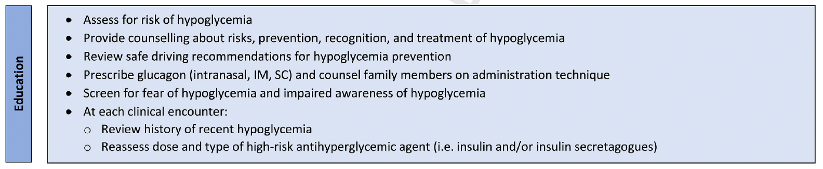
2023 Diabetes Canada CPG Update – Chapter 14. Hypoglycemia
2023
Education

Slide 10
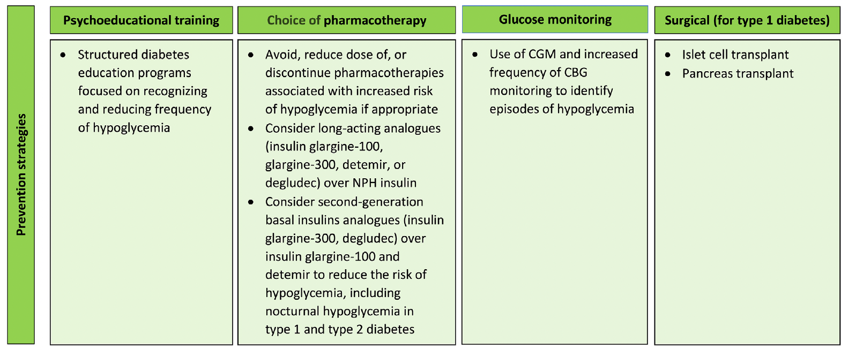
2023 Diabetes Canada CPG Update – Chapter 14. Hypoglycemia
Prevention Strategies
2023

Slide 11
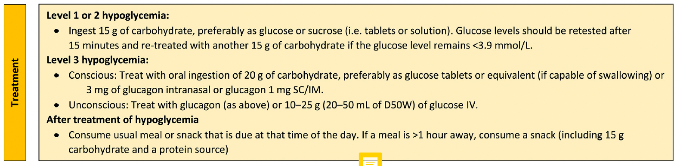
2023 Diabetes Canada CPG Update – Chapter 14. Hypoglycemia
2023
Treatment

Slide 12


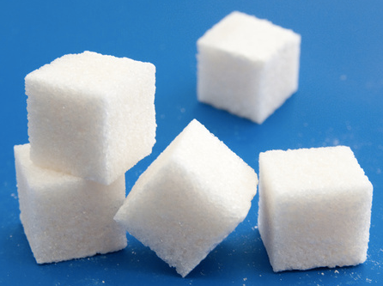

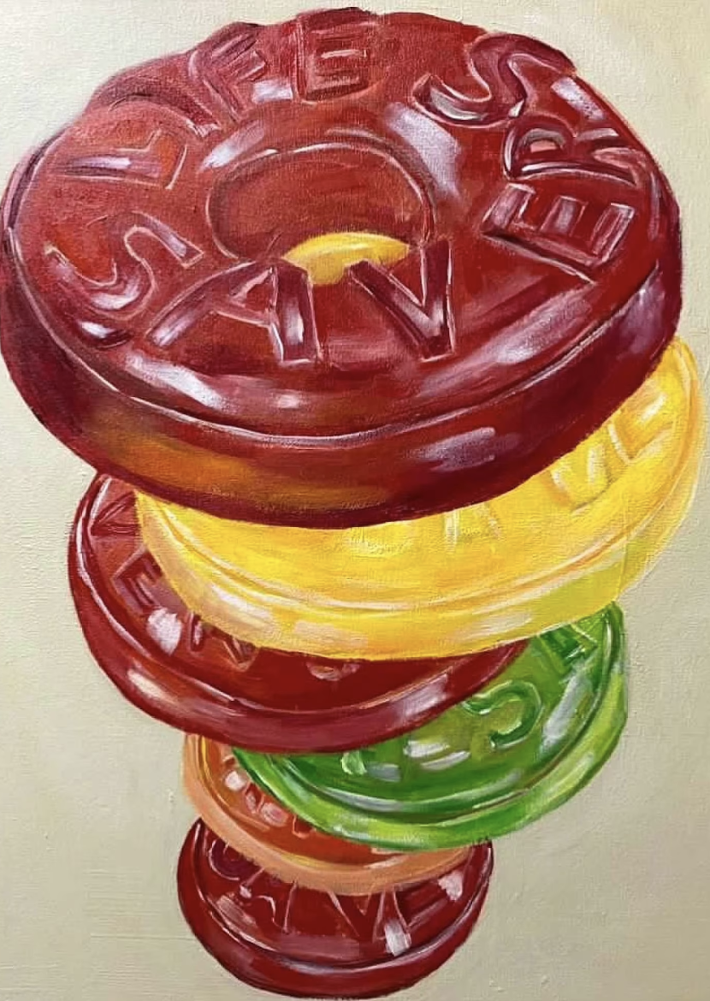

Examples of 15 g Simple Carbohydrate
2023 Diabetes Canada CPG Update – Chapter 14. Hypoglycemia
2023
4 x 4 g glucose tablets
15 mL (3 teaspoons) or 3 packets of sugar dissolved in water
5 cubes of sugar
150 mL of juice or regular soft drink
6 Lifesavers
15 mL (1 tablespoon) of honey
Notes:
: Evidence suggests that 15 g of glucose (monosaccharide) is required to produce an increase in BG of approximately 2.1 mmol/L within 20 minutes, with adequate symptom relief for most people
12

Slide 13
2023 Diabetes Canada CPG Update – Chapter 14. Hypoglycemia
2023
Treatment

Slide 14
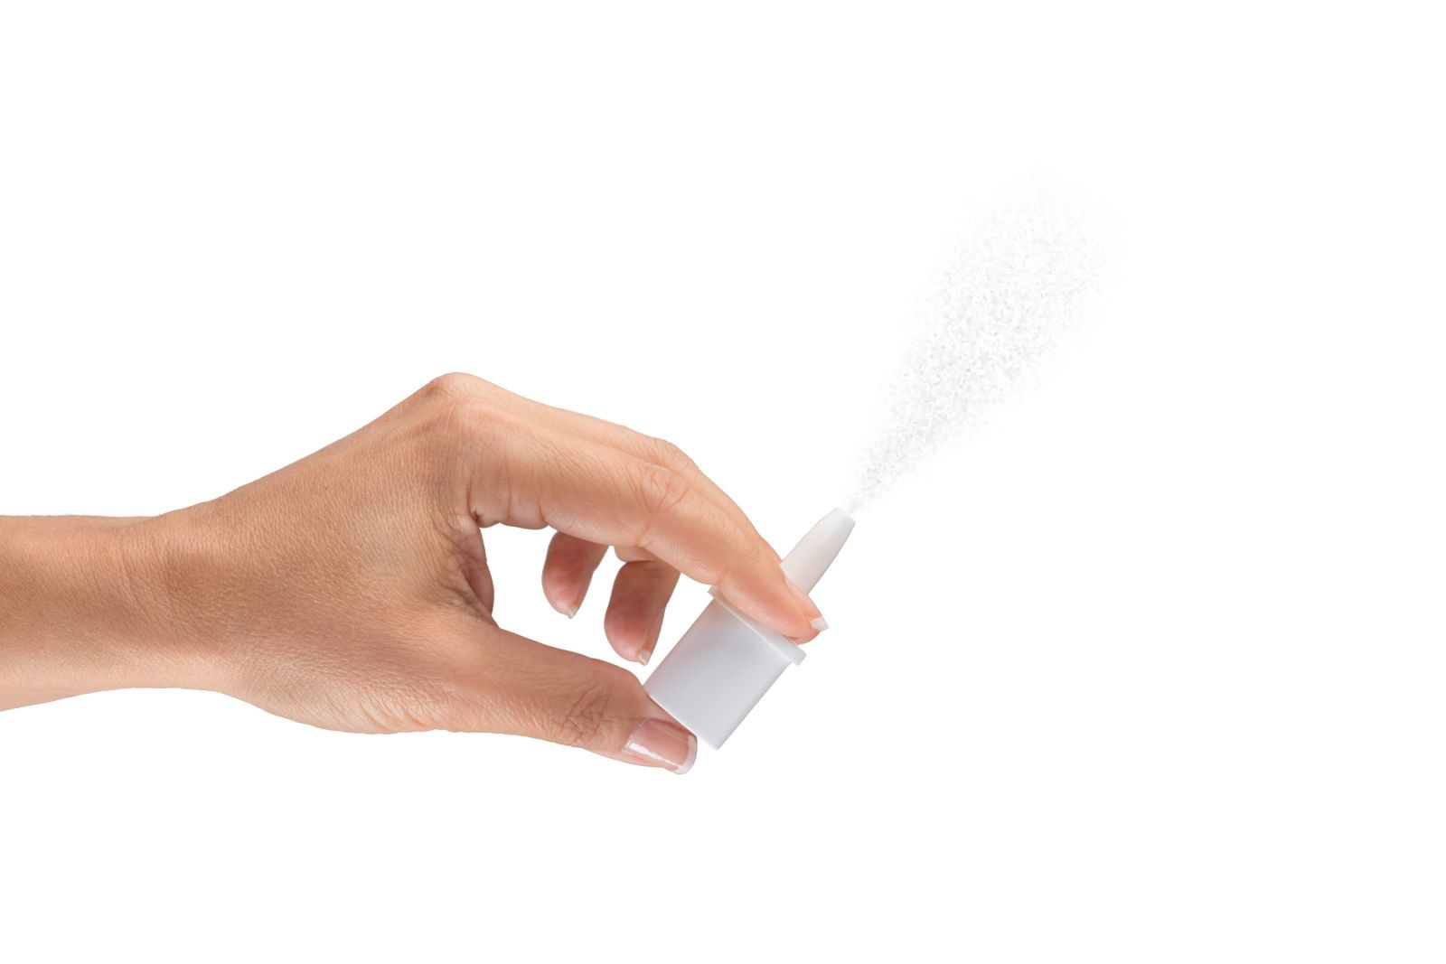
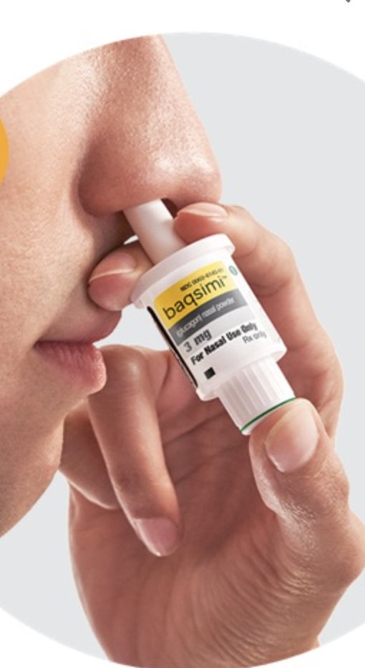
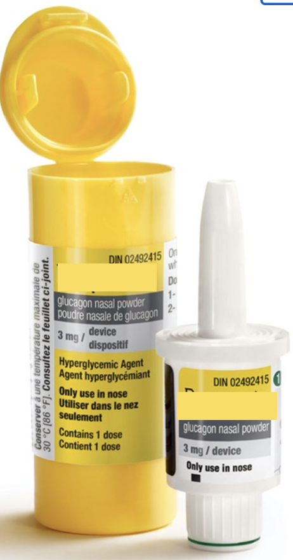
Nasal Glucagon 3 mg
2023 Diabetes Canada CPG Update – Chapter 14. Hypoglycemia
2023

Slide 15

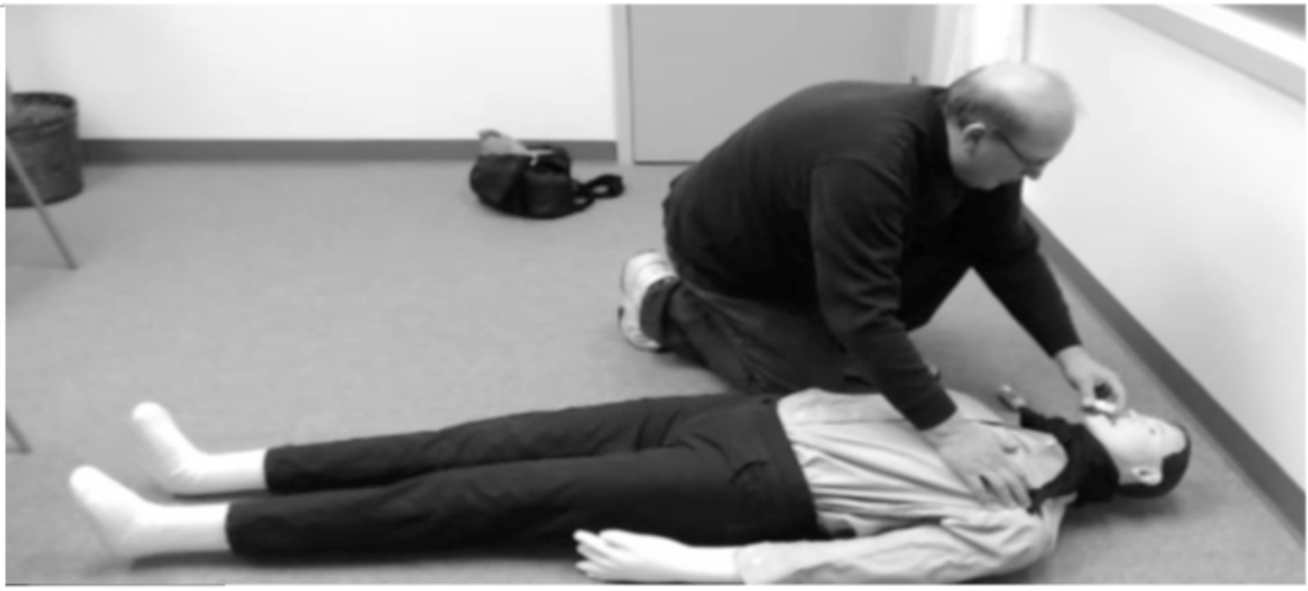
Intranasal Glucagon: Ease of Administration
2023 Diabetes Canada CPG Update – Chapter 14. Hypoglycemia
2023
Injectable Glucagon
Nasal Glucagon
Complete dose administered
13%
6%
Instructed caregivers
(N = 16)
No dose administered
50%
94%
Complete dose administered
(p<.0,001)†
94%
38%
Partial dose administered

Slide 16
2023 Diabetes Canada CPG Update – Chapter 14. Hypoglycemia
2023
Treatment

Slide 17
Recommendations 1-2
2023 Diabetes Canada CPG Update – Chapter 14. Hypoglycemia
2023
All individuals with diabetes currently using or starting therapy with insulin or insulin secretagogues, and their support persons, should be counselled about the risk, prevention, recognition and treatment of hypoglycemia. Risk factors for severe hypoglycemia should be identified and addressed. [Grade D, Consensus]
At every visit, for all individuals with diabetes, the diabetes health care team should review the recent history of hypoglycemic episodes, including, but not limited to, identification of contributing factors, frequency, symptoms, recognition, severity, and treatment approach, as well as the risk of driving with hypoglycemia. [Grade D, Consensus]

Slide 18
Recommendations 3-4
2023 Diabetes Canada CPG Update – Chapter 14. Hypoglycemia
2023
All individuals at risk for severe hypoglycemia and impaired awareness of hypoglycemia (IAH) should be screened with a careful history or using a validated measure of hypoglycemia awareness at each clinic visit to identify those who may need support. [Grade D, Consensus]
All individuals with diabetes treated with insulin and/or insulin secretagogues should be screened for fear of hypoglycemia (FOH) with a careful history or using a validated measure to identify those who may need interventions, like advanced therapeutic technologies and psychoeducational training. In addition, referrals to mental health-care professionals for those with persistent FOH can be considered.
[Grade D, Consensus]

Slide 19
Recommendation 5
2023 Diabetes Canada CPG Update – Chapter 14. Hypoglycemia
2023
5. In individuals with diabetes at increased risk of hypoglycemia, the following strategies may be used to reduce the risk of hypoglycemia:
  Use of CGM and/or increased frequency of CBG monitoring, including during sleep hours, to identify episodes of unrecognized hypoglycemia. [Grade B, Level 2 for type 2 diabetes; Grade A, Level 1A for type 1 diabetes; Grade D Consensus for CBG recommendation]
  Avoidance, reduction in dose, or discontinuation of pharmacotherapies associated with increased risk of hypoglycemia (i.e. insulin and insulin secretagogues), where appropriate. [Grade D, Consensus]
  Long-acting analogues (i.e. insulin glargine U-100, glargine U-300, insulin degludec) should be considered over NPH insulin to reduce the risk of hypoglycemia, including nocturnal hypoglycemia. [Grade A, Level 1A]
  Second-generation basal insulin analogues (i.e. insulin glargine U-300, insulin degludec) should be considered over first-generation basal insulin analogues (i.e. insulin glargine U-100, insulin detemir) to reduce the risk of hypoglycemia, including nocturnal hypoglycemia [Grade B, Level 2 for insulin glargine U-300 in insulin-naive individuals with type 2 diabetes and ≥ 1 risk factor for hypoglycemia; Grade A Level 1A for insulin degludec for type 1 and type 2 diabetes]
  A structured diabetes education program, where available, with frequent follow-up targeting enhanced awareness of cues for hypoglycemia, education on insulin pharmacodynamics, and dose adjustments to reduce frequency and severity of hypoglycemia. [Grade B, Level 1 for type 1 diabetes; Grade D Consensus for type 2 diabetes]
  Psychobehavioural intervention program (BG Awareness Training). [Grade C, Level 3]

Slide 20
Recommendation 6
2023 Diabetes Canada CPG Update – Chapter 14. Hypoglycemia
2023
In individuals with diabetes with recurrent hypoglycemia or Level 3 hypoglycemia, or impaired awareness of hypoglycemia (IAH), the following additional strategies may be considered to reduce or eliminate the risk of hypoglycemia:
  CSII or CGM or sensor augmented pump with education and follow-up for type 1 diabetes [Grade B, Level 2]
  Avoidance of hypoglycemia, with individualized glycemic targets, and, where appropriate, dose reduction or cessation of antihyperglycemic agent(s) that increase the risk of hypoglycemia (i.e. insulin and insulin secretagogues) for up to 3 months [Grade D, Level 4]
  Islet Transplantation for type 1 diabetes [Grade C, Level 3]
  Pancreas transplantation for type 1 diabetes [Grade D, Level 4]
CGM, continuous glucose monitoring; CSII, continuous subcutaneous insulin infusion

Slide 21
Recommendation 7
2023 Diabetes Canada CPG Update – Chapter 14. Hypoglycemia
2023
In individuals with type 1 diabetes exhibiting fear of hypoglycemia, CGM should be used to enhance glycemic awareness, reduce fear of hypoglycemia, and minimize behaviors that lead to above target BG trends. [Grade A, Level 1A]

Slide 22
Recommendation 8
2023 Diabetes Canada CPG Update – Chapter 14. Hypoglycemia
2023
Individuals with diabetes experiencing Level 1 and 2 hypoglycemia should ingest 15g of fast-acting carbohydrate, preferably as glucose or sucrose (i.e. tablets or solution) [Grade B, Level 2].
BG should be retested after 15 minutes and retreated with 15 g carbohydrate if BG remains < 3.9 mmol/L [Grade D, Consensus]
BG, blood glucose

Slide 23
Recommendation 9
2023 Diabetes Canada CPG Update – Chapter 14. Hypoglycemia
2023
Individuals with diabetes experiencing level 3 hypoglycemia who are conscious and:
capable of swallowing: i) should be treated by oral ingestion of 20 g carbohydrate, preferably as glucose tablets or equivalent; ii) 3 mg glucagon IN or glucagon 1 mg SC/IM can also be used. BG should be retested in 15 minutes and then retreated with 15 g glucose if it remains
< 3.9 mmol/L. [Grade C, Level 3 for type 2 diabetes; Grade A, Level 1A for glucagon use
in type 1 diabetes; Grade D, Consensus for carbohydrate]
unable to swallow: can be treated with glucagon 1 mg SC / IM or 3 mg IN. [Grade D, Consensus]
BG, blood glucose

Slide 24
Recommendation 10
2023 Diabetes Canada CPG Update – Chapter 14. Hypoglycemia
2023
Individuals with diabetes experiencing Level 3 hypoglycemia who are unconscious with:
  no intravenous access: can be treated with glucagon
  1 mg SC/IM or 3 mg IN. Caregivers or support persons should call for emergency services and the episode should be discussed with a health-care provider as soon as possible [Grade D, Consensus]
  intravenous access: can be treated with administration of 10-25 g (20 to 50 mL of D50W) of glucose intravenously over 1 to 3 minutes [Grade D, Consensus]
DHC, diabetes health-care team

Slide 25
Recommendations 11-12
2023 Diabetes Canada CPG Update – Chapter 14. Hypoglycemia
2023
11. For individuals with diabetes at risk of Level 3 hypoglycemia, support persons should be taught how to administer SC/IM or intranasal glucagon [Grade D, Consensus].
12. Once any level of hypoglycemia has been treated, the person should have the usual meal or snack that is due at that time of the day to prevent repeated hypoglycemia. If a meal is >1 hour away, a snack (including 15 g carbohydrate and a protein source) should be consumed [Grade D, Consensus]

Slide 26
Key Messages
2023 Diabetes Canada CPG Update – Chapter 14. Hypoglycemia
2023
Hypoglycemia caused by insulin or insulin secretagogues (i.e. sulfonylureas, meglitinides) can cause distressing and potentially debilitating complications. It is therefore imperative that events are reduced in frequency and severity, recognized safely, and treated quickly.
It is safer and more effective to prevent hypoglycemia than to treat it after it occurs. Hence, individuals with diabetes who are at high risk for hypoglycemia, and their support persons, should be identified and counselled about ways to prevent low blood glucose.
Individuals at risk of hypoglycemia and their support persons (i.e. friends, family, colleagues,etc) should be counselled about the recognition and treatment of hypoglycemia

Slide 27
Key Messages
2023 Diabetes Canada CPG Update – Chapter 14. Hypoglycemia
2023
For individuals at high risk of hypoglycemia who are treated with insulin or insulin secretagogues (i.e. sulfonylureas, meglitinides), the doses and need for insulin and insulin secretagogues should be reassessed and appropriately modified at each clinic visit to reduce the risk of hypoglycemia.
Hypoglycemia should be detected and treated promptly by using an intervention that provides the fastest rise in blood glucose to a safe level, to reduce the risk of injury, and to relieve symptoms quickly. Once the blood glucose reaches a safe level, the individual should have the usual meal or snack that is due at that time of the day to prevent repeated hypoglycemia. If a meal is >1 hour away, a snack (including 15 g carbohydrate and a protein source) should be consumed
BG, blood glucose

Slide 28
Key Messages
2023 Diabetes Canada CPG Update – Chapter 14. Hypoglycemia
2023
Individuals with type 1 diabetes and those with type 2 diabetes treated with insulin or insulin secretagogues should be screened for impaired awareness of hypoglycemia (IAH)
Fear of hypoglycemia (FoH) is an underestimated problem for individuals living with diabetes. FoH has negative impacts on mental health (both for individuals living with diabetes, caregivers, and support persons) and can lead individuals living with diabetes to target higher BG values, to over-treat hypoglycemia, and to avoid activities and social situations that may result in hypoglycemia.
Individuals at high risk for severe hypoglycemia, such as those treated with insulin, should be prescribed glucagon, along with provision of counselling on administration technique for their support persons.
Continuous glucose monitoring (CGM) should be used in conjunction with a structured educational program to detect and prevent hypoglycemia for those at high risk of hypoglycemia, IAH, or FoH.

Slide 29
Key Messages for People with Diabetes
2023 Diabetes Canada CPG Update – Chapter 14. Hypoglycemia
2023
Know the signs and symptoms of a low blood glucose level. Some of the more common symptoms of low blood glucose are trembling, sweating, anxiety, confusion, difficulty concentrating or nausea. Not all symptoms will be present and some individuals may have different symptoms or no symptoms at all.
Talk with your health care provider about the prevention and emergency treatment of a severe low blood glucose, which can be associated with confusion, loss of consciousness, or seizure.
Carry a source of fast acting carbohydrate with you at all times such as glucose tablets, Life Savers, and/or a juice box that you can take quickly if you are experiencing low blood glucose.

Slide 30
Key Messages for People with Diabetes
2023 Diabetes Canada CPG Update – Chapter 14. Hypoglycemia
2023
For individuals treated with either insulin or insulin secretagogues (i.e. sulfonylureas, meglitinides), ensure that support persons, including work colleagues, are counselled on administration of glucagon.
Wear diabetes identification (i.e. a MedicAlert® bracelet).
Talk with your diabetes health-care team about any fears or concerns you may have related to hypoglycemia.

