Slide 1
Organization of Care
2018 Clinical Practice Guidelines
Chapter 6
Maureen Clement MD CCFP, Pierre Filteau MD CFPC CMFC,
Betty Harvey RN(EC) BScN MScN CDE, Susie Jin RPh CDE CPT BCGP,
Tessa Laubscher MBChB CCFP FCFP, Geetha Mukerji MD MSc FRCPC,
Diana Sherifali RN PhD CDE

Slide 2
Disclaimer
All Content contained on this slide deck is the property of Diabetes Canada, its content suppliers or its licensors as the case may be, and is protected by Canadian and international copyright, trademark, and other applicable laws. Diabetes Canada grants personal, limited, revocable, non-transferable and non-exclusive license to access and read content in this slide deck for personal, non-commercial and not-for-profit use only. The slide deck is made available for lawful, personal use only and not for commercial use.
The unauthorized reproduction, distribution of this copyrighted work is not permitted.
For permission to use this slide deck for commercial or any use other than personal, please contact guidelines@diabetes.ca

Slide 3
Key Changes
2018 Diabetes Canada CPG – Chapter 5. Organization of Diabetes Care
2018
Reinforce the importance of the interprofessional team in diabetes care and that care should be:
  Structured
  Evidenced-based
  Supported by clinical information and decision support systems
New information on the role of Telehealth technologies

Slide 4
Reality: Guidelines are NOT Followed
2018 Diabetes Canada CPG – Chapter 5. Organization of Diabetes Care
Care gap between diabetes management guidelines and real-life practice
Organizational and evidence-based approach to treating chronic diseases
Real
Life
Ideal
Practice
Notes:
4

Slide 5
Chronic Care for a Chronic Disease
2018 Diabetes Canada CPG – Chapter 5. Organization of Diabetes Care
Acute and reactive
Proactive, planned, and population-based
The Chronic Care Model
Notes:
5

Slide 6
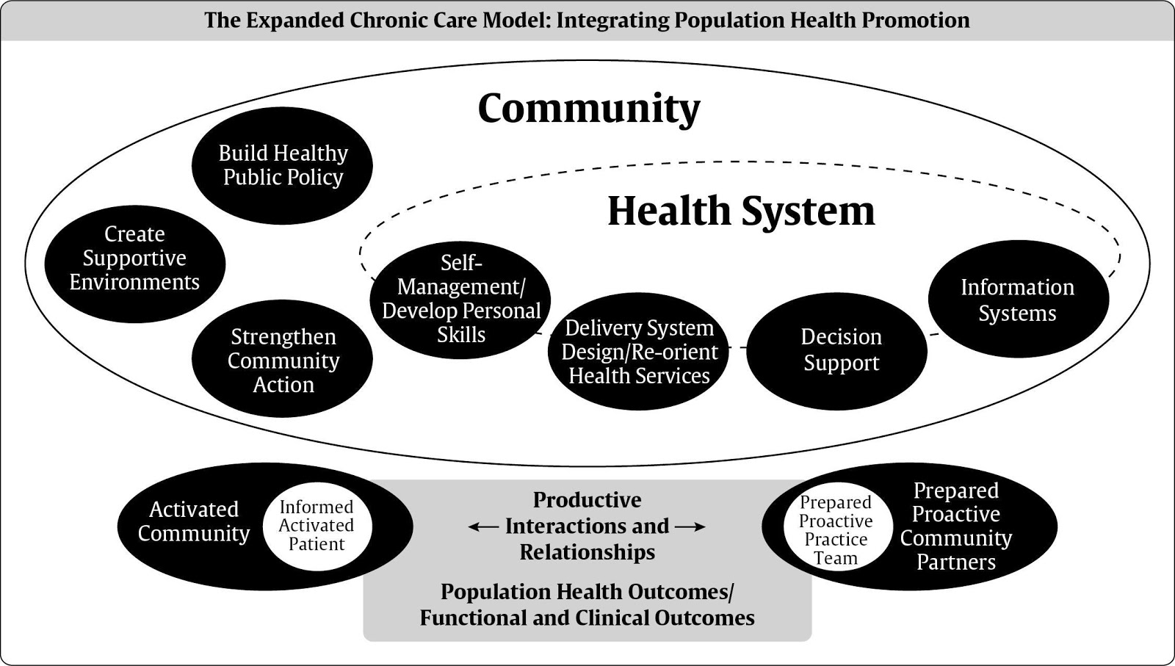
2018 Diabetes Canada CPG – Chapter 5. Organization of Diabetes Care
Barr VJ, et al. Hospital Quarterly. 2003;7:73-80.

Slide 7
The Chronic Care Model (CCM) Saves Lives
2018 Diabetes Canada CPG – Chapter 5. Organization of Diabetes Care
The CCM improves:
  A1C
  LDL-C
  Use of statins
  Drug and hospital expenditures
  Overall mortality
A1C, glycated hemoglobin; LDL-C, low density lipoprotein cholesterol
Notes:
7

Slide 8







Elements of the Chronic Care Model
2018 Diabetes Canada CPG – Chapter 5. Organization of Diabetes Care
2. Self-Management
Support
1. Delivery Systems Design: The Team
3. Decision Support
4. Clinical Information Systems
5. Community
6. Health Systems
Notes:
8

Slide 9
1. Delivery Systems Design: The Team
2018 Diabetes Canada CPG – Chapter 5. Organization of Diabetes Care
Expertise of nurses, registered dietitians, pharmacists, and psychological support
Team working with primary care providers supported by specialists
Disease management model that uses patient education, coaching, treatment adjustment, monitoring, care co-ordination
Notes:
9

Slide 10
Your diabetes health-care team may include a …
You
Optometrist or ophthalmologist
Local diabetes education centre
Your doctor
Your nurse
Your dietitian
Your pharmacist
Kidney specialist
Physical activity specialist
and/or nurse practitioner
YOU
Dentist
Heart specialist
Family and friends
Mental Health Professional
Foot care specialist
Other people you know who have diabetes
Notes:
10

Slide 11
2. Self-Management Support
2018 Diabetes Canada CPG – Chapter 5. Organization of Diabetes Care
Formerly known as Diabetes Education
Shift from didactic diabetes education to a patient-empowering motivational approach
Problem-solving and goal-setting
Notes:
11

Slide 12
3. Decision Support
2018 Diabetes Canada CPG – Chapter 5. Organization of Diabetes Care
Tools and techniques to improve patient care decisions
Flowsheets, electronic medical records (EMRs), care algorithms, accessible specialist support, education, etc.
Most helpful if available at point of care
Notes:
12

Slide 13
The Patient Care Flow Sheet
2018 Diabetes Canada CPG – Chapter 5. Organization of Diabetes Care
Organizes information for care of patients with diabetes
Shown to improve outcomes
Available for download & printing at https://guidelines.diabetes.ca
Notes:
13

Slide 14
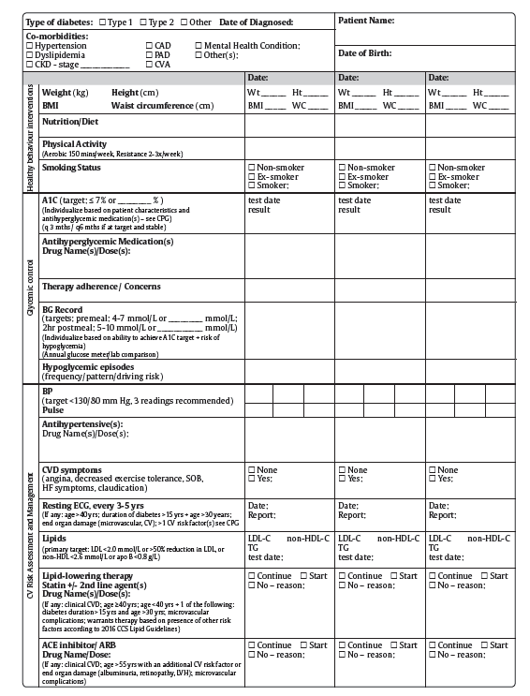
2018 Diabetes Canada CPG – Chapter 5. Organization of Diabetes Care
2018

Slide 15
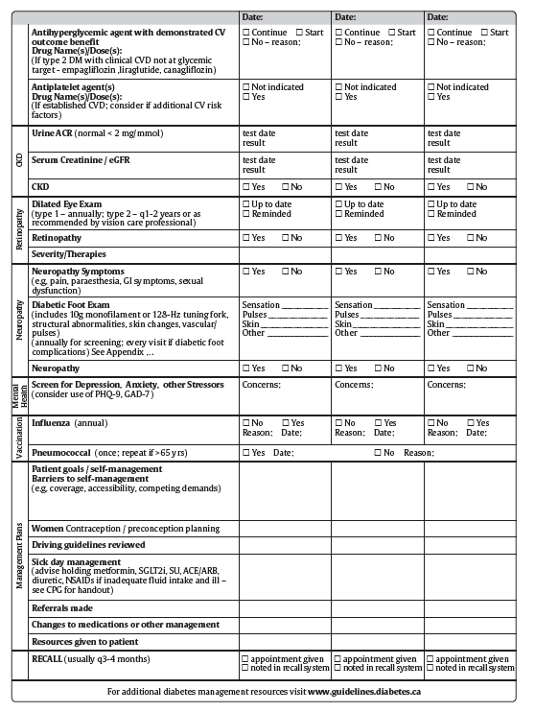
2018 Diabetes Canada CPG – Chapter 5. Organization of Diabetes Care
2018

Slide 16
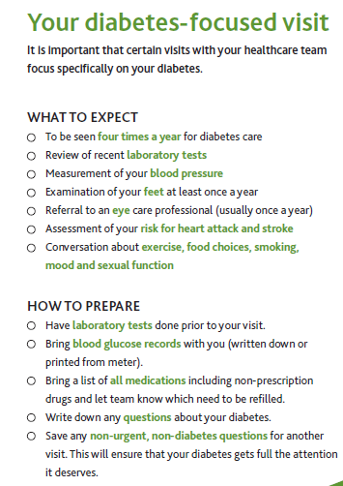
Patient Education Tools
2018 Diabetes Canada CPG – Chapter 5. Organization of Diabetes Care
Help patients prepare for, and know what to expect from, a diabetes visit
Notes:
16

Slide 17
4. Clinical Information Systems
2018 Diabetes Canada CPG – Chapter 5. Organization of Diabetes Care
Include EMRs and databases to plan and assess care for the population
Allow practice overviews to prevent inertia and provide timely care
Notes:
17

Slide 18
5. Community
2018 Diabetes Canada CPG – Chapter 5. Organization of Diabetes Care
Tapping into community resources to improve care or lifestyles
May involve peer-led self-management support groups
Notes:
18

Slide 19
6. Health Systems
2018 Diabetes Canada CPG – Chapter 5. Organization of Diabetes Care
Promoting preventative care and appropriately planning resource allocation
May include provider incentives for achieving milestones
Notes:
19

Slide 20

Telehealth
2018 Diabetes Canada CPG – Chapter 5. Organization of Diabetes Care
Not a specific element of CCM, but may facilitate other aspects
  Conferencing or education of team members
  Telemonitoring of health data, such as glucose readings
  Disease management via telephone or internet
  Teleconsultation with specialists
Notes:
20

Slide 21
The 5Rs of Organized Care
2018 Diabetes Canada CPG – Chapter 5. Organization of Diabetes Care
Recognize: Consider diabetes risk factors for all of your patients and screen appropriately for diabetes.
Register: Develop a registry for all of your patients with diabetes to track care.
Resource: Support self-management through the use of interprofessional teams which could include the primary care provider, diabetes educator, dietitian, nurse, pharmacist, specialists and self-management supports including linkage to community services.
Relay: Facilitate information sharing between the person with diabetes and the healthcare team for coordinated care and timely management changes.
Recall: Develop a system to remind your patients and caregivers of timely review and reassessment.

Slide 22
Recommendation 1
2018 Diabetes Canada CPG – Chapter 5. Organization of Diabetes Care
Diabetes care should be:
  Organized around the person living with diabetes (and their supports). They should be an active participant in their own care and shared-care decision making; and self-manage to their full abilities and;
  Facilitated by a proactive, interprofessional team with specific training in diabetes. They should be able to provide ongoing self-management education and support, and incorporate as many components of the CCM as possible [Grade A, Level 1A for type 2 diabetes; Grade C, Level 3 for type 1 diabetes for both (a) and (b)]

Slide 23
Recommendation 2 (part 1)
2018 Diabetes Canada CPG – Chapter 5. Organization of Diabetes Care
2. The following quality improvement strategies should be used alone or in combination to reduce A1C and improve one or more of the following: BP, LDL-C, adherence to recommended diabetes complication screening:
  Promotion of self-management [Grade A, Level 1A]
  Team changes [Grade A, Level 1A]
  Case management [Grade A, Level 1A]
  Patient education [Grade A, Level 1A]
  Facilitated relay of clinical information [Grade A, Level 1A]
  Electronic patient registries [Grade A, Level 1A]
  Patient reminders [Grade A, Level 1A]

Slide 24
Recommendation 2 (part 2)
2018 Diabetes Canada CPG – Chapter 5. Organization of Diabetes Care
2. The following quality improvement strategies should be used alone or in combination to reduce A1C and improve one or more of the following: BP, LDL-C, adherence to recommended diabetes complication screening:
  Audit and feedback/benchmarking [Grade A, Level 1A]
  Clinician education [Grade A, Level 1A]
  Clinician reminders (with or without decision support) [Grade A, Level 1A]
  Clinical Decision Support Systems (processes of care only and clinical outcomes when combined with feedback, case management) [Grade A, Level 1A]
  Structured care [Grade A, Level 1A]
  Multi-component QI strategies [Grade A, Level 1A]

Slide 25
Recommendation 3
2018 Diabetes Canada CPG – Chapter 5. Organization of Diabetes Care
3. An interprofessional team with specific training in diabetes and supported by specialist input should be integrated within diabetes care delivery models in the primary care [Grade A, Level 1A] and specialist care [Grade D, Consensus] settings

Slide 26
Recommendation 4
2018 Diabetes Canada CPG – Chapter 5. Organization of Diabetes Care
4. The role of the diabetes case manager should be enhanced, in cooperation with the collaborating physician [Grade A, Level 1A], to include interventions led by a nurse [Grade A, Level 1A], pharmacist [Grade B, Level 2] or registered dietitian [Grade B, Level 2] to improve coordination of care and facilitate timely changes to diabetes management

Slide 27
Recommendation 5
2018 Diabetes Canada CPG – Chapter 5. Organization of Diabetes Care
5. The following individuals should work with an interprofessional team with specialized training in these areas of diabetes as part of a collaborative, shared care approach:
  Children with diabetes [Grade D, Level 4]
  Adolescents and emerging adults (age 14-29 years) with type 1 diabetes as part of a structured transitional program [Grade C, Level 3]
  People with type 1 diabetes [Grade C, Level 3]
  Women with pre-existing diabetes who require preconception counselling and prenatal counseling [Grade C, Level 3] and women with gestational diabetes [Grade D, Consensus]

Slide 28
Recommendation 6
2018 Diabetes Canada CPG – Chapter 5. Organization of Diabetes Care
6. Referral to an interprofessional team with specialized training may be considered for
  Individuals with type 2 diabetes who are consistently not meeting cardiometabolic targets [Grade A, Level 1]
  Adults with depression and diabetes for collaborative care and in particular nurse case management for improvement in depression and glycemic control [Grade A, Level 1A]

Slide 29
Recommendation 7
2018 Diabetes Canada CPG – Chapter 5. Organization of Diabetes Care
2018
7. Telehealth technologies may be used to:
  Improve self-management in underserviced communities [Grade B, Level 2]
  Facilitate consultation with specialized teams as part of a shared-care model [Grade A, Level 1A]
  Improve clinical outcomes in type 2 diabetes, including a decrease in A1C, an increase in quality of care (i.e., guideline adherence), a decrease in health service use and cost, and an increase in patient satisfaction and knowledge [Grade A, Level 1A]
  Improve glycemic and CV risk factor control in type 1 and type 2 diabetes [Grade A, Level 1]

Slide 30
Summary
2018 Diabetes Canada CPG – Chapter 5. Organization of Diabetes Care
Diabetes is a chronic disease that requires proactive, planned and population-based care
It takes a team. Diabetes care should involve a interprofessional team working within the chronic care model
Technology (telehealth, reminder systems, EMRs, etc.) can be used to improve care
Notes:
30

Slide 31
Key Messages
2018 Diabetes Canada CPG – Chapter 5. Organization of Diabetes Care
Diabetes care should be :
  organized around the person living with diabetes and their supports. The person with diabetes should be an active participant in their own care, be involved in shared-care decision making, and self-manage to their full abilities
  facilitated by a proactive, interprofessional team with training in diabetes and the ability to provide ongoing self-management education and support
  organized within the context of the expanded chronic care model and delivered using as many of the components of the model as possible (in particular, self-management education and support; interprofessional team-based care with expansion of professional roles; collaboration with the primary care provider; and monitoring with medication adjustment and case management)
  structured, evidence-based and supported by clinical information and decision support systems that include patient registries, clinician and patient reminders, facilitated relay of information, audits, feedback and benchmarking
Any of the above strategies may be facilitated with telehealth technologies

Slide 32
Key Messages for People with Diabetes
2018 Diabetes Canada CPG – Chapter 5. Organization of Diabetes Care
Know the members of your diabetes team and stay connected with them
Remember you are the most important member of the team
Be prepared to learn how to care for your diabetes on a daily basis. Also be ready to share in decision making regarding how you will care for your diabetes and health

Slide 33
Key Messages for People with Diabetes
2018 Diabetes Canada CPG – Chapter 5. Organization of Diabetes Care
Prepare for visits with your diabetes healthcare team:
  Have laboratory tests done prior to the visit so the results will be available to review at the visit
  Be prepared to set and update your personal goals for caring for your diabetes and health. Be prepared to share any issues that may affect your ability to care for your diabetes on a daily basis, including any fears or anxiety you may have.
  Bring your medication bottles or an up-to-date medication list including non-prescription drugs and supplements. Also bring your glucose meter and insulin pen device if you use one.
  Bring or upload your most recent glucose monitoring results as well as other health behaviour records (e.g. food and exercise diary), as well as a healthcare diary in which you have recorded important health events (e.g. visits with healthcare providers, surgeries, illnesses, vaccinations)

Slide 34
Key Messages for People with Diabetes
2018 Diabetes Canada CPG – Chapter 5. Organization of Diabetes Care
Share the information you learn during your visits with your diabetes healthcare team with all of your healthcare providers and diabetes team members
If travel distance or time is a barrier to your care, ask your team about telehealth (telephone, web-based or virtual) diabetes support and visits

Slide 35

Visit guidelines.diabetes.ca

Slide 36


Or download the App

Slide 37
Diabetes Canada Clinical Practice Guidelines
http://guidelines.diabetes.ca – for health-care providers
1-800-BANTING (226-8464)
http://diabetes.ca – for people with diabetes

