Slide 1
Physical Activity and Diabetes
2018 Clinical Practice Guidelines
Chapter 10
Ronald J. Sigal MD MPH FRCPC, Marni J. Armstrong CEP PhD,
Simon L. Bacon PhD, Normand G Boulé PhD,
Kaberi Dasgupta MD MSc FRCPC, Glen P Kenny PhD,
Michael C Riddell PhD

Slide 2
Disclaimer
All Content contained on this slide deck is the property of Diabetes Canada, its content suppliers or its licensors as the case may be, and is protected by Canadian and international copyright, trademark, and other applicable laws. Diabetes Canada grants personal, limited, revocable, non-transferable and non-exclusive license to access and read content in this slide deck for personal, non-commercial and not-for-profit use only. The slide deck is made available for lawful, personal use only and not for commercial use.
The unauthorized reproduction, distribution of this copyrighted work is not permitted.
For permission to use this slide deck for commercial or any use other than personal, please contact guidelines@diabetes.ca

Slide 3
Key Changes
2018 Diabetes Canada CPG – Chapter 10. Physical Activity
2018
New information on
  The importance of minimizing sedentary time activities
  Setting exercise goals and prescriptions
  Role of step count monitoring with a pedometer or accelerometer
  Strategies to reduce the risk of hypoglycemia during and after exercise

Slide 4
Physical Activity Checklist
2018 Diabetes Canada CPG – Chapter 10. Physical Activity
TRY TO DO a minimum of 150 minutes of moderate-to vigorous-intensity aerobic exercise per week.
INCLUDE resistance exercise (strength training) ≥ 2 times a week.
SET physical activity goals and INVOLVE a multi-disciplinary team if available.
MINIMIZE uninterrupted sedentary time.
Notes:
4

Slide 5
Pre-exercise Assessment
2018 Diabetes Canada CPG – Chapter 10. Physical Activity
Assess for conditions that can predispose to injury before prescribing an exercise regimen:
  Neuropathy (autonomic and peripheral)
  Retinopathy
  Coronary artery disease – resting ECG and possibly exercise stress test
  Peripheral arterial disease
Notes:
5

Slide 6
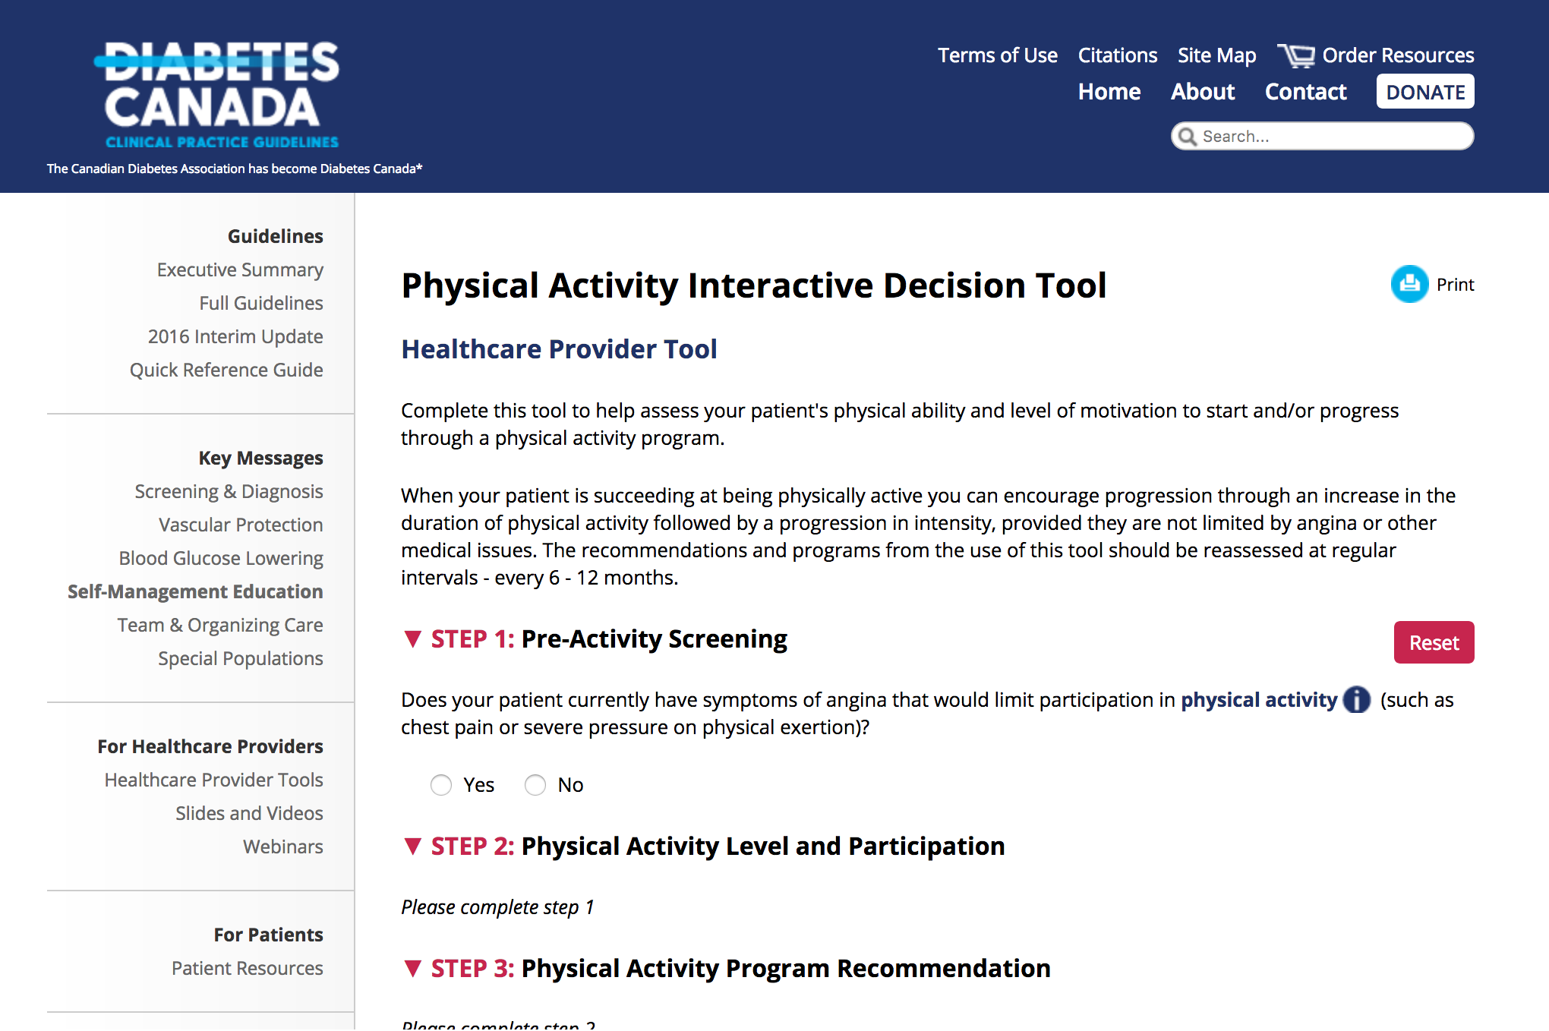
Tools available at guidelines.diabetes.ca
2018 Diabetes Canada CPG – Chapter 10. Physical Activity
Notes:
This is a screen capture: “Much more information is available at the Diabetes Canada guidelines web site: guidelines.diabetes. ca” The audience is not expected to read the text on this slide.
I (R Sigal) suggest to make it much more clear that this is a screen capture. Show the browser menu bar. Show less text and make it larger. For example, delete the text starting with “These tools will help you..”
6

Slide 7
Exercise Advice:
2018 Diabetes Canada CPG – Chapter 10. Physical Activity
Aerobic exercise
Start by walking at a comfortable pace for as little as 5 to 15 minutes at one time
Gradually progress over 12 weeks to up to 50 minutes per session (including warm-up and cool down) of brisk walking
Alternatively, shorter exercise sessions in the course of a day, e.g., 10 minutes 3 times a day after meals, can replace a single longer session of equivalent length and intensity

Slide 8
Exercise Advice (2)
2018 Diabetes Canada CPG – Chapter 10. Physical Activity
Resistance exercise
Choose 6 to 8 exercises targeting the major muscle groups: arms, chest, back, legs, abdomen.
Gradually increase the resistance until you can only perform 3 sets of 8 to 12 repetitions for each exercise, with 1 to 2 minutes of rest between sets.
When beginning resistance exercise, it is best to receive initial instruction and periodic supervision by a qualified exercise specialist, to maximize benefits and minimize risk of injury.

Slide 9
Exercise Advice (3)
2018 Diabetes Canada CPG – Chapter 10. Physical Activity
Interval exercise
Exercise performed in intervals, alternating between higher-intensity and lower-intensity, can shorten total exercise duration, increase fitness gains, and increase variety.
  For example, try alternating between 3 minutes of faster walking and 3 minutes of slower walking.
High intensity interval training is also an option.
  For example, alternate between 30 seconds at very high intensity and 90 seconds at low intensity.

Slide 10
Exercise Advice (4)
2018 Diabetes Canada CPG – Chapter 10. Physical Activity
Other types of exercise
Exercise in the water can have similar benefits as other forms of exercise and help minimize barriers from conditions such as osteoarthritis.
  Exercise in the water can include walking briskly in the water, swimming or classes that include a variety of exercises

Slide 11
Exercise Advice (5)
2018 Diabetes Canada CPG – Chapter 10. Physical Activity
Using pedometers or accelerometers
Encourage people with diabetes to self-monitor physical activity with a pedometer or accelerometer. Ask them to record values, review at visits, set step count targets, and formalize recommendations with a written prescription
Breaking up sedentary time
It is best to avoid prolonged sitting. Try to interrupt sitting time by getting up briefly every 20 to 30 minutes

Slide 12
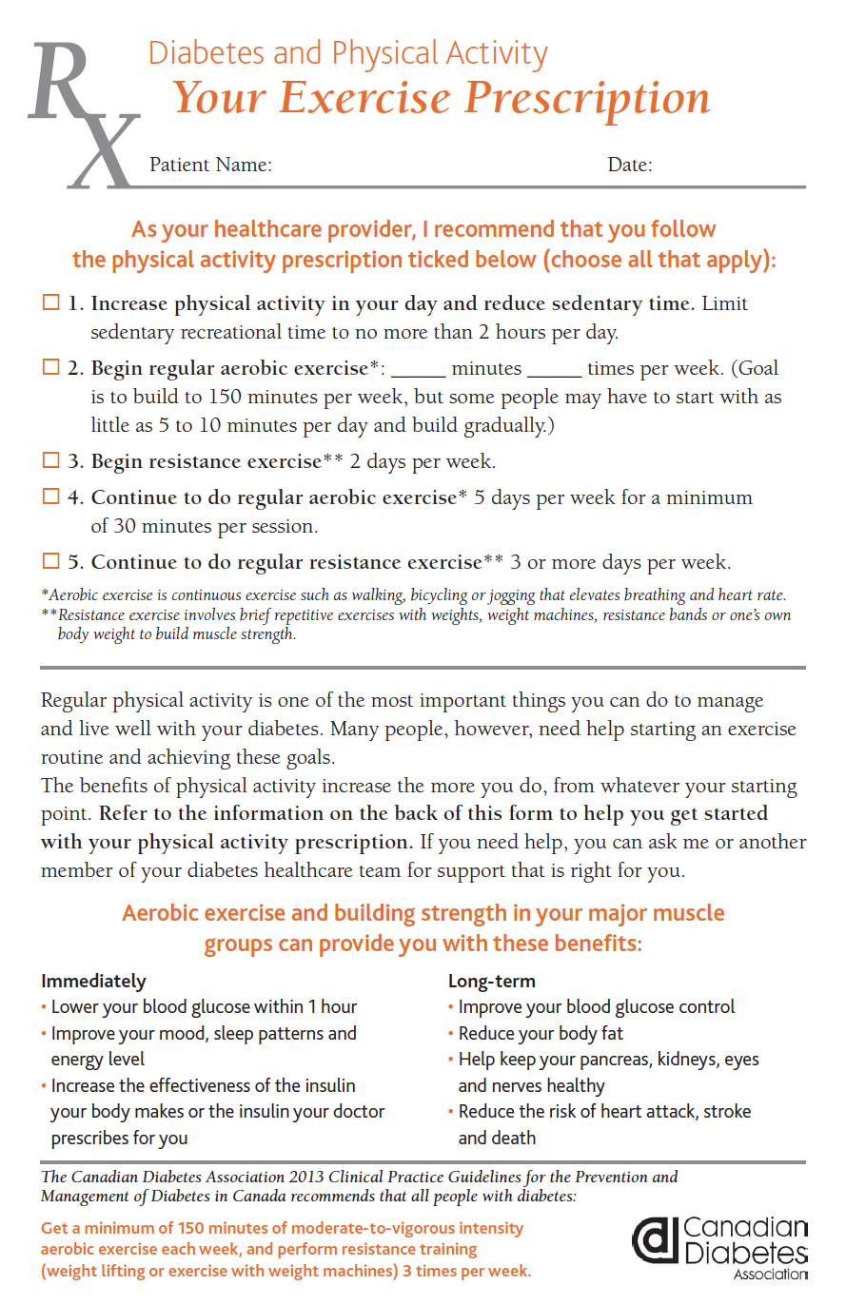
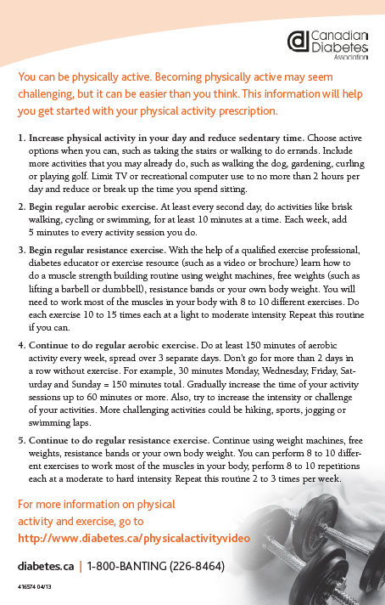
Notes:
Note: This document should be reformatted with new Diabetes Canada colours, logos and formatting
12

Slide 13
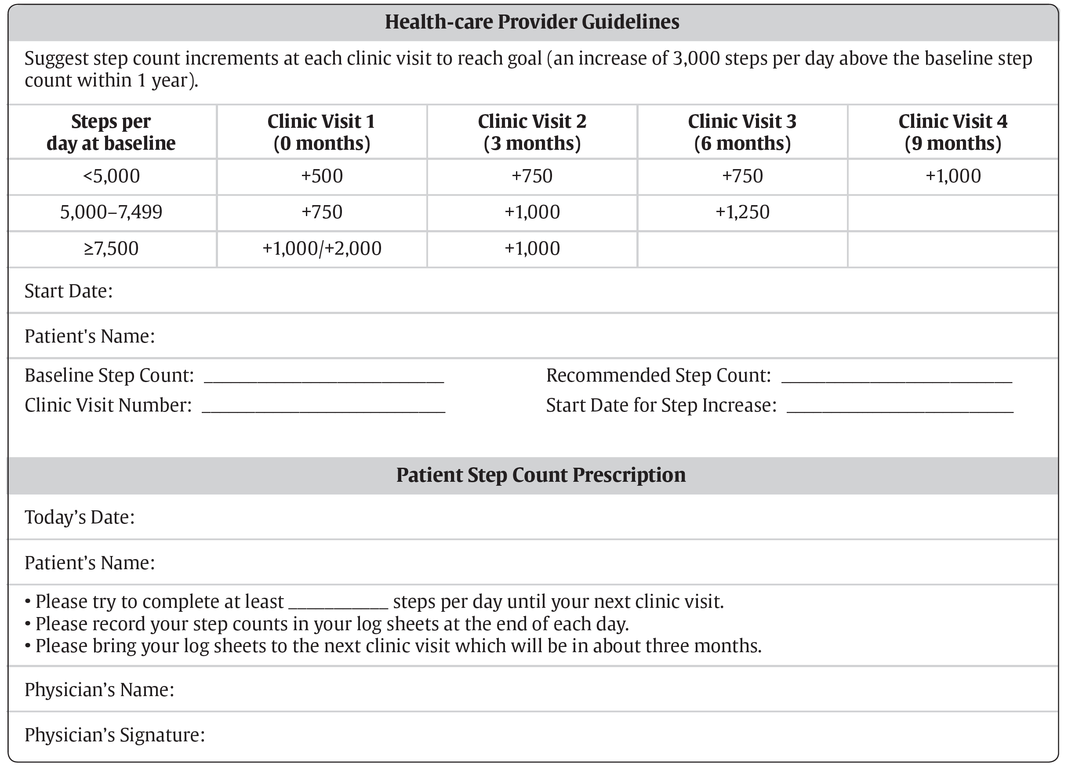
Sample Step Count Prescription
2018 Diabetes Canada CPG – Chapter 10. Physical Activity
2018 Diabetes Canada CPG – Appendix 4

Slide 14

2018 Diabetes Canada CPG – Chapter 10. Physical Activity

Slide 15
Physical Activity: Problems and Solutions
2018 Diabetes Canada CPG – Chapter 10. Physical Activity
Challenges | Solutions
Time constraints during physician-patient encounter | Involve a multi-disciplinary team of Kinesiologists, Physical Therapists, Diabetes Educators and Case Workers who can help motivate patients.
Pre-existing or suspected heart disease | If patient wishes to take on activity more vigorous than walking, evaluate with a history and physical, resting ECG and possibly exercise ECG stress test.
Notes:
Too much info for slide slide dec. Barrier’s and Solutions
Make a slide: a clipart of the team…. Change title “bridging PA gap” title problem soluation…
15

Slide 16




Know your Community Resources
2018 Diabetes Canada CPG – Chapter 10. Physical Activity
Speak to your patients about community resources:
Community pools, gyms, safe walking trails, weight loss smart phone apps etc.
Notes:
16

Slide 17
Recommendation 1
2018 Diabetes Canada CPG – Chapter 10. Physical Activity
2018
People with diabetes should ideally accumulate a minimum of 150 minutes of moderate- to vigorous-intensity aerobic exercise each week, spread over at least 3 days of the week, with no more than 2 consecutive days without exercise, to improve glycemic control [Grade B, Level 2, for adults with type 2 diabetes and children with type 1 diabetes]; and to reduce risk of CVD and overall mortality [Grade C, Level 3, for adults with type 1 diabetes and type 2 diabetes].
Notes:
Including the grades and levels makes it difficult to read this material. How about just including the recommendation, and putting the grades and levels in footnotes? This comment applies to all recommendations slides.

Slide 18
Recommendation 1 (continued)
2018 Diabetes Canada CPG – Chapter 10. Physical Activity
2018
(continued) … Smaller amounts (90-140 minutes/week) of exercise or planned physical activity can also be beneficial but to a lesser extent. [Grade B, Level 2 for glycemic control in type 2 diabetes; Grade C, Level 3 for mortality in type 2 diabetes and type 1 diabetes]
Notes:
Including the grades and levels makes it difficult to read this material. How about just including the recommendation, and putting the grades and levels in footnotes? This comment applies to all recommendations slides.

Slide 19
Recommendation 2
2018 Diabetes Canada CPG – Chapter 10. Physical Activity
2018
2. Interval training (short periods of vigorous exercise alternating with short recovery periods at low-to-moderate intensity or rest from 30 seconds to 3 minute each) can be recommended to people willing and able to perform it to increase gains in cardiorespiratory fitness in type 2 diabetes [Grade B, Level 2] and to reduce risk of hypoglycemia during exercise in type 1 diabetes [Grade C, Level 3]
Notes:
Including the grades and levels makes it difficult to read this material. How about just including the recommendation, and putting the grades and levels in footnotes? This comment applies to all recommendations slides.

Slide 20
Recommendation 3
2018 Diabetes Canada CPG – Chapter 10. Physical Activity
People with diabetes (including elderly people) should perform resistance exercise at least twice a week and preferably 3 times per week [Grade B, Level 2] in addition to aerobic exercise [Grade B, Level 2]. Initial instruction and periodic supervision by an exercise specialist are recommended [Grade C, Level 3]
Notes:
Including the grades and levels makes it difficult to read this material. How about just including the recommendation, and putting the grades and levels in footnotes? This comment applies to all recommendations slides.

Slide 21
Recommendation 4
2018 Diabetes Canada CPG – Chapter 10. Physical Activity
2018
4. In addition to achieving physical activity goals, people with diabetes should minimize the amount of time spent in sedentary activities and periodically break up long periods of sitting [Grade C, Level 3]
Notes:
Including the grades and levels makes it difficult to read this material. How about just including the recommendation, and putting the grades and levels in footnotes? This comment applies to all recommendations slides.

Slide 22
Recommendation 5
2018 Diabetes Canada CPG – Chapter 10. Physical Activity
2018
5. Setting specific exercise goals, problem solving potential barriers to physical activity, providing information on where and when to exercise, and self-monitoring should be performed collaboratively between the person with diabetes and the healthcare provider to increase physical activity and improve A1C [Grade B, Level 2]
Notes:
Including the grades and levels makes it difficult to read this material. How about just including the recommendation, and putting the grades and levels in footnotes? This comment applies to all recommendations slides.

Slide 23
Recommendation 6
2018 Diabetes Canada CPG – Chapter 10. Physical Activity
2018
6. Step count monitoring with a pedometer or accelerometer can be considered in combination with physical activity counselling, support and goal-setting to support and reinforce increased physical activity [Grade B, Level 2]
Notes:
Including the grades and levels makes it difficult to read this material. How about just including the recommendation, and putting the grades and levels in footnotes? This comment applies to all recommendations slides.

Slide 24
Recommendation 7
2018 Diabetes Canada CPG – Chapter 10. Physical Activity
2018
7. To reduce risk of hypoglycemia during and after exercise in people with type 1 diabetes, the following 5 strategies can be considered alone or in combination:
  reduce the bolus dose of the insulin that is most active at the time of exercise [Grade B, Level 2]
  significantly reduce, or suspend (only if the activity is ≤45 minutes) basal insulin for the exercise duration [Grade B, Level 2], and lower the basal rate overnight after exercise by ~20% [Grade B, Level 2]
  increase carbohydrate consumption prior to, during and after exercise, as necessary [Grade C, Level 3]
Notes:
Including the grades and levels makes it difficult to read this material. How about just including the recommendation, and putting the grades and levels in footnotes? This comment applies to all recommendations slides.

Slide 25
Recommendation 7 (continued)
2018 Diabetes Canada CPG – Chapter 10. Physical Activity
2018
  To reduce risk of hypoglycemia during and after exercise in people with type 1 diabetes, the following 5 strategies can be considered alone or in combination (continued)
  perform brief (10 seconds), maximal-intensity sprints at the start of exercise [Grade D, Level 4], periodically during the activity [Grade D, Level 4], or at the end of exercise [Grade D, Level 4]
  perform resistance exercise before aerobic exercise [Grade D, Level 4]
Notes:
Including the grades and levels makes it difficult to read this material. How about just including the recommendation, and putting the grades and levels in footnotes? This comment applies to all recommendations slides.

Slide 26
Recommendation 8
2018 Diabetes Canada CPG – Chapter 10. Physical Activity
2018
Older individuals with diabetes who wish to undertake very vigorous or prolonged exercise*, should be assessed for conditions that might place them at increased risk for an adverse event with history, physical examination (including fundoscopic exam, foot exam, and neuropathy screening), resting ECG, and, possibly, exercise ECG stress testing [Grade D, Consensus]
  * Examples of such exercise: competitive running, long-distance running, high-intensity interval training,

Slide 27
Recommendation 9
2018 Diabetes Canada CPG – Chapter 10. Physical Activity
9. Structured exercise programs supervised by qualified trainers should be implemented when feasible for people with type 2 diabetes to improve glycemic control, CVD risk factors and physical fitness [Grade B, Level 2]
Notes:
Including the grades and levels makes it difficult to read this material. How about just including the recommendation, and putting the grades and levels in footnotes? This comment applies to all recommendations slides.

Slide 28
Key Messages
2018 Diabetes Canada CPG – Chapter 10. Physical Activity
Higher levels of physical activity and fitness are associated with lower morbidity and mortality in people with diabetes
Both aerobic and resistance exercise are beneficial, and it is optimal to do both.
We recommend at least 150 minutes per week of aerobic exercise and at least two sessions per week of resistance exercise, but smaller amounts than these still have some health benefits.

Slide 29
Key Messages
2018 Diabetes Canada CPG – Chapter 10. Physical Activity
To increase physical activity, employ strategies such as setting specific physical activity goals, using self-monitoring tools (pedometers or accelerometers), and developing plans to overcome anticipated barriers
Habitual, prolonged sitting is associated with increased risk of death and major cardiovascular events.

Slide 30
Key Messages for People with Diabetes
2018 Diabetes Canada CPG – Chapter 10. Physical Activity
Physical activity often improves glucose control, and has multiple other health benefits even if weight and glucose control do not change.
It is best to avoid prolonged sitting. Try to interrupt sitting time by getting up briefly every 20 to 30 minutes.
Using a step monitor (pedometer or accelerometer) can be helpful in tracking your activity

Slide 31
Key Messages for People with Diabetes
2018 Diabetes Canada CPG – Chapter 10. Physical Activity
Try to do at least two sessions per week of strength training (like exercises with weights, or weight machines).
Try to get at least 150 minutes per week of aerobic exercise (like walking, bicycling or jogging).
If you cannot reach these levels of activity, doing smaller amounts of activity still has some health benefits.

Slide 32

Visit guidelines.diabetes.ca
Notes:
The full guidelines, interactive tools and other useful resources can be accessed on the guidelines website - guidelines.diabetes.ca. The information is also accessible on the diabetes Canada app available for Apple devices in the App Store and for Android.

Slide 33


Or download the App

Slide 34
Diabetes Canada Clinical Practice Guidelines
http://guidelines.diabetes.ca – for health-care providers
1-800-BANTING (226-8464)
http://diabetes.ca – for people with diabetes

