Slide 1
Self-Management Education and Support
2018 Clinical Practice Guidelines
Chapter 7
Diana Sherifali RN PhD CDE
Lori D. Berard RN CDE,
Enza Guicciardi PhD,
Barbara MacDonald RN BSN MS-DEDM CDE,
Gail MacNeill BNSc RN MEd CDE

Slide 2
Disclaimer
All Content contained on this slide deck is the property of Diabetes Canada, its content suppliers or its licensors as the case may be, and is protected by Canadian and international copyright, trademark, and other applicable laws. Diabetes Canada grants personal, limited, revocable, non-transferable and non-exclusive license to access and read content in this slide deck for personal, non-commercial and not-for-profit use only. The slide deck is made available for lawful, personal use only and not for commercial use.
The unauthorized reproduction, distribution of this copyrighted work is not permitted.
For permission to use this slide deck for commercial or any use other than personal, please contact guidelines@diabetes.ca

Slide 3
Key Changes
2018 Diabetes Canada CPG – Chapter 7. Self-Management Education and Support
2018
Self-management education and support should be interactive and collaborative, to improve: knowledge, attitudes, self-efficacy, healthy behaviours, as well as clinical outcomes.
Self-management support should offer implementing and maintaining diabetes self-management:
  a) Peer-led support or community support workers
  b) Diabetes coaching
  c) Telephone follow up
Technologies such as internet-based computer programs, glucose monitoring systems, brief text messages and mobile apps may be used to support self-management.

Slide 4
Self-Management Education (SME)
2018 Diabetes Canada CPG – Chapter 7. Self-Management Education and Support
An intervention that involves
active patient participation
in self-monitoring and/or
decision-making with the application of
knowledge and skills.
Notes:
4

Slide 5

Knowledge is Power
2018 Diabetes Canada CPG – Chapter 7. Self-Management Education and Support
Empowering patients through self-management education improves:
    A1C
    Quality of life
    Weight loss
    Cardiovascular fitness
Notes:
5

Slide 6
Basic Knowledge and Skills
2018 Diabetes Canada CPG – Chapter 7. Self-Management Education and Support
Monitoring health parameters (including SMBG)
Healthy eating
Physical activity
Pharmacotherapy and medication adjustment
Hypo-/hyperglycemia prevention/management
Prevention and surveillance of complications
Problem identification and solving
SMBG; self-monitoring blood glucose
Notes:
6

Slide 7
Not Just Knowledge: Work on Behaviour!
2018 Diabetes Canada CPG – Chapter 7. Self-Management Education and Support
Cognitive-behavioural interventions improve self-management and metabolic outcomes
They may involve:
    Cognitive re-structuring
    Problem-solving
    Cognitive-behavioural therapy (CBT)
    Stress management
    Goal setting
    Relaxation
Notes:
7

Slide 8






How should SME be delivered?
2018 Diabetes Canada CPG – Chapter 7. Self-Management Education and Support
Interprofessional team and/or peer-education
Personal contact with health-care workers
Combination of group and individual sessions
Combination of didactic and interactive
Notes:
8

Slide 9

SME must be Reinforced Regularly
2018 Diabetes Canada CPG – Chapter 7. Self-Management Education and Support
Booking follow up sessions
Patient-educator contact between sessions
Automated or technology-based reminders
Notes:
9

Slide 10
Diabetes Education… Improved!
2018 Diabetes Canada CPG – Chapter 7. Self-Management Education and Support
Collaborative and interactive
Patient-centred and individualized
Knowledge and technical skills, but also problem-solving skills
Repeatedly reinforced
Educational, psychological, and behavioural interventions and a variety of teaching methods
Notes:
10

Slide 11
Steps to Success
2018 Diabetes Canada CPG – Chapter 7. Self-Management Education and Support
Evaluate and support long-term self-management
Implement a realistic plan for skills training
Collaborate on decisions and goals for action
Assess & identify personal self-care needs
Make informed consideration of self-care options
Notes:
11

Slide 12
Self-Management Support (SMS)
2018 Diabetes Canada CPG – Chapter 7. Self-Management Education and Support
Defined as strategies that augment an individual’s ability to self-manage their diabetes.
Such support may include frequent follow up by a health-care provider, diabetes coaching, peer support or community health workers, linkages with community support groups or interest groups.
To date, a growing body of research evidence indicates that combining SME and SMS is most advantageous for improving glycemic control, self-efficacy and self-care behaviours, and reducing diabetes distress and foot complications.
SME, self-management education; SMS, self-management support
Notes:
12

Slide 13
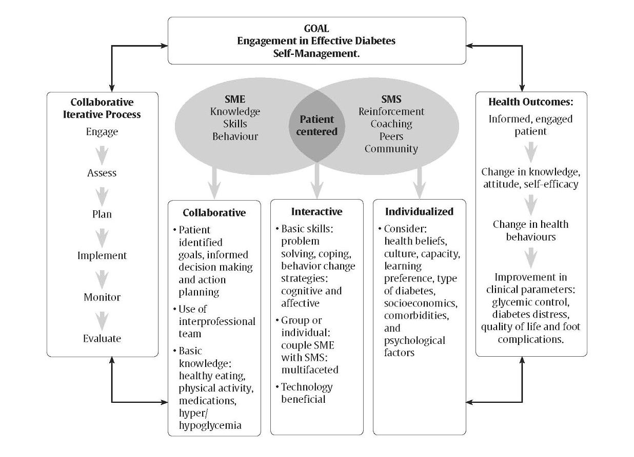
A model for self-management education and support
2018 Diabetes Canada CPG – Chapter 7. Self-Management Education and Support
SME, self-management education; SMS, self-management support

Slide 14
Recommendations 1-3
2018 Diabetes Canada CPG – Chapter 7. Self-Management Education and Support
People with diabetes should be offered timely self-management education that is tailored to enhance self-care practices and behaviours [Grade A, Level 1A]
All people with diabetes who are able should be taught how to self-manage their diabetes [Grade B, Level 2]
SME that incorporates cognitive-behavioural educational interventions, such as problem solving, goal setting, self-monitoring of health parameters and dietary modifications and physical activity should be implemented for all able individuals with diabetes [Grade B, Level 2]

Slide 15
Recommendations 4-5
2018 Diabetes Canada CPG – Chapter 7. Self-Management Education and Support
4. SME interventions may be offered in small group and/or one-on-one settings [Grade A, Level 1A for type 2 diabetes; Grade D, Consensus for type 1 diabetes]
5. Interventions that increase participation and collaboration of the person with diabetes in healthcare decision-making should be used by healthcare providers [Grade B, Level 2]

Slide 16
Recommendation 6
2018 Diabetes Canada CPG – Chapter 7. Self-Management Education and Support
2018
6. Support for self-management should be offered to assist individuals in implementing and maintaining diabetes self-management [Grade B, Level 2] by offering any of the following:
  Peer-led support or community support workers [Grade B, Level 2]
  Diabetes coaching [Grade B, Level 2]
  Telephone follow-up [Grade B, Level 2]

Slide 17
Recommendations 7-8
2018 Diabetes Canada CPG – Chapter 7. Self-Management Education and Support
2018
7. In both type 1 and type 2 diabetes, interventions that target the family’s ability to cope with stress or diabetes-related conflict should be included in educational interventions when indicated [Grade B, Level 2]
8. Technologies, such as internet-based computer programs and glucose monitoring systems, brief text messages and mobile apps may be used to support self-management in order to improve glycemic control [Grade A, Level 1A for type 2 diabetes; Grade B, Level 2 for type 1 diabetes]

Slide 18
Recommendation 9-10
2018 Diabetes Canada CPG – Chapter 7. Self-Management Education and Support
9. Culturally appropriate SME and SMS, which may include peer or lay educators, may be used to increase diabetes-related knowledge and self-care behaviours and to improve glycemic control [Grade A, Level 1A]
10. Adding literacy- and numeracy-sensitive materials to comprehensive diabetes management education and support programs may improve knowledge, self-efficacy and A1C outcomes for people with low literacy [Grade C, Level 3]

Slide 19
Key Messages
2018 Diabetes Canada CPG – Chapter 7. Self-Management Education and Support
Offer collaborative and interactive self-management education and support
Incorporate problem solving, goal setting and self-monitoring of health parameters for ongoing self-management of clinical and psychosocial aspects of care
Design and implement person-centred learning to facilitate informed decision-making and achievement of individual goals

Slide 20
Key Messages
2018 Diabetes Canada CPG – Chapter 7. Self-Management Education and Support
Individualize self-management education interventions according to the type of diabetes and recommended therapy within the context of the individual’s ability for learning and change, culture, health beliefs and preferences, literacy level, socioeconomic status, and other health challenges
Create and offer self-management support that reflects person-centred goals and needs

Slide 21
Key Messages for People with Diabetes
2018 Diabetes Canada CPG – Chapter 7. Self-Management Education and Support
A variety of diabetes education and support programs are available to you. These may include group classes and individual counselling sessions as well as strategies that use technology (e.g., Internet-based computer programs, mobile phone apps)
You are strongly encouraged to access diabetes self-management education and support when you are first diagnosed as well as during times when there are changes in your diabetes treatment, general health or life circumstances
Work with your diabetes team to
  establish a trusting and collaborative relationship
  set goals for caring for your diabetes and health, and
  identify strategies to help you manage your diabetes

Slide 22

Visit guidelines.diabetes.ca

Slide 23


Or download the App

Slide 24
Diabetes Canada Clinical Practice Guidelines
http://guidelines.diabetes.ca – for health-care providers
1-800-BANTING (226-8464)
http://diabetes.ca – for people with diabetes

