Slide 1
Reducing the Risk of Developing Diabetes
2018 Clinical Practice Guidelines
Chapter 5
Ally P.H. Prebtani MD BScPhm, FRCPC,
Harpreet S. Bajaj MD MPH ECNU FACE,
Ronald Goldenberg MD FRCPC FACE,
Yvonne Mullan MSc RD CDE

Slide 2
Disclaimer
All Content contained on this slide deck is the property of Diabetes Canada, its content suppliers or its licensors as the case may be, and is protected by Canadian and international copyright, trademark, and other applicable laws. Diabetes Canada grants personal, limited, revocable, non-transferable and non-exclusive license to access and read content in this slide deck for personal, non-commercial and not-for-profit use only. The slide deck is made available for lawful, personal use only and not for commercial use.
The unauthorized reproduction, distribution of this copyrighted work is not permitted.
For permission to use this slide deck for commercial or any use other than personal, please contact guidelines@diabetes.ca

Slide 3
Key Changes
2018 Diabetes Canada CPG – Chapter 5. Reducing the Risk of Developing Diabetes
2018
Reinforcement of the role of healthy behaviour interventions (moderate weight loss and regular physical activity) in reducing the risk of type 2 diabetes in individuals with prediabetes
New information on the role of certain dietary patterns in reducing the risk of type 2 diabetes

Slide 4
No Safe and Effective Strategies to Prevent Type 1 diabetes at this time
2018 Diabetes Canada CPG – Chapter 5. Reducing the Risk of Developing Diabetes
Type 1 diabetes is a chronic autoimmune condition with destruction of pancreatic beta cells
Ongoing or completed trials
    ENDIT¹: High-dose nicotinamide – Not effective
    DPT-1²: Low-dose insulin in high risk relatives – Not effective overall
    TRIGR³: Exclusion of cow’s milk protein to infants until 6-8 months of age – Not effective
Alternate strategy to use immunosuppression / modulation at the time of diagnosis but significant side effects and ethical considerations
Lancet 2004;363:925
NEJM 2002;346:1685, Diabetes Care 2005;28:1068
JAMA 2014;311:2279
Notes:
4

Slide 5
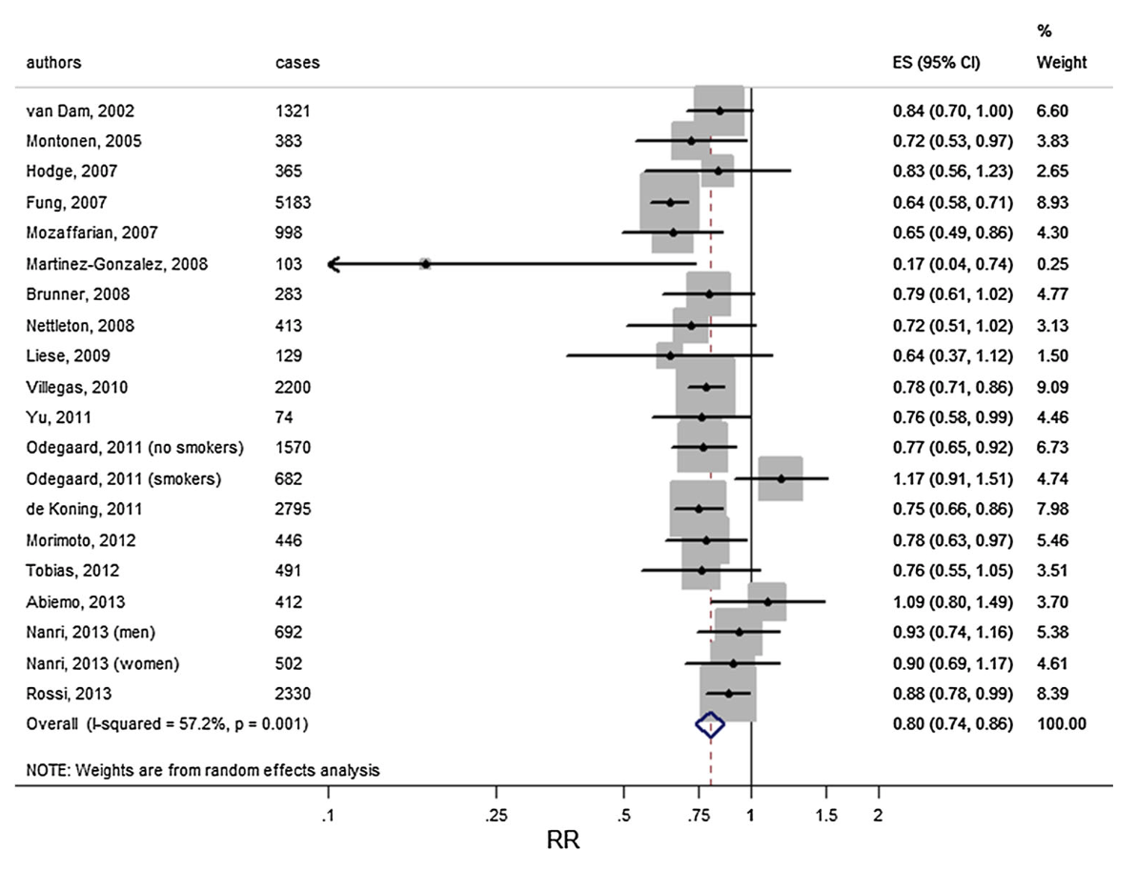
Meta-analysis of healthy dietary patterns and reduced risk of type 2 diabetes
Several healthy diets ( Mediterranean, DASH, AHEI) were associated with a 20% reduced risk of future type 2 diabetes
Esposito K et al. Endocrine 2014;47:107-116.

Slide 6
Diabetes Prevention Program (DPP)
2018 Diabetes Canada CPG – Chapter 5. Reducing the Risk of Developing Diabetes
Benefit of diet and exercise or metformin on diabetes prevention in at-risk patients
N = 3234 with IFG and IGT, without diabetes
40
Placebo
P*
30
Metformin
< 0.001
Cumulative
incidence of diabetes
(%)
↓31%
20
Lifestyle
< 0.001
↓58%
10
*vs placebo
IFG = impaired fasting glucose, IGT = impaired glucose tolerance
0
0
1.0
2.0
3.0
4.0
Years
Diabetes Prevention Program (DPP) Research Group. N Engl J Med 2002;346:393-403.
Notes:
6
In DPP, 3234 nondiabetic persons with elevated fasting and post-load plasma glucose concentrations were randomly assigned to placebo, metformin (850 mg twice daily), or a lifestyle-modification program with the goals of at least a 7% weight loss and at least 150 minutes of physical activity per week. The mean age of the participants was 51 years, and the mean body mass index (BMI) was 34; average follow-up was 2.8 years.
Compared to placebo, the lifestyle intervention reduced the incidence of diabetes by 58% (95% CI, 48 to 66%) and metformin reduced the incidence by 31% (95% CI, 17 to 43%); the lifestyle intervention was significantly more effective than metformin.
Knowler WC, Barrett-Connor E, Fowler SE, et al. Reduction in the incidence of type 2 diabetes with lifestyle intervention or metformin. N Engl J Med 2002;346:393-403.

Slide 7
Pharmacology to Reduce Progression to type 2 diabetes
2018 Diabetes Canada CPG – Chapter 5. Reducing the Risk of Developing Diabetes
Metformin has been shown to reduce the incidence of type 2 diabetes by approximately 30% in the Diabetes Prevention Program (DPP)
Acarbose has been shown to reduce the risk of progression to diabetes by approximately 30% in the Study to Prevent Non-Insulin Dependent Diabetes (STOP-NIDDM) study
Diabetes Prevention Program (DPP) Research Group. N Engl J Med 2002;346:393
STOP-NIDDM. Lancet 2002;359:2072
Notes:
7

Slide 8
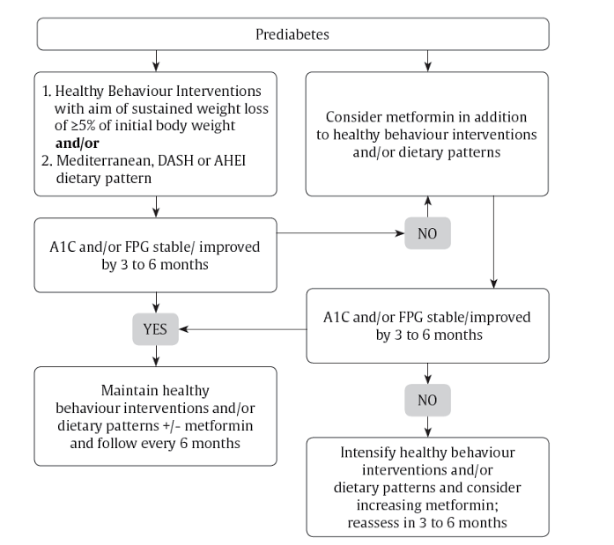
2018 Diabetes Canada CPG – Chapter 5. Reducing the Risk of Developing Diabetes
DASH=Dietary Approaches to Stop Hypertension
AHEI= Alternate Healthy Eating Index

Slide 9
Recommendation 1
2018 Diabetes Canada CPG – Chapter 5. Reducing the Risk of Developing Diabetes
In individuals with prediabetes, a structured program of healthy behaviour interventions that includes moderate weight loss and regular physical activity of 150 minutes per week over 5 days a week should be implemented to reduce the risk of type 2 diabetes [Grade A, Level 1A for individuals with IGT; Grade B, Level 2 for individuals with IFG; Grade D, Consensus for individuals with A1C 6.0%-6.4%]

Slide 10
Recommendation 2
2018 Diabetes Canada CPG – Chapter 5. Reducing the Risk of Developing Diabetes
2018
2. In individuals at risk for type 2 diabetes, dietary patterns may be used to reduce the risk of diabetes, specifically:
  Mediterranean-style [Grade C, Level 3]
  DASH (Dietary Approaches to Stop Hypertension) [Grade C, Level 3]
  AHEI (Alternate Healthy Eating Index) diet [Grade C, Level 3]

Slide 11
Recommendation 3
2018 Diabetes Canada CPG – Chapter 5. Reducing the Risk of Developing Diabetes
3. In individuals with prediabetes, pharmacologic therapy with metformin may be used to reduce the risk of type 2 diabetes [Grade A, Level 1A for individuals with IGT; Grade D, Consensus for individuals with IFG or A1C 6.0%-6.4%]

Slide 12
Key Messages
2018 Diabetes Canada CPG – Chapter 5. Reducing the Risk of Developing Diabetes
As safe and effective preventive therapies for type 1 diabetes have not yet been identified, any attempts to prevent type 1 diabetes should be undertaken only within the confines of formal research protocols

Slide 13
Key Messages
2018 Diabetes Canada CPG – Chapter 5. Reducing the Risk of Developing Diabetes
Intensive and structured healthy behaviour interventions, ideally resulting in loss of approximately 5% of initial body weight, can reduce the risk of progression from IFG or IGT to type 2 diabetes by almost 60%. When initiated early, the effects of healthy behaviour interventions are long lasting (more than 20 years)
IFG, impaired fasting glucose; IGT, impaired glucose tolerance

Slide 14
Key Messages
2018 Diabetes Canada CPG – Chapter 5. Reducing the Risk of Developing Diabetes
Progression from prediabetes to type 2 diabetes can also be reduced by pharmacologic therapy with metformin (~30% reduction), with persistent benefits observed after more than 10 years of stopping treatment in the Diabetes Prevention Program

Slide 15
Key Messages for People with Diabetes
2018 Diabetes Canada CPG – Chapter 5. Reducing the Risk of Developing Diabetes
If you have prediabetes, healthy behaviour changes that result in a loss of 5% of your initial body weight can delay or prevent type 2 diabetes from developing
A registered dietitian can educate you about dietary changes that may help reduce your risk for developing diabetes

Slide 16
Key Messages for People with Diabetes
Regular physical activity is also important to reduce your risk of diabetes
If healthy behaviour changes are not enough to normalize your blood glucose, your healthcare provider may recommend that you use medication in addition to ongoing healthy behaviour changes to manage your prediabetes

Slide 17

Visit guidelines.diabetes.ca

Slide 18


Or download the App

Slide 19
Diabetes Canada Clinical Practice Guidelines
http://guidelines.diabetes.ca – for health-care providers
1-800-BANTING (226-8464)
http://diabetes.ca – for people with diabetes

