Slide 1
Methods
2018 Clinical Practice Guidelines
Chapter 2
Diana Sherifali RN PhD CDE,
Doreen Rabi MD MSc FRCPC,
Robyn L. Houlden MD FRCPC

Slide 2
Disclaimer
All Content contained on this slide deck is the property of Diabetes Canada, its content suppliers or its licensors as the case may be, and is protected by Canadian and international copyright, trademark, and other applicable laws. Diabetes Canada grants personal, limited, revocable, non-transferable and non-exclusive license to access and read content in this slide deck for personal, non-commercial and not-for-profit use only. The slide deck is made available for lawful, personal use only and not for commercial use.
The unauthorized reproduction, distribution of this copyrighted work is not permitted.
For permission to use this slide deck for commercial or any use other than personal, please contact guidelines@diabetes.ca

Slide 3
Methods – Guiding Principles
2018 Diabetes Canada CPG – Chapter 2. Methods
Building on 2013 CPGs
Rigorous, evidence-based
Transparency – process, evidence that guidelines are based on and how we evaluated that evidence
Fulfill criteria outlined in AGREE II instrument
Harmonization with other guidelines

Slide 4
The Process
2018 Diabetes Canada CPG – Chapter 2. Methods
Develop clinical questions
Centralized literature search (X3)
Review of literature search
Write preamble and recommendations
Every recommendation reviewed and approved by 100% consensus of Steering Committee

Slide 5
The Process (continued)
2018 Diabetes Canada CPG – Chapter 2. Methods
External Review (national, international)
Independent Methods Review
Final approval of Steering Committee
Publication
Dissemination and Implementation

Slide 6
Identifying Articles
2018 Diabetes Canada CPG – Chapter 2. Methods
Identifying clinically important questions
  Treatment or prevention
  Diagnosis
  Prognosis
Centralized literature search
  Systematically conducted lit searches
  Known articles
  Manual search of listed citations from articles
Notes:
6

Slide 7
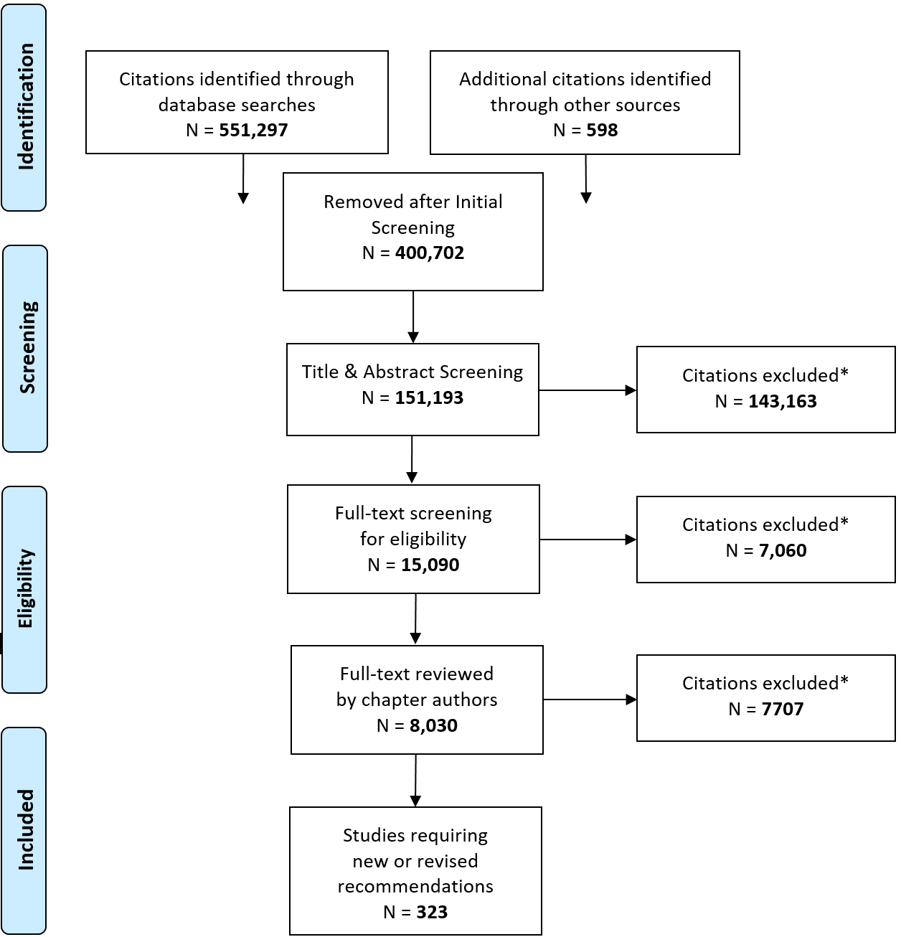
Literature Review Flow Diagram
2018 Diabetes Canada CPG – Chapter 2. Methods
2018

Slide 8
Rating the Evidence
2018 Diabetes Canada CPG – Chapter 2. Methods
Relevant studies
Formally assign each a level of evidence
Highest available level of evidence
Notes:
8

Slide 9
Rating the Evidence (cont’d)
2018 Diabetes Canada CPG – Chapter 2. Methods
Same standardized approach as in 2008
Set of ‘rules’ to rate studies of a certain type (prevention/treatment, diagnosis, prognosis)
Rating depends on study design plus strengths and weaknesses of the study
Notes:
9

Slide 10
Formulating a Recommendation
2018 Diabetes Canada CPG – Chapter 2. Methods
Recommendation What the evidence says
Grade What the highest level of
evidence is
Reference(s) Study which provides the
highest level of evidence
Notes:
10

Slide 11
Grading Recommendations
2018 Diabetes Canada CPG – Chapter 2. Methods
Grade Best Evidence
A Level 1
B Level 2
C Level 3
D Level 4
High level RCT(s) or systematic review / meta-analysis of RCTs
RCT(s) or systematic review/meta-analysis
Cohort studies
Case control studies,
case series
Notes:
11

Slide 12
Grading Recommendations (continued)
2018 Diabetes Canada CPG – Chapter 2. Methods
Grade Level of confidence
A Higher
B
C
D Lower
Notes:
12

Slide 13
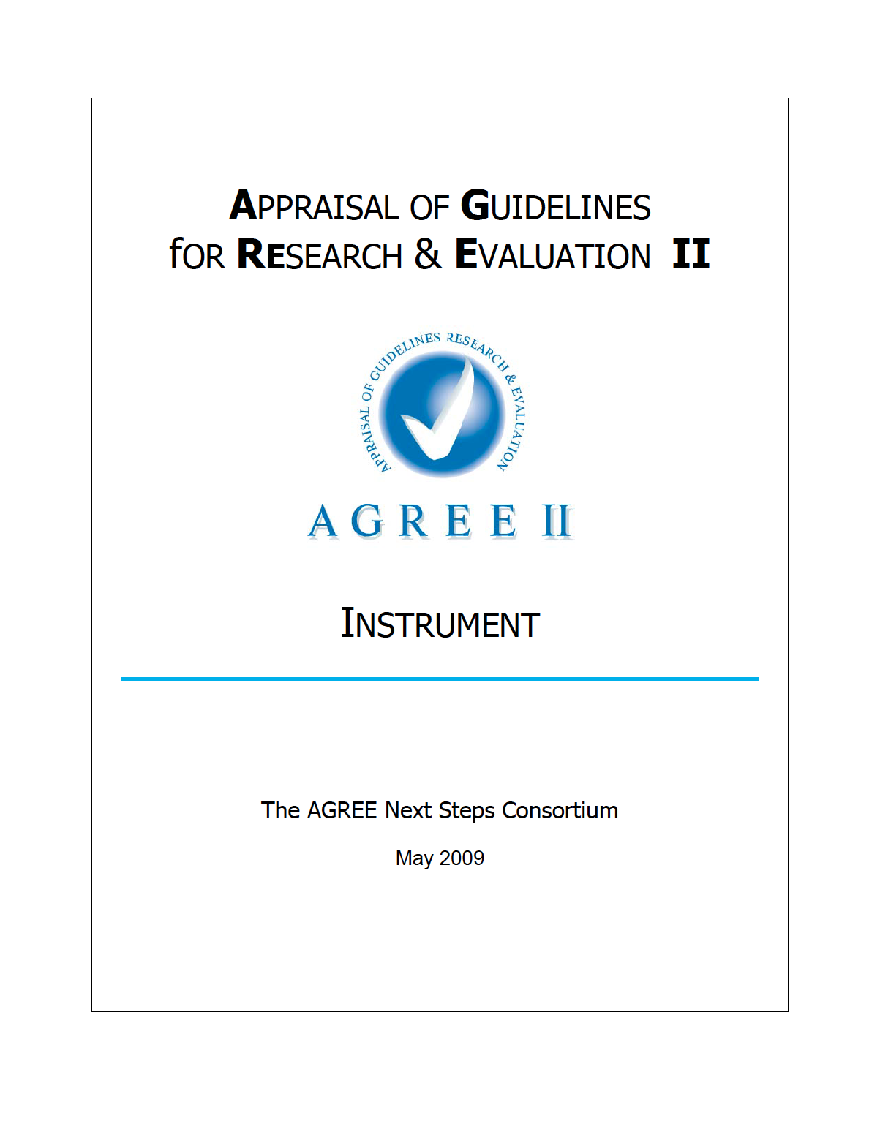
2018 Diabetes Canada CPG – Chapter 2. Methods
AGREE II
Scope and Purpose
Stakeholder involvement
Rigour of development
Applicability
Editorial independence

Slide 14
AGREE II Criteria
2018 Diabetes Canada CPG – Chapter 2. Methods
SCOPE AND PURPOSE
Objectives and purpose of CPGs specifically described | √
Clinical questions covered by CPGs specifically described | √
Patients to whom CPGs apply are specifically described | √

Slide 15
AGREE II Criteria (continued)
2018 Diabetes Canada CPG – Chapter 2. Methods
STAKEHOLDER INVOLVEMENT
All relevant professional groups involved in process | √
Patient’s views and preferences sought | √
Target users of CPGs clearly stated | √
Guideline has been pilot tested among target users before publication | √

Slide 16
AGREE II Criteria (continued)
2018 Diabetes Canada CPG – Chapter 2. Methods
RIGOUR OF DEVELOPMENT
Systematic methods used to search for evidence | √
Criteria for selecting evidence are clearly described | √
Methods used to formulate recommendations | √
Health benefits, side effects and risks considered | √
Explicit link between supporting evidence and recommendations | √
External review prior to publication | √
Procedure for updating guideline in place | √

Slide 17
AGREE II Criteria (continued)
2018 Diabetes Canada CPG – Chapter 2. Methods
RIGOUR OF DEVELOPMENT (cont’d)
Recommendations are specific and unambiguous | √
Different options for management are presented | √
Key recommendations are easily identifiable | √
CPGs are supported with tools for application | √

Slide 18
AGREE II Criteria (continued)
2018 Diabetes Canada CPG – Chapter 2. Methods
APPLICABILITY
Potential organizational barriers discussed | √
Potential cost implications considered | (√)
CPGs offer review criteria for purpose of monitoring and audit | √

Slide 19
AGREE II Criteria (continued)
2018 Diabetes Canada CPG – Chapter 2. Methods
EDITORIAL INDEPENDENCE
CPGs are editorially independent of funding body | √
Conflicts of interest of guideline development members recorded | √

Slide 20
Independent Methods Review Committee
2018 Diabetes Canada CPG – Chapter 2. Methods
2018
Doreen Rabi MD MSc FRCPC, Co-Chair, Methods, University of Calgary
Diana Sherifali RN PhD CDE, Co-Chair, Methods, McMaster University
Sonia Butalia MD FRCPC MSc, University of Calgary
David Campbell MD PhD MSc, University of Calgary
Dereck Hunt MD MSc FRCPC, McMaster University
Alexander Leung MD MPH FRCPC MRCP(UK) FACP, University of Calgary
Jeffrey Mahon MD MSc FRCPC, University of Western Ontario
Kerry McBrien MD MPH, University of Calgary
Charlotte McDonald MD MSc FRCPC, University of Western Ontario
Valerie Palda MD MSc FRCPC, University of Toronto

Slide 21
Independent Methods Review Committee
2018 Diabetes Canada CPG – Chapter 2. Methods
Group of methodologists that appraise evidence independently from expert author groups
External review ensures content is valuable and accurate
IMR ensure process is rigorous and risk of bias is minimized

Slide 22
Methods review- IMR Committee
2018 Diabetes Canada CPG – Chapter 2. Methods
IMR reviewed recommendations at each stage of development (i.e. prior to all Steering Committee Meetings)
Early review: Focused on process & wording of drafted recommendations
Final review: Focused on fidelity of wording with evidence and grading of recommendations (based on review of all available evidence)

Slide 23
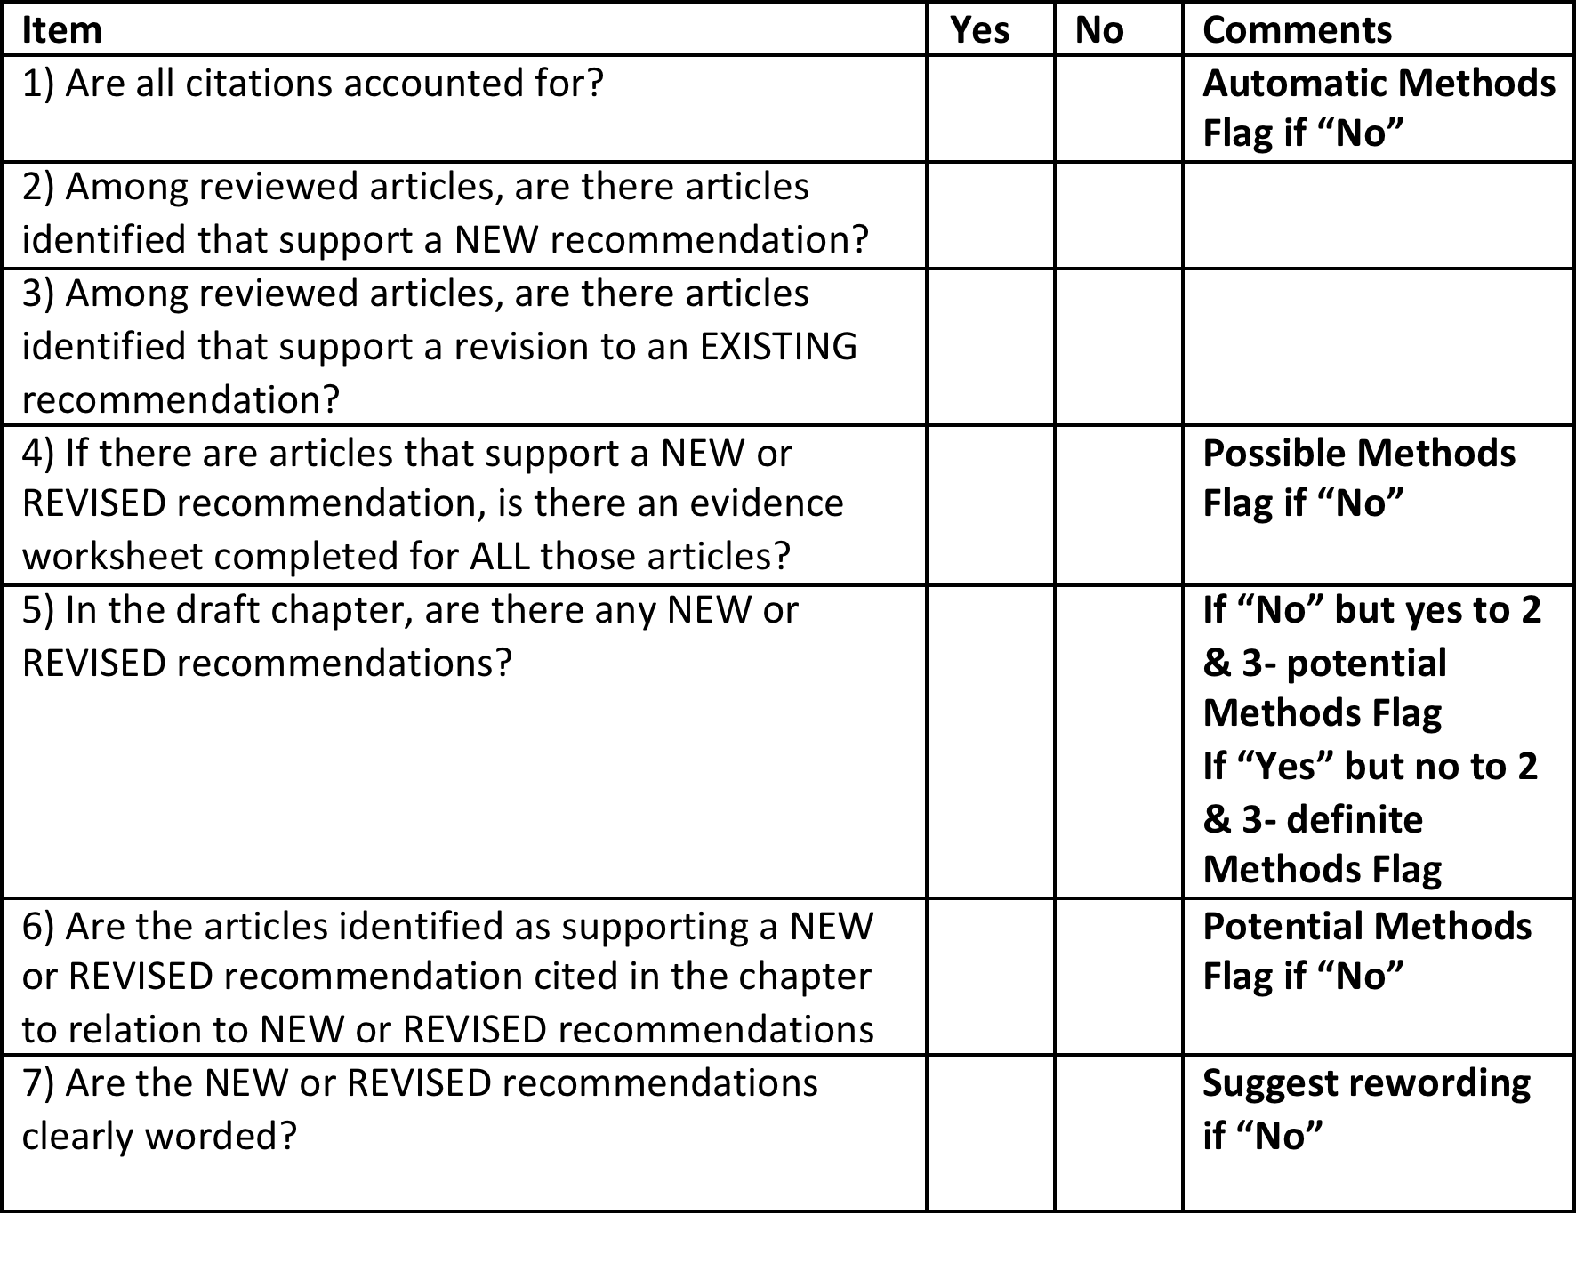
IMR Preliminary Methods Checklist
2018 Diabetes Canada CPG – Chapter 2. Methods

Slide 24
Final Methods Review
2018 Diabetes Canada CPG – Chapter 2. Methods
Step 1: Evidence review and reporting
  Evidence review completed by a single reviewer
  Reviewer must be WITHOUT CONFLICT in the topic under review
Step 2: Evidence grading
Step 3: Consensus grading (arbitration by IMR chairs)
Step 4: Summary report to the Steering Committee

Slide 25
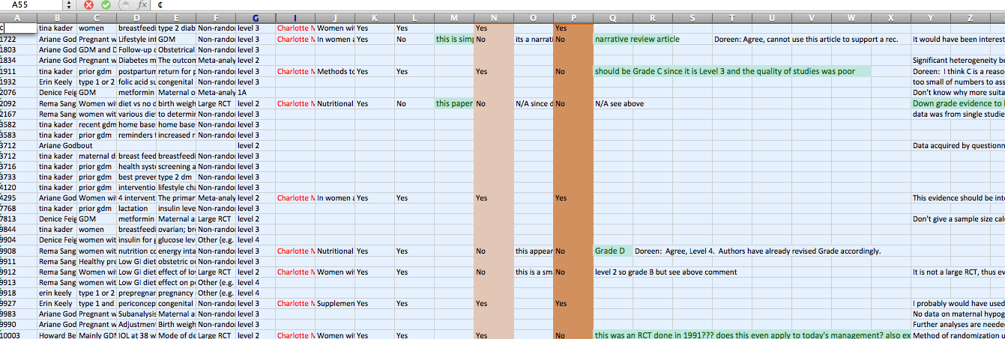
Details of study & author group assessment of study
IMR Process
Verification &
Assessment of
Evidence
Detailed reviewer comments

Slide 26
“The trials we have comprise islands of evidence, linked by shorter and longer bridges of extrapolation spanning oceans of uncertainty …
The longer the bridge and the farther we are from an island, the shakier the extrapolation…
More good outcomes trials means more islands, shorter bridges and less uncertainty…
But there will always be an ocean to span and a bridge to cross.”
(Hertzel Gerstein, 2015)

Slide 27

Visit guidelines.diabetes.ca

Slide 28


Or download the App

Slide 29
Diabetes Canada Clinical Practice Guidelines
www.guidelines.diabetes.ca – for health-care providers
1-800-BANTING (226-8464)
www.diabetes.ca – for people with diabetes
Notes:
29

