Slide 1
2018 Clinical Practice Guidelines
Diabetes and Driving
Chapter 21
Robyn L. Houlden MD FRCPC, Lori Berard RN CDE, Joshua M. Lakoff MD FRCPC, Vincent C. Woo MD FRCPC, Jean-François Yale MD FRCPC
Notes:
Welcome to the Diabetes and Driving chapter.
1

Slide 2
Disclaimer
All Content contained on this slide deck is the property of Diabetes Canada, its content suppliers or its licensors as the case may be, and is protected by Canadian and international copyright, trademark, and other applicable laws. Diabetes Canada grants personal, limited, revocable, non-transferable and non-exclusive license to access and read content in this slide deck for personal, non-commercial and not-for-profit use only. The slide deck is made available for lawful, personal use only and not for commercial use.
The unauthorized reproduction, distribution of this copyrighted work is not permitted.
For permission to use this slide deck for commercial or any use other than personal, please contact guidelines@diabetes.ca

Slide 3
Key Changes
2018 Diabetes Canada CPG – Chapter 21. Diabetes & Driving
2018
New chapter
New information on
  When to start driving if BG <4.0 mmol/L
  When to report a driver with diabetes
BG, blood glucose
Notes:
This was a new chapter for the Diabetes Canada guidelines. It contains new information on management of hypoglycemia prior to driving and when a health-care provider should report a driver with diabetes.

Slide 4
Diabetes and driving
2018 Diabetes Canada CPG – Chapter 21. Diabetes & Driving
Diabetes can affect driving performance due to
  Chronic complications which impair sensory or motor function (retinopathy, neuropathy, amputation, vascular disease)
  Transient cognitive dysfunction or loss of consciousness from antihyperglycemic medication-induced hypoglycemia
    Primarily related to insulin or insulin secretatogues
  Other medical disorders associated with type 2 diabetes such as sleep apnea
Notes:
Diabetes can affect driving performance due to
Chronic complications which impair sensory or motor function. These include retinopathy, neuropathy, amputation, and vascular disease.
Transient cognitive dysfunction or loss of consciousness from antihyperglycemic medication-induced hypoglycemia. This is primarily related to insulin or insulin secretatogues. And,
Other medical disorders often associated with type 2 diabetes such as sleep apnea

Slide 5
Fitness of people with diabetes to drive should be assessed on an individual basis as per provincial regulations
2018 Diabetes Canada CPG – Chapter 21. Diabetes & Driving
Notes:
A key principal is that the fitness of people with diabetes to drive should be assessed on an individual basis as per provincial regulations

Slide 6
Driving risks associated with diabetes
2018 Diabetes Canada CPG – Chapter 21. Diabetes & Driving
1. Diabetes Care 2006;29:1942
2. Can J Diabets 2010;34;233
BG, blood glucose; MVA, motor vehicle accident
Case control studies suggest drivers with diabetes pose a modestly increased but acceptable risk of MVAs^{1,2}
Notes:
Case control studies suggest drivers with diabetes pose a modestly increased but acceptable risk of motor vehicle accidents compared to drivers without diabetes, but many studies are limited and or poor quality. Older studies may no longer be as relevant due to changes in road conditions, motor vehicles and diabetes management.

Slide 7
Driving risks associated with diabetes
2018 Diabetes Canada CPG – Chapter 21. Diabetes & Driving
1. Diabetes Care 2000;23;163
2. Diabetes 1993;42;239
3. Diabetes Care 2000;23:893
4. Diabetes 2008;57:732
BG, blood glucose
Driving stimulator studies with induced hypoglycemia have demonstrated
  driving performance starts to deteriorate with BG < 3.8 mmol/L^{1,2}
  Only 25% aware driving performance impaired
  Cognitive function may not recover until > 40 minutes after restoration of euglycemia^{3,4}
Notes:
Unrecognized hypoglycemia is the most relevant driving hazard for drivers with diabetes. A number of studies have examined driving performance with a driving simulator during induced hypoglycemia in individuals with type 1 and 2 diabetes. Studies in type 1 diabetes have demonstrated that performance starts to deteriorate at blood glucose levels below 3.8 mmol/L. In one study, only 30% of drivers self-treated their low BG, and the treatment occurred only when the blood glucose was ≤2.8 mmol/L. Fewer than 25% were aware that their driving performance was impaired. The ability of deciding when it is safe to drive may be unreliable or absent in those with hypoglycemia unawareness. During a driving stimulator study, only 4% of those with normal hypoglycemia awareness stated that they would drive while hypoglycemic compared to 43% with impaired awareness of hypoglycemia. Studies have demonstrated that cognitive function may not recover until 40 minutes or more after restoration of euglycemia.

Slide 8
Factors associated with increased driving risk
2018 Diabetes Canada CPG – Chapter 21. Diabetes & Driving
1. Diabetes Care 2009;32;2177
2. Diabetes Obes Metab 2013;15:335
3. Annu Proc Assoc Adv Automot Med 2006;50;335
BG, blood glucose
Previous episodes of severe hypoglycemia within the past 2 years with greater risk in those with lower A1C levels¹⁻³
Previous hypoglycemia while driving¹
Absence of BG monitoring before driving¹
Notes:
Hypoglycemia is not a problem for drivers with diabetes treated with healthy behaviour interventions (diet and physical activity) alone, nor is it a problem for drivers with diabetes treated with
most non-insulin antihyperglycemic medications, when used as monotherapy or in combination with each other. Treatment with insulin secretagogues may provoke higher rates of hypoglycemia when used alone or in combination with other noninsulin antihyperglycemic medications, including the elderly. Studies of rates of motor vehicle accidents in drivers with diabetes have consistently described
the highest rates for individuals treated with insulin.
Factors that have been shown to increase driving risk include previous episodes of severe hypoglycemia within the past 2 years with a greater risk in those with lower A1C levels, previous hypoglycemia while driving and absence of blood glucose monitoring before driving.
These risks may be mitigated by frequent blood glucose testing or use of a real-time continuous glucose monitoring device. Use of a memory glucose meter is recommended so that measurements can be assessed by the health-care team and by driving authorities, if indicated.

Slide 9
Commercial Driving
2018 Diabetes Canada CPG – Chapter 21. Diabetes & Driving
BG, blood glucose; MVA, motor vehicle accident
Greater risk
  Typically on road for longer periods of time
  More serious consequences with a MVA
Notes:
The risk for commercial vehicle drivers is higher than that for private drivers as the former are on the road many hours of the day or night, thus increasing their time exposure. The consequences of
a motor vehicle accident involving a commercial vehicle are also likely to be more serious, particularly if the vehicle carries passengers or dangerous goods. Therefore, higher medical standards are
applied for all commercial vehicle drivers.

Slide 10
Roles and responsibilities
2018 Diabetes Canada CPG – Chapter 21. Diabetes & Driving
Driver with diabetes
Active role in assessing their own fitness to drive
Duty to report conditions that may impair their ability to drive safely
Health-care provider(s)
Assess fitness to drive
Duty to report unfit drivers according to provincial/territorial regulations
Need to educate patients on strategies to reduce risk of hypoglycemia while driving
Notes:
People with diabetes should play an active role in assessing their own fitness to drive and should have a duty to report conditions that may potentially impair their ability to drive safely, such as
hypoglycemia unawareness and episodes of severe hypoglycemia while driving or while awake but not driving. However, studies have demonstrated limited patient awareness of and adherence to recommendations for safe driving. As few as 15% of adults routinely perform self-monitoring of blood glucose before driving.
Health-care providers play an important role in assessing the individual’s fitness to drive.
They have a duty to report unfit drivers according to provincial/territorial regulations.
They also play a critical role in educating people with diabetes on strategies to reduce their risk of hypoglycemia while driving. However, it is important to recognize that currently many drivers with diabetes receive little or no advice. In a large multinational study, only 52% of drivers with type 1 diabetes and 27% with type 2 diabetes had discussed driving guidelines with their physician.

Slide 11
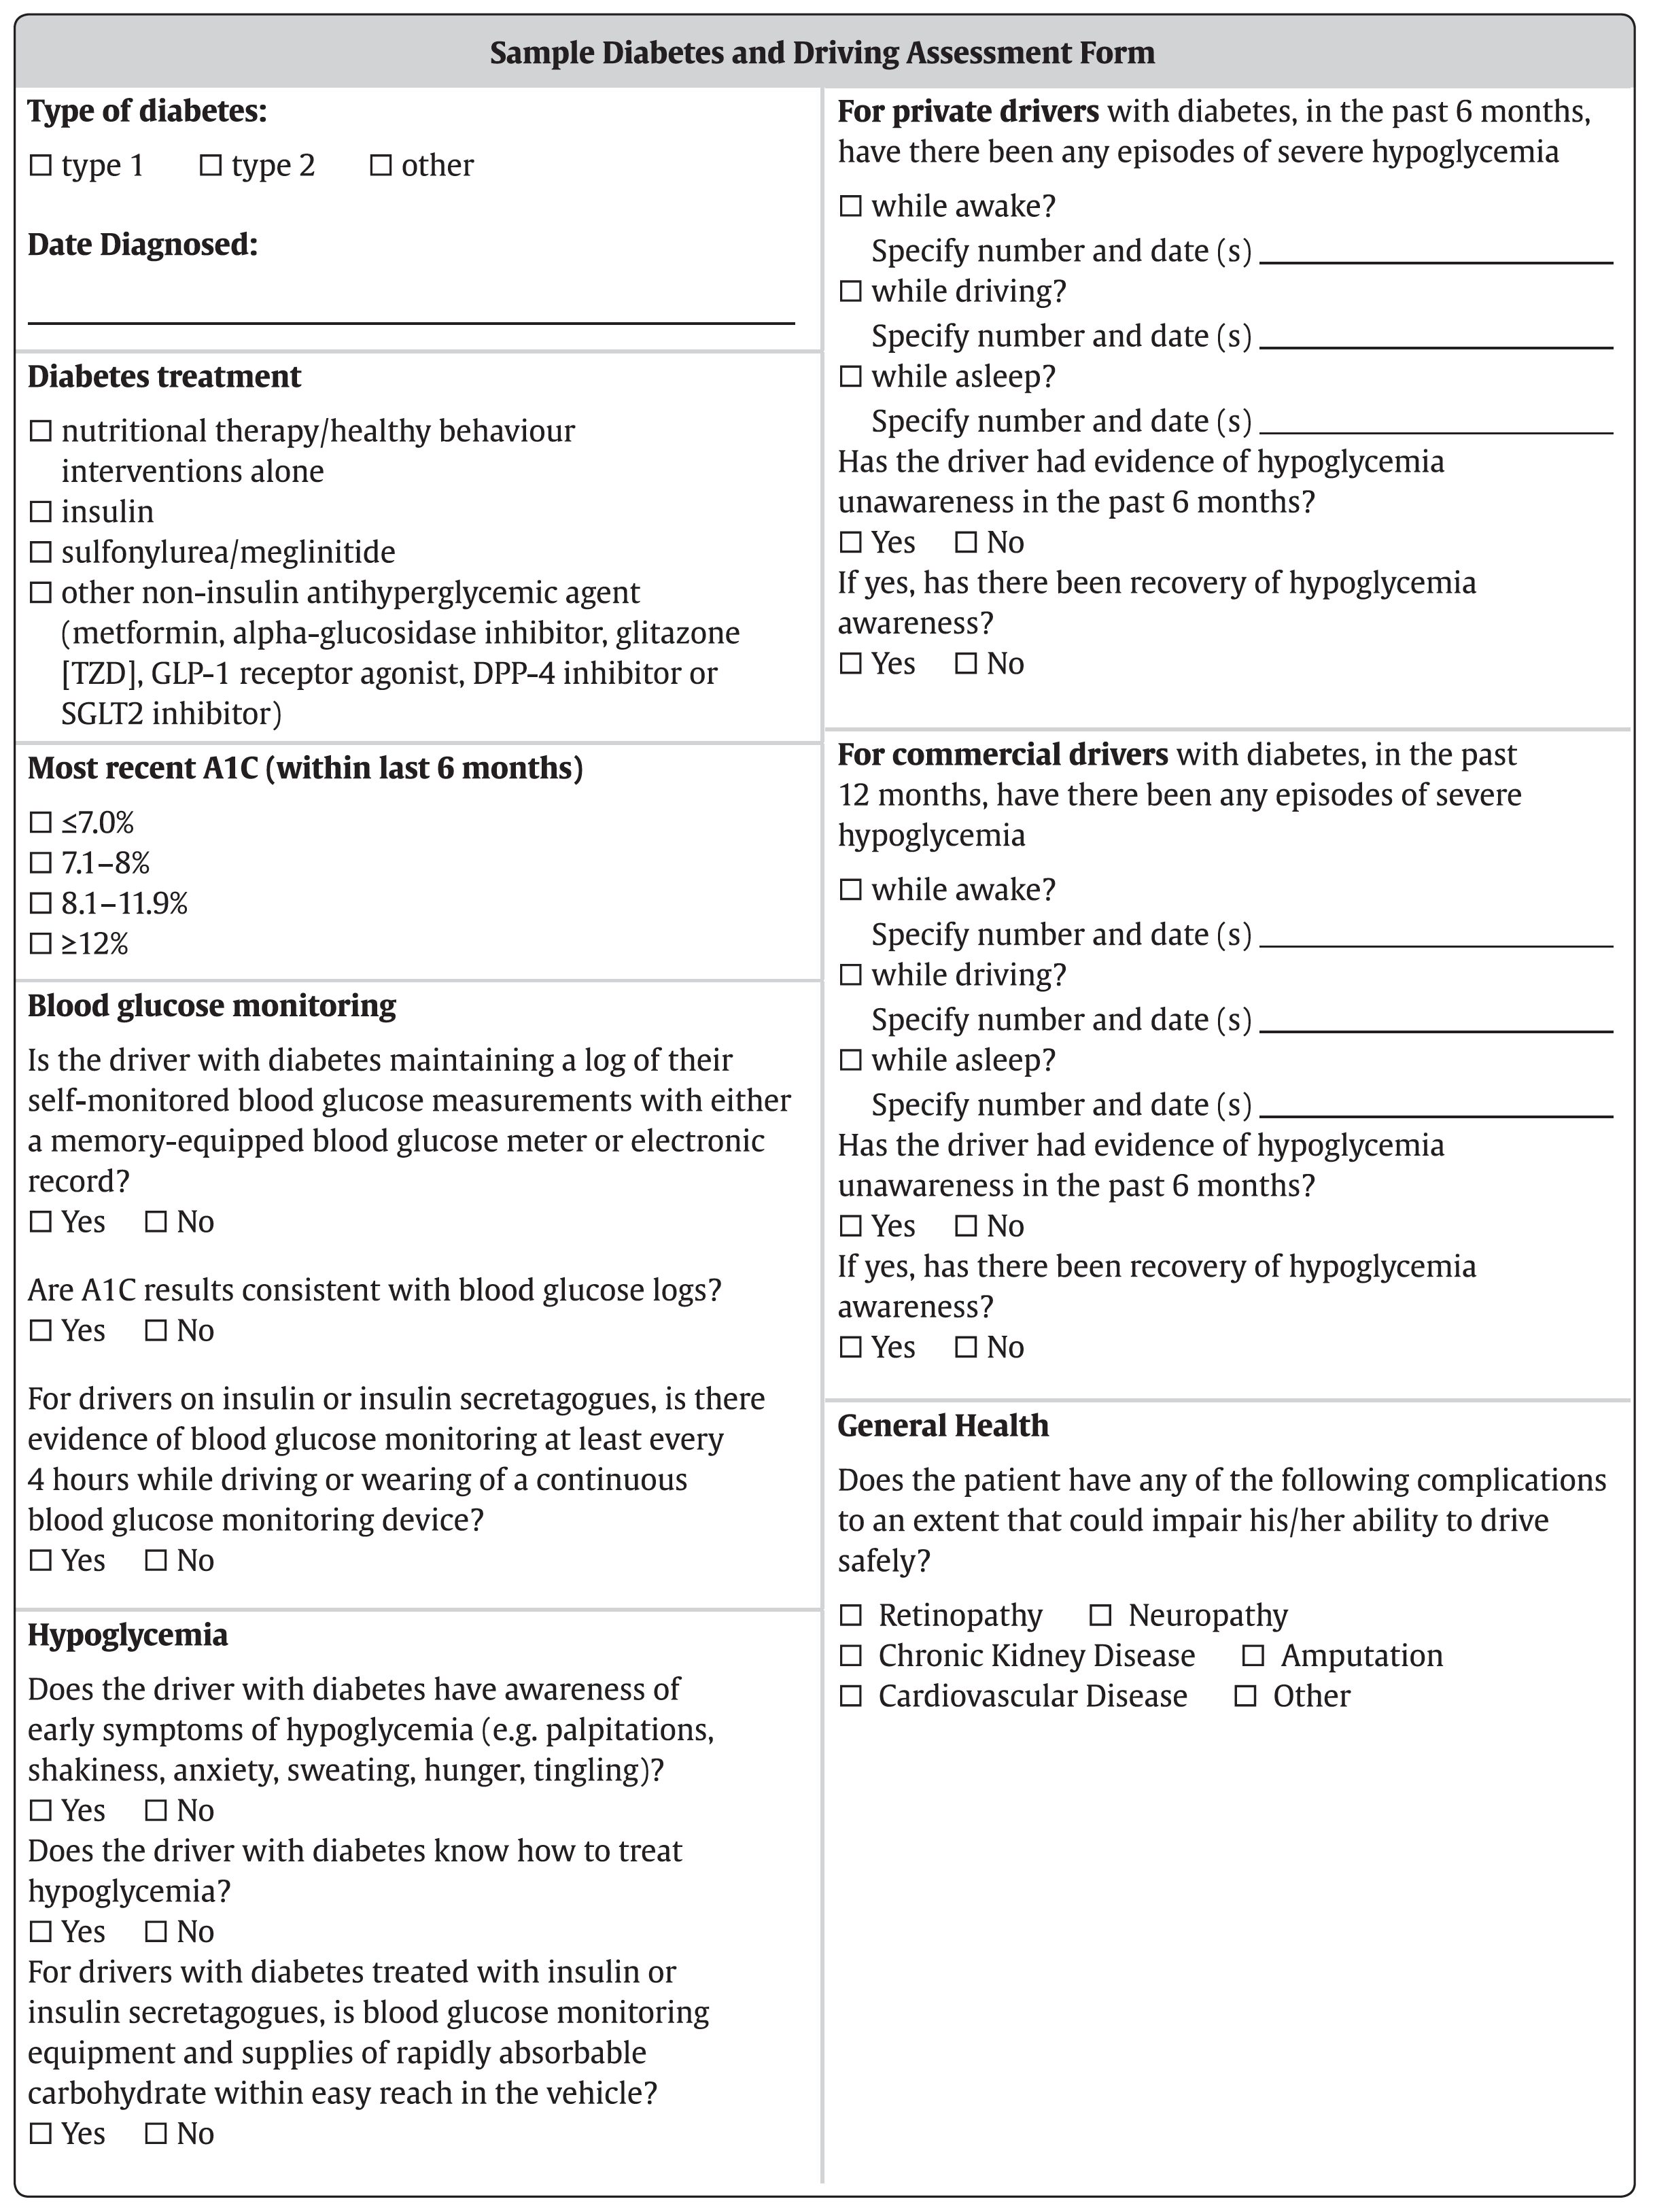
Notes:
The 2018 guidelines contain an appendix entitled Sample Diabetes and Driving Assessment Form to assist health-care provider in assessing the fitness of people with diabetes to safely drive.

Slide 12
Canadian regulations for reporting medically unfit drivers (as of 2017)
Province/Territory | Reporting*
Alberta | Discretionary
British Columbia | Mandatory (only if the driver has been warned of the dangers of driving and still continues to drive)
Manitoba | Mandatory
New Brunswick | Mandatory
Newfoundland and Labrador | Mandatory
Northwest Territories | Mandatory
Nova Scotia | Discretionary
Nunavut | Mandatory
Ontario | Mandatory
Prince Edward Island | Mandatory
Quebec | Discretionary
Saskatchewan | Mandatory
Yukon | Mandatory
*For more information regarding reporting processes in Canada, see the Canadian Medical Association Driver’s Guide available at https://joule.cma.ca/en/evidence/CMA-drivers-guide.html
Notes:
Currently 10 Canadian provinces and territories have a mandatory reporting system obliging medical practitioners to report to the appropriate regulatory body those people who have conditions that impair their driving ability. Federal organizations, such as the Canadian Council of Motor Transport Administrators (CCMTA), should have consistent, clear and easily accessible reporting mechanisms for physicians and nurse practitioners; in addition, provincial and territorial ministries of transportation should include information on their websites about diabetes and driving, and which types of people with diabetes should be reported. A study in Ontario showed that a program of medical warnings issued to 100,075 people over a 3-year period for a variety of different medical issues, including alcoholism, epilepsy, dementia, sleep disorders and diabetes, resulted in a 45% reduction in annual accident rates when compared with the period before the warning.

Slide 13
Recommendation 1
2018 Diabetes Canada CPG – Chapter 21. Diabetes & Driving
2018
Fitness of people with diabetes to drive should be assessed on an individual basis [Grade D, Consensus].
  People with diabetes should take an active role in assessing their ability to drive safely.
Notes:
And now reviewing the 5 recommendations in this chapter.

Slide 14
Recommendation 2
2018 Diabetes Canada CPG – Chapter 21. Diabetes & Driving
2018
All drivers with diabetes should undergo a comprehensive medical examination at least every 2 years by a physician/nurse practitioner competent in managing people with diabetes. The medical examination should include an assessment of glycemic control; frequency and severity of hypoglycemia; symptomatic awareness of hypoglycemia; and the presence of retinopathy, neuropathy, nephropathy, amputation, and CV disease, to identify whether any of these factors could significantly increase the risk of a motor vehicle accident [Grade D, Consensus].
  Commercial drivers should also undergo a medical examination at the time of application for a commercial license [Grade D, Consensus]

Slide 15
Recommendation 3
2018 Diabetes Canada CPG – Chapter 21. Diabetes & Driving
2018
3. Drivers with diabetes treated with insulin secretagogues and/or insulin
  a. should maintain a log of their SMBG measurements either by using a memory-equipped BG meter or electronic record of BG measurement performed at a frequency deemed appropriate by the person with diabetes and their health-care team. For commercial drivers, for initial commercial licence application, the record should include the last 6 months (or since the diagnosis of diabetes if less than six months). BG logs should be verifiable on request [Grade D, Consensus]
  b. should always have BG monitoring equipment and supplies of rapidly absorbable carbohydrate within easy reach (e.g., attached to the driver’s-side visor or in the centre console) [Grade D, Consensus]

Slide 16
Recommendation 3 cont’d
2018 Diabetes Canada CPG – Chapter 21. Diabetes & Driving
2018
3. Drivers with diabetes treated with insulin secretagogues and/or insulin
  c. should consider measuring their BG level immediately before and at least every 4 hours while driving or wear a real-time CGM device [Grade D, Consensus]
  d. should not drive when their BG level is <4.0 mmol/L [Grade C, Level 3 for type 1 diabetes; Grade D Consensus for type 2 diabetes]. If the BG level is <4.0 mmol/L, they should not drive until at least 40 minutes after successful treatment of hypoglycemia has increased their BG level to at least 5.0 mmol/L [Grade C, Level 3 for type 1 diabetes; Grade D, Consensus for type 2 diabetes]

Slide 17
Recommendation 3 cont’d
2018 Diabetes Canada CPG – Chapter 21. Diabetes & Driving
2018
Drivers with diabetes treated with insulin secretagogues and/or insulin
  e. must refrain from driving immediately if they experience severe hypoglycemia while driving, and notify their health-care provider as soon as possible (no longer than 72 hours) [Grade D, Consensus]

Slide 18
Recommendation 4
2018 Diabetes Canada CPG – Chapter 21. Diabetes & Driving
2018
Private and commercial drivers with diabetes and hypoglycemia unawareness or history of severe hypoglycemia in the past 12 months must measure their BG level immediately before and at least every two hours while driving or wear a real-time CGM device [Grade D, Consensus]

Slide 19
Recommendation 5
2018 Diabetes Canada CPG – Chapter 21. Diabetes & Driving
2018
5. If any of the following occur, health-care professionals should inform people with diabetes treated with insulin secretagogues and/or insulin to no longer drive, and should report their concerns about the person’s fitness to drive to the appropriate driving licensing body:
  a. Any episode of severe hypoglycemia while driving in the past 12 months [Grade D, Consensus]
  b. More than 1 episode of severe hypoglycemia while awake but not driving in the past 6 months for private drivers and in the past 12 months for commercial drivers [Grade D, Consensus]

Slide 20
Key Messages
2018 Diabetes Canada CPG – Chapter 21. Diabetes & Driving
The fitness of people with diabetes to drive should be assessed on an individual basis
All drivers with diabetes should undergo a medical examination at least every two years to assess fitness to drive.
Commercial drivers should undergo an assessment at the time of application for a commercial license and as per provincial requirements thereafter
Notes:
The Key messages for health-care providers inclue

Slide 21
Key Messages
People with diabetes should play an active role in assessing their fitness to drive
Health-care professionals should educate people with diabetes about strategies to reduce their risks for hypoglycemia while driving. They should also identify and inform individuals with diabetes at higher risk for motor vehicle accidents

Slide 22
Key Messages for People with Diabetes
2018 Diabetes Canada CPG – Chapter 21. Diabetes & Driving
If you take insulin and/or an insulin secretagogue and intend to drive,
  consider measuring your blood glucose level immediately before driving, always keep an emergency supply of fast-acting carbohydrate such as dextrose tablets within easy reach inside the vehicle and carry your glucose meter and supplies
  consider measuring your blood glucose level immediately before driving, if you develop symptoms of hypoglycemia, and at least every 4 hours while driving. You can also wear a real-time continuous blood glucose monitoring device
Notes:
And the key messages that have been developed for people with diabetes include:

Slide 23
Key Messages for People with Diabetes
2018 Diabetes Canada CPG – Chapter 21. Diabetes & Driving
If you take insulin and/or an insulin secretagogue and intend to drive,
  Consider measuring your blood glucose more frequently if there are factors that may increase your risk of hypoglycemia such as recent physical activity or a delay in eating or skipping a meal
  If you have a history of recurrent severe hypoglycemia or have hypoglycemia unawareness, you must measure your blood glucose immediately before and at least every 2 hours while driving or wear a real-time continuous blood glucose monitoring device

Slide 24
Key Messages for People with Diabetes
2018 Diabetes Canada CPG – Chapter 21. Diabetes & Driving
If you take insulin and/or an insulin secretagogue and intend to drive,
  Do not start driving if your blood glucose level is less than 4 mmol/L. If your blood glucose is less than 4 mmol/L, do not start driving until you have ingested 15 grams of carbohydrate, you have retested and your blood glucose is at least 5 mmol/L. It is suggested to wait for 40 minutes as it takes time for judgment and reflexes to the brain to recover fully from hypoglycemia

Slide 25
Key Messages for People with Diabetes
2018 Diabetes Canada CPG – Chapter 21. Diabetes & Driving
If you take insulin and/or an insulin secretagogue and intend to drive,
  If hypoglycemia develops while driving, stop the vehicle in a safe location and remove the keys from the ignition. Treat the low blood glucose and considering waiting 40 minutes before driving
  On longer journeys, take regular meals, snacks and periods of rest

Slide 26
Key Messages for People with Diabetes
2018 Diabetes Canada CPG – Chapter 21. Diabetes & Driving
Immediately notify your health-care provider and your driving licensing body if you experience any episode of severe hypoglycemia while driving or you experience more than 1 episode of severe hypoglycemia while awake but not driving in the past 6 months if you are a private driver, or in the past 12 months if you are a commercial driver

Slide 27

Visit guidelines.diabetes.ca
Notes:
I encourage you to review the full text of the chapter available at the Diabetes Canada guidelines website.
Educational tools for health-care providers and people with diabetes on diabetes and driving have also been developed by the Dissemination and Implementation Committee and are available on the website.

Slide 28


Or download the App
Notes:
The same information can be obtained by downloading the app.

Slide 29
Diabetes Canada Clinical Practice Guidelines
http://guidelines.diabetes.ca – for health-care providers
1-800-BANTING (226-8464)
http://diabetes.ca – for people with diabetes

