Slide 1
Targets for Glycemic Control
2018 Clinical Practice Guidelines
Chapter 8
S. Ali Imran MBBS FRCP (Edin) FRCPC,
Gina Agarwal MBBS PhD MRCGP CCFP FCFP,
Harpreet S. Bajaj MD MPH ECNU FACE,
Stuart Ross MB ChB FRACP FRCPC

Slide 2
Disclaimer
All Content contained on this slide deck is the property of Diabetes Canada, its content suppliers or its licensors as the case may be, and is protected by Canadian and international copyright, trademark, and other applicable laws. Diabetes Canada grants personal, limited, revocable, non-transferable and non-exclusive license to access and read content in this slide deck for personal, non-commercial and not-for-profit use only. The slide deck is made available for lawful, personal use only and not for commercial use.
The unauthorized reproduction, distribution of this copyrighted work is not permitted.
For permission to use this slide deck for commercial or any use other than personal, please contact guidelines@diabetes.ca

Slide 3
Key Changes
2018 Diabetes Canada CPG – Chapter 8. Targets for Glycemic Control
2018
Addition of target category of
  Functionally dependent → 7.1%-8.0%
Lower FPG and PPG targets in individuals not meeting an A1C target of <7.0%
Strengthening of the recommendation for targeting an A1C ≤6.5% in people with type 2 diabetes to further lower the risk of chronic kidney disease and retinopathy if they are at low risk of hypoglycemia based on class of antihyperglycemic agent(s) taken and patient characteristics
A1C, glycated hemoglobin; FPG, fasting plasma glucose; PPG, postprandial glucose

Slide 4
Targets Checklist
2018 Diabetes Canada CPG – Chapter 8. Targets for Glycemic Control
A1C ≤7.0% for MOST people with diabetes
A1C ≤6.5% for SOME people with type 2 diabetes
A1C 7.1%-8.5% in people with specific features
Notes:
4

Slide 5
A1C Targets
2018 Diabetes Canada CPG – Chapter 8. Targets for Glycemic Control
2018
≤6.5
Adults with type 2 diabetes to reduce the risk of CKD and retinopathy if at low risk of hypoglycemia
≤7.0
MOST ADULTS WITH TYPE 1 OR TYPE 2 DIABETES
7.1
8.5
7.1-8.0%: Functionally dependent*
7.1-8.5%:
Recurrent severe hypoglycemia and/or hypoglycemia unawareness
Limited life expectancy
Frail elderly and/or with dementia**
Avoid higher A1C to minimize risk of symptomatic hyperglycemia and acute and chronic complications
End of life
A1C measurement not recommended. Avoid symptomatic hyperglycemia and any hypoglycemia
* Based on class of antihyperglycemic medication(s) utilized and person’s characteristics
** see Diabetes in Older People chapter
CKD; chronic kidney disease

Slide 6
To achieve A1C ≤7.0%
2018 Diabetes Canada CPG – Chapter 8. Targets for Glycemic Control
 | A1C (%) | Preprandial PG (mmol/L) | 2 hour Postprandial PG (mmol/L)
For most patients | ≤7.0 | 4.0-7.0 | 5.0-10.0
If A1C ≤7.0% not achieved despite the above PG targets |  | 4.0-5.5 | 5.0-8.0
PG, plasma glucose
Notes:
6

Slide 7
Correlation between A1C and estimated mean glucose values
2018 Diabetes Canada CPG – Chapter 8. Targets for Glycemic Control
A1C values (%) | 5.5–6.5 | 6.5–6.9 | 7.0–7.4 | 7.5–7.9 | 8.0–8.5
Estimated mean glucose (mmol/L) | 6.2–7.7 | 7.8–8.5 | 8.6–9.3 | 9.4–10.1 | 10.2–10.9
A1C, glycated hemoglobin

Slide 8
< 7.0%
2018 Diabetes Canada CPG – Chapter 8. Targets for Glycemic Control
Notes:
8

Slide 9
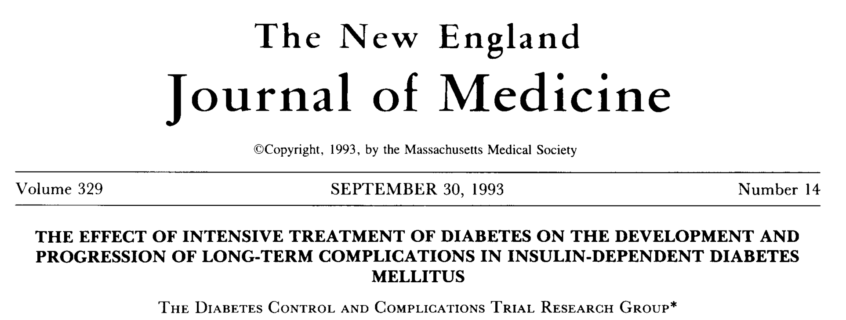
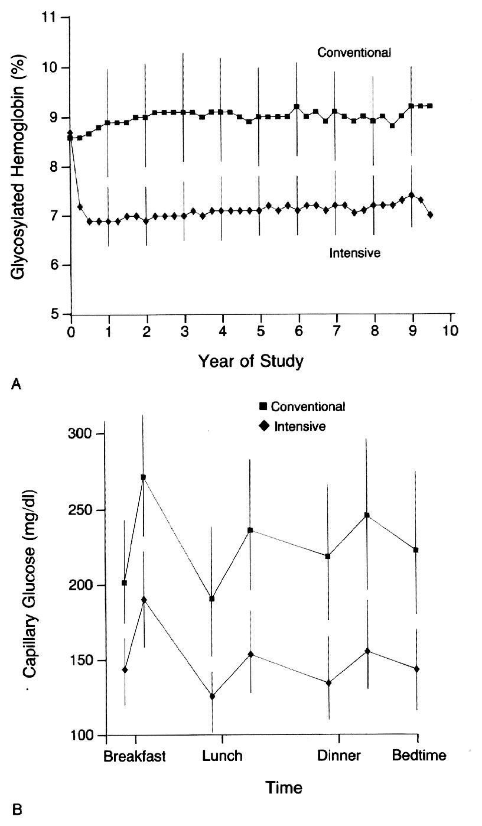
DCCT
N = 1441 T1DM
Intensive
(≥ 3 injections/day or CSII) vs.
Conventional
(1-2 injections per day)
Notes:
N Engl J Med. 1993 Sep 30;329(14):977-86.
The effect of intensive treatment of diabetes on the development and progression of long-term complications in insulin-dependent diabetes mellitus. The Diabetes Control and Complications Trial Research Group.
[No authors listed]
Abstract
BACKGROUND:
Long-term microvascular and neurologic complications cause major morbidity and mortality in patients with insulin-dependent diabetes mellitus (IDDM). We examined whether intensive treatment with the goal of maintaining blood glucose concentrations close to the normal range could decrease the frequency and severity of these complications.
METHODS:
A total of 1441 patients with IDDM--726 with no retinopathy at base line (the primary-prevention cohort) and 715 with mild retinopathy (the secondary-intervention cohort) were randomly assigned to intensive therapy administered either with an external insulin pump or by three or more daily insulin injections and guided by frequent blood glucose monitoring or to conventional therapy with one or two daily insulin injections. The patients were followed for a mean of 6.5 years, and the appearance and progression of retinopathy and other complications were assessed regularly.
RESULTS:
In the primary-prevention cohort, intensive therapy reduced the adjusted mean risk for the development of retinopathy by 76 percent (95 percent confidence interval, 62 to 85 percent), as compared with conventional therapy. In the secondary-intervention cohort, intensive therapy slowed the progression of retinopathy by 54 percent (95 percent confidence interval, 39 to 66 percent) and reduced the development of proliferative or severe nonproliferative retinopathy by 47 percent (95 percent confidence interval, 14 to 67 percent). In the two cohorts combined, intensive therapy reduced the occurrence of microalbuminuria (urinary albumin excretion of > or = 40 mg per 24 hours) by 39 percent (95 percent confidence interval, 21 to 52 percent), that of albuminuria (urinary albumin excretion of > or = 300 mg per 24 hours) by 54 percent (95 percent confidence interval 19 to 74 percent), and that of clinical neuropathy by 60 percent (95 percent confidence interval, 38 to 74 percent). The chief adverse event associated with intensive therapy was a two-to-threefold increase in severe hypoglycemia.
CONCLUSIONS:
Intensive therapy effectively delays the onset and slows the progression of diabetic retinopathy, nephropathy, and neuropathy in patients with IDDM.
9

Slide 10
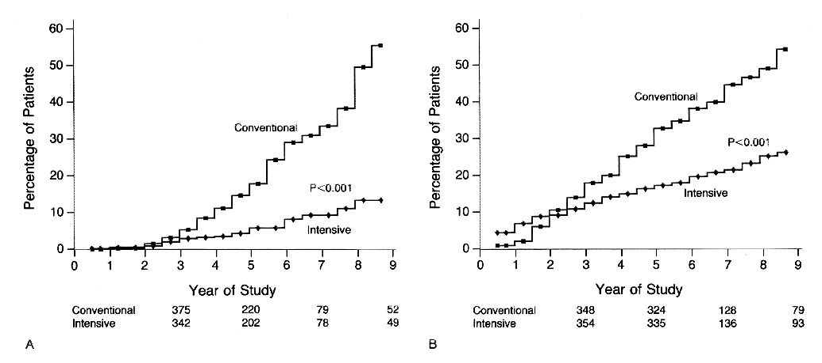
DCCT: Reduction in Retinopathy
2018 Diabetes Canada CPG – Chapter 8. Targets for Glycemic Control
Primary Prevention
Secondary Intervention
76% RRR
(95% CI 62-85%)
54% RRR
(95% CI 39-66%)
RRR = relative risk reduction CI = confidence interval
The Diabetes Control and Complications Trial Research Group. N Engl J Med 1993;329:977-986.
Notes:
N Engl J Med. 1993 Sep 30;329(14):977-86.
The effect of intensive treatment of diabetes on the development and progression of long-term complications in insulin-dependent diabetes mellitus. The Diabetes Control and Complications Trial Research Group.
[No authors listed]
Abstract
BACKGROUND:
Long-term microvascular and neurologic complications cause major morbidity and mortality in patients with insulin-dependent diabetes mellitus (IDDM). We examined whether intensive treatment with the goal of maintaining blood glucose concentrations close to the normal range could decrease the frequency and severity of these complications.
METHODS:
A total of 1441 patients with IDDM--726 with no retinopathy at base line (the primary-prevention cohort) and 715 with mild retinopathy (the secondary-intervention cohort) were randomly assigned to intensive therapy administered either with an external insulin pump or by three or more daily insulin injections and guided by frequent blood glucose monitoring or to conventional therapy with one or two daily insulin injections. The patients were followed for a mean of 6.5 years, and the appearance and progression of retinopathy and other complications were assessed regularly.
RESULTS:
In the primary-prevention cohort, intensive therapy reduced the adjusted mean risk for the development of retinopathy by 76 percent (95 percent confidence interval, 62 to 85 percent), as compared with conventional therapy. In the secondary-intervention cohort, intensive therapy slowed the progression of retinopathy by 54 percent (95 percent confidence interval, 39 to 66 percent) and reduced the development of proliferative or severe nonproliferative retinopathy by 47 percent (95 percent confidence interval, 14 to 67 percent). In the two cohorts combined, intensive therapy reduced the occurrence of microalbuminuria (urinary albumin excretion of > or = 40 mg per 24 hours) by 39 percent (95 percent confidence interval, 21 to 52 percent), that of albuminuria (urinary albumin excretion of > or = 300 mg per 24 hours) by 54 percent (95 percent confidence interval 19 to 74 percent), and that of clinical neuropathy by 60 percent (95 percent confidence interval, 38 to 74 percent). The chief adverse event associated with intensive therapy was a two-to-threefold increase in severe hypoglycemia.
CONCLUSIONS:
Intensive therapy effectively delays the onset and slows the progression of diabetic retinopathy, nephropathy, and neuropathy in patients with IDDM.
10

Slide 11
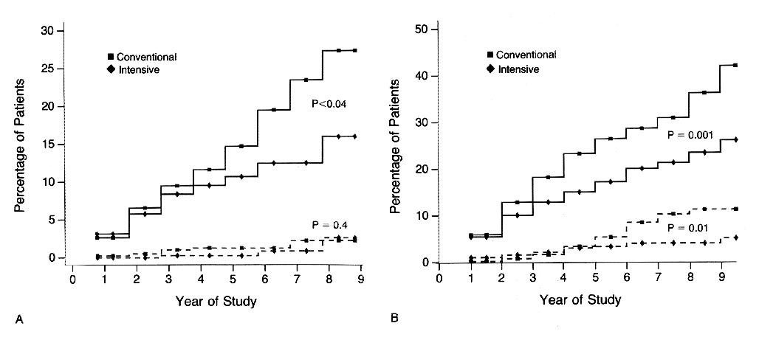
DCCT: Reduction in Albuminuria
2018 Diabetes Canada CPG – Chapter 8. Targets for Glycemic Control
Primary Prevention
Secondary Intervention
34% RRR (p<0.04)
43% RRR
(p=0.001)
56% RRR
(p=0.01)
Solid line = risk of developing microalbuminuria
Dashed line = risk of developing macroalbuminuria
RRR = relative risk reduction
CI = confidence interval
The Diabetes Control and Complications Trial Research Group. N Engl J Med 1993;329:977-986.
Notes:
N Engl J Med. 1993 Sep 30;329(14):977-86.
The effect of intensive treatment of diabetes on the development and progression of long-term complications in insulin-dependent diabetes mellitus. The Diabetes Control and Complications Trial Research Group.
[No authors listed]
Abstract
BACKGROUND:
Long-term microvascular and neurologic complications cause major morbidity and mortality in patients with insulin-dependent diabetes mellitus (IDDM). We examined whether intensive treatment with the goal of maintaining blood glucose concentrations close to the normal range could decrease the frequency and severity of these complications.
METHODS:
A total of 1441 patients with IDDM--726 with no retinopathy at base line (the primary-prevention cohort) and 715 with mild retinopathy (the secondary-intervention cohort) were randomly assigned to intensive therapy administered either with an external insulin pump or by three or more daily insulin injections and guided by frequent blood glucose monitoring or to conventional therapy with one or two daily insulin injections. The patients were followed for a mean of 6.5 years, and the appearance and progression of retinopathy and other complications were assessed regularly.
RESULTS:
In the primary-prevention cohort, intensive therapy reduced the adjusted mean risk for the development of retinopathy by 76 percent (95 percent confidence interval, 62 to 85 percent), as compared with conventional therapy. In the secondary-intervention cohort, intensive therapy slowed the progression of retinopathy by 54 percent (95 percent confidence interval, 39 to 66 percent) and reduced the development of proliferative or severe nonproliferative retinopathy by 47 percent (95 percent confidence interval, 14 to 67 percent). In the two cohorts combined, intensive therapy reduced the occurrence of microalbuminuria (urinary albumin excretion of > or = 40 mg per 24 hours) by 39 percent (95 percent confidence interval, 21 to 52 percent), that of albuminuria (urinary albumin excretion of > or = 300 mg per 24 hours) by 54 percent (95 percent confidence interval 19 to 74 percent), and that of clinical neuropathy by 60 percent (95 percent confidence interval, 38 to 74 percent). The chief adverse event associated with intensive therapy was a two-to-threefold increase in severe hypoglycemia.
CONCLUSIONS:
Intensive therapy effectively delays the onset and slows the progression of diabetic retinopathy, nephropathy, and neuropathy in patients with IDDM.
11

Slide 12
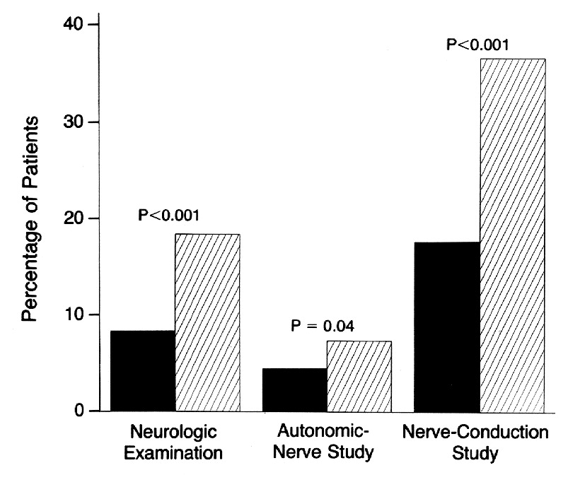
DCCT: Reduction in Neuropathy
2018 Diabetes Canada CPG – Chapter 8. Targets for Glycemic Control
The Diabetes Control and Complications Trial Research Group. N Engl J Med 1993;329:977-986.
Notes:
N Engl J Med. 1993 Sep 30;329(14):977-86.
The effect of intensive treatment of diabetes on the development and progression of long-term complications in insulin-dependent diabetes mellitus. The Diabetes Control and Complications Trial Research Group.
[No authors listed]
Abstract
BACKGROUND:
Long-term microvascular and neurologic complications cause major morbidity and mortality in patients with insulin-dependent diabetes mellitus (IDDM). We examined whether intensive treatment with the goal of maintaining blood glucose concentrations close to the normal range could decrease the frequency and severity of these complications.
METHODS:
A total of 1441 patients with IDDM--726 with no retinopathy at base line (the primary-prevention cohort) and 715 with mild retinopathy (the secondary-intervention cohort) were randomly assigned to intensive therapy administered either with an external insulin pump or by three or more daily insulin injections and guided by frequent blood glucose monitoring or to conventional therapy with one or two daily insulin injections. The patients were followed for a mean of 6.5 years, and the appearance and progression of retinopathy and other complications were assessed regularly.
RESULTS:
In the primary-prevention cohort, intensive therapy reduced the adjusted mean risk for the development of retinopathy by 76 percent (95 percent confidence interval, 62 to 85 percent), as compared with conventional therapy. In the secondary-intervention cohort, intensive therapy slowed the progression of retinopathy by 54 percent (95 percent confidence interval, 39 to 66 percent) and reduced the development of proliferative or severe nonproliferative retinopathy by 47 percent (95 percent confidence interval, 14 to 67 percent). In the two cohorts combined, intensive therapy reduced the occurrence of microalbuminuria (urinary albumin excretion of > or = 40 mg per 24 hours) by 39 percent (95 percent confidence interval, 21 to 52 percent), that of albuminuria (urinary albumin excretion of > or = 300 mg per 24 hours) by 54 percent (95 percent confidence interval 19 to 74 percent), and that of clinical neuropathy by 60 percent (95 percent confidence interval, 38 to 74 percent). The chief adverse event associated with intensive therapy was a two-to-threefold increase in severe hypoglycemia.
CONCLUSIONS:
Intensive therapy effectively delays the onset and slows the progression of diabetic retinopathy, nephropathy, and neuropathy in patients with IDDM.
12

Slide 13
DCCT/EDIC: Early intensive glucose control leads to long-term reduction nonfatal MI, stroke or CVD death
2018 Diabetes Canada CPG – Chapter 8. Targets for Glycemic Control
0.12
0.10
0.08
0.06
0.04
0.02
0.00
57% risk reduction
(P=0.02; 95% CI: 12–79%)
Conventional
treatment
MI, stroke or CV death
Intensive
treatment
0 1 2 3 4 5 6 7 8 9 10 11 12 13 14 15 16 17 18 19 20 21
Years since entry
DCCT/EDIC Study Research Group. N Engl J Med 2005;353:2643–2653.
Notes:
13
13
N Engl J Med. 2005 Dec 22;353(25):2643-53.
Intensive diabetes treatment and cardiovascular disease in patients with type 1 diabetes.
Nathan DM, Cleary PA, Backlund JY, Genuth SM, Lachin JM, Orchard TJ, Raskin P, Zinman B; Diabetes Control and Complications Trial/Epidemiology of Diabetes Interventions and Complications (DCCT/EDIC) Study Research Group.
Source
dnathan@partners.org
Abstract
BACKGROUND:
Intensive diabetes therapy aimed at achieving near normoglycemia reduces the risk of microvascular and neurologic complications of type 1 diabetes. We studied whether the use of intensive therapy as compared with conventional therapy during the Diabetes Control and Complications Trial (DCCT) affected the long-term incidence of cardiovascular disease.
METHODS:
The DCCT randomly assigned 1441 patients with type 1 diabetes to intensive or conventional therapy, treating them for a mean of 6.5 years between 1983 and 1993. Ninety-three percent were subsequently followed until February 1, 2005, during the observational Epidemiology of Diabetes Interventions and Complications study. Cardiovascular disease (defined as nonfatal myocardial infarction, stroke, death from cardiovascular disease, confirmed angina, or the need for coronary-artery revascularization) was assessed with standardized measures and classified by an independent committee.
RESULTS:
During the mean 17 years of follow-up, 46 cardiovascular disease events occurred in 31 patients who had received intensive treatment in the DCCT, as compared with 98 events in 52 patients who had received conventional treatment. Intensive treatment reduced the risk of any cardiovascular disease event by 42 percent (95 percent confidence interval, 9 to 63 percent; P=0.02) and the risk of nonfatal myocardial infarction, stroke, or death from cardiovascular disease by 57 percent (95 percent confidence interval, 12 to 79 percent; P=0.02). The decrease in glycosylated hemoglobin values during the DCCT was significantly associated with most of the positive effects of intensive treatment on the risk of cardiovascular disease. Microalbuminuria and albuminuria were associated with a significant increase in the risk of cardiovascular disease, but differences between treatment groups remained significant (P< or =0.05) after adjusting for these factors.
CONCLUSIONS:
Intensive diabetes therapy has long-term beneficial effects on the risk of cardiovascular disease in patients with type 1 diabetes.

Slide 14
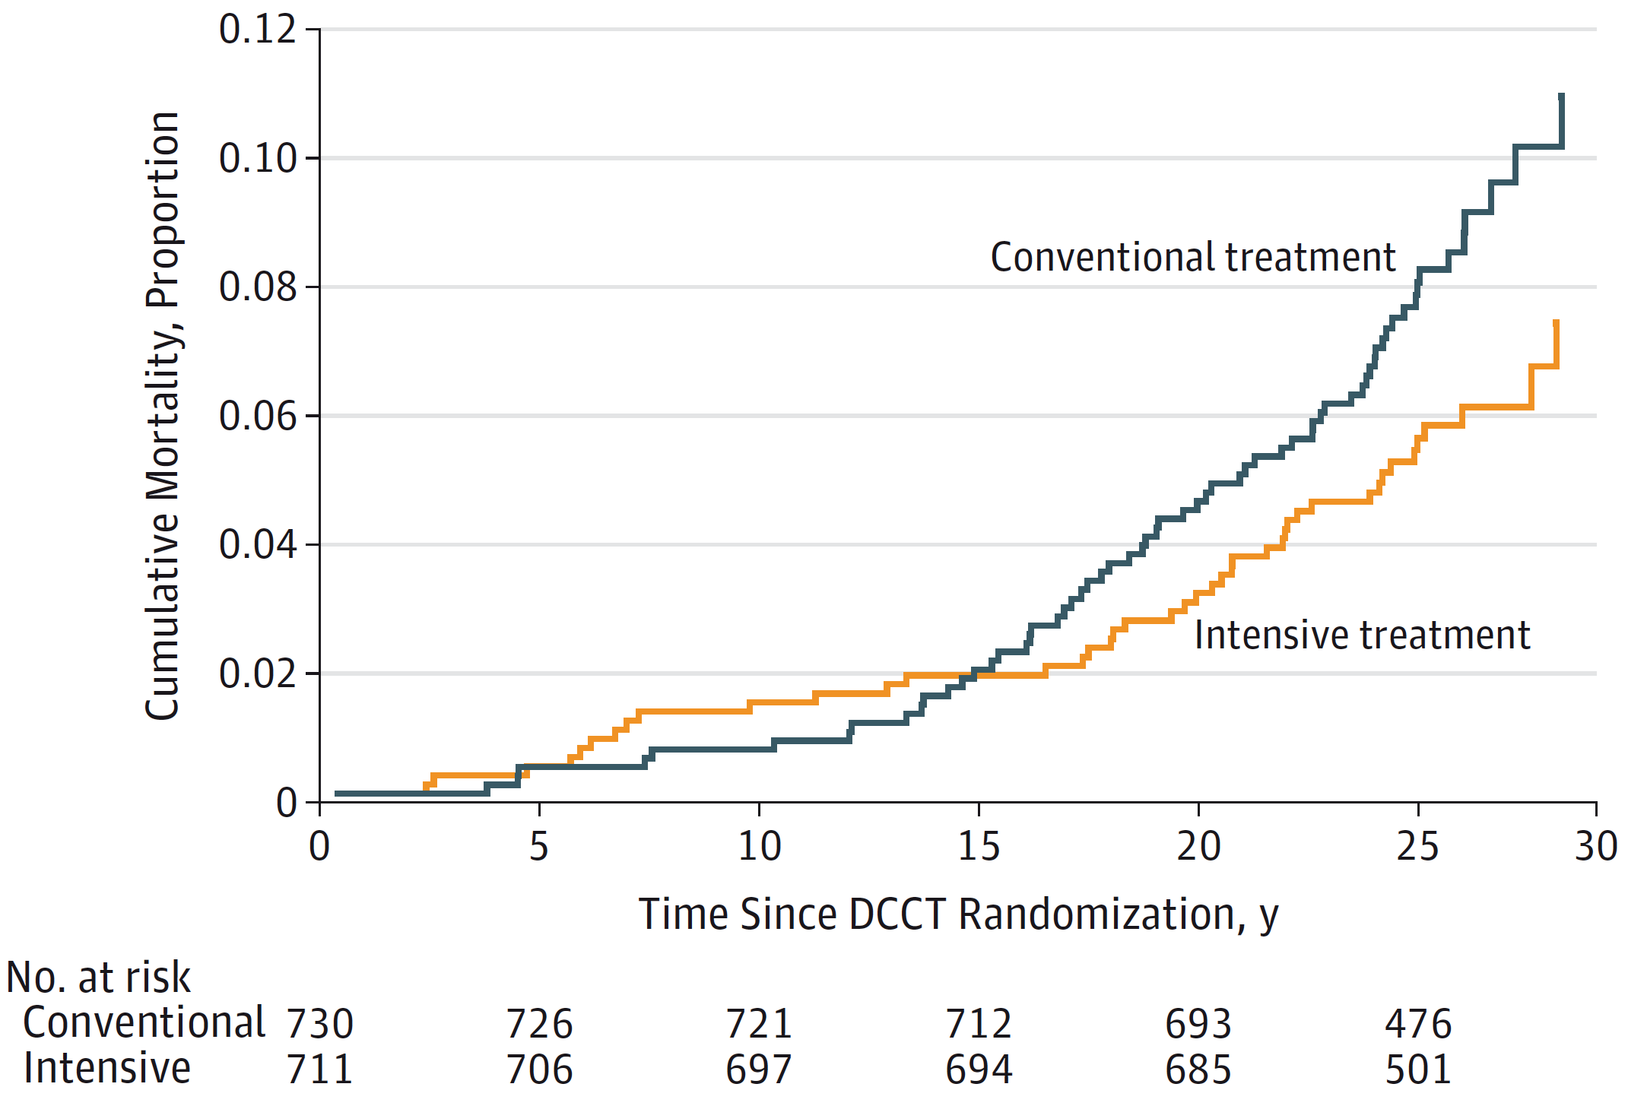
2018 Diabetes Canada CPG – Chapter 8. Targets for Glycemic Control
DCCT/EDIC: Early intensive glucose control leads to long-term reduction in mortality
HR 0.67
(95% CI, 0.46-0.99)
P=0.045
DCCT/EDIC Research Group. JAMA 2015;313:45-53.

Slide 15
UKPDS 33: Intensive glucose control with sulfonylureas or insulin in type 2 diabetes
N = 3867 Recent Onset T2DM
9
Conventional
7.9%
8
A1C (%)
Intensive
7.0%
7
6
0
0
3
6
9
12
15
UKPDS Study Group. Lancet 1998:352:837-53.
Notes:
Lancet. 1998 Sep 12;352(9131):837-53.
Intensive blood-glucose control with sulphonylureas or insulin compared with conventional treatment and risk of complications in patients with type 2 diabetes (UKPDS 33). UK Prospective Diabetes Study (UKPDS) Group.
[No authors listed]
Erratum in
Lancet 1999 Aug 14;354(9178):602.
Abstract
BACKGROUND:
Improved blood-glucose control decreases the progression of diabetic microvascular disease, but the effect on macrovascular complications is unknown. There is concern that sulphonylureas may increase cardiovascular mortality in patients with type 2 diabetes and that high insulin concentrations may enhance atheroma formation. We compared the effects of intensive blood-glucose control with either sulphonylurea or insulin and conventional treatment on the risk of microvascular and macrovascular complications in patients with type 2 diabetes in a randomised controlled trial.
METHODS:
3867 newly diagnosed patients with type 2 diabetes, median age 54 years (IQR 48-60 years), who after 3 months' diet treatment had a mean of two fasting plasma glucose (FPG) concentrations of 6.1-15.0 mmol/L were randomly assigned intensive policy with a sulphonylurea (chlorpropamide, glibenclamide, or glipizide) or with insulin, or conventional policy with diet. The aim in the intensive group was FPG less than 6 mmol/L. In the conventional group, the aim was the best achievable FPG with diet alone; drugs were added only if there were hyperglycaemic symptoms or FPG greater than 15 mmol/L. Three aggregate endpoints were used to assess differences between conventional and intensive treatment: any diabetes-related endpoint (sudden death, death from hyperglycaemia or hypoglycaemia, fatal or non-fatal myocardial infarction, angina, heart failure, stroke, renal failure, amputation [of at least one digit], vitreous haemorrhage, retinopathy requiring photocoagulation, blindness in one eye, or cataract extraction); diabetes-related death (death from myocardial infarction, stroke, peripheral vascular disease, renal disease, hyperglycaemia or hypoglycaemia, and sudden death); all-cause mortality. Single clinical endpoints and surrogate subclinical endpoints were also assessed. All analyses were by intention to treat and frequency of hypoglycaemia was also analysed by actual therapy.
FINDINGS:
Over 10 years, haemoglobin A1c (HbA1c) was 7.0% (6.2-8.2) in the intensive group compared with 7.9% (6.9-8.8) in the conventional group--an 11% reduction. There was no difference in HbA1c among agents in the intensive group. Compared with the conventional group, the risk in the intensive group was 12% lower (95% CI 1-21, p=0.029) for any diabetes-related endpoint; 10% lower (-11 to 27, p=0.34) for any diabetes-related death; and 6% lower (-10 to 20, p=0.44) for all-cause mortality. Most of the risk reduction in the any diabetes-related aggregate endpoint was due to a 25% risk reduction (7-40, p=0.0099) in microvascular endpoints, including the need for retinal photocoagulation. There was no difference for any of the three aggregate endpoints between the three intensive agents (chlorpropamide, glibenclamide, or insulin). Patients in the intensive group had more hypoglycaemic episodes than those in the conventional group on both types of analysis (both p<0.0001). The rates of major hypoglycaemic episodes per year were 0.7% with conventional treatment, 1.0% with chlorpropamide, 1.4% with glibenclamide, and 1.8% with insulin. Weight gain was significantly higher in the intensive group (mean 2.9 kg) than in the conventional group (p<0.001), and patients assigned insulin had a greater gain in weight (4.0 kg) than those assigned chlorpropamide (2.6 kg) or glibenclamide (1.7 kg).
INTERPRETATION:
Intensive blood-glucose control by either sulphonylureas or insulin substantially decreases the risk of microvascular complications, but not macrovascular disease, in patients with type 2 diabetes.(ABSTRACT TRUNCATED)
15

Slide 16
UKPDS: Legacy Effect of Early Intensive Glucose Control
2018 Diabetes Canada CPG – Chapter 8. Targets for Glycemic Control
2007: After total of 20 years follow-up
Aggregate Endpoint 1997 2007
Any diabetes related endpoint RRR: 12% 9%
P: 0.029 0.040
Microvascular disease RRR: 25% 24%
P: 0.0099 0.001
Myocardial infarction RRR: 16% 15%
P: 0.052 0.014
All-cause mortality RRR: 6% 13%
P: 0.44 0.007
Holman R, et al. N Engl J Med 2008;359.
Notes:
16
N Engl J Med. 2008 Oct 9;359(15):1577-89. doi: 10.1056/NEJMoa0806470. Epub 2008 Sep 10.
10-year follow-up of intensive glucose control in type 2 diabetes.
Holman RR, Paul SK, Bethel MA, Matthews DR, Neil HA.
Source
Diabetes Trials Unit, Oxford Centre for Diabetes, Endocrinology, and Metabolism, Churchill Hospital, Headington, Oxford OX3 7LJ, United Kingdom. rury.holman@dtu.ox.ac.uk
Abstract
BACKGROUND:
During the United Kingdom Prospective Diabetes Study (UKPDS), patients with type 2 diabetes mellitus who received intensive glucose therapy had a lower risk of microvascular complications than did those receiving conventional dietary therapy. We conducted post-trial monitoring to determine whether this improved glucose control persisted and whether such therapy had a long-term effect on macrovascular outcomes.
METHODS:
Of 5102 patients with newly diagnosed type 2 diabetes, 4209 were randomly assigned to receive either conventional therapy (dietary restriction) or intensive therapy (either sulfonylurea or insulin or, in overweight patients, metformin) for glucose control. In post-trial monitoring, 3277 patients were asked to attend annual UKPDS clinics for 5 years, but no attempts were made to maintain their previously assigned therapies. Annual questionnaires were used to follow patients who were unable to attend the clinics, and all patients in years 6 to 10 were assessed through questionnaires. We examined seven prespecified aggregate clinical outcomes from the UKPDS on an intention-to-treat basis, according to previous randomization categories.
RESULTS:
Between-group differences in glycated hemoglobin levels were lost after the first year. In the sulfonylurea-insulin group, relative reductions in risk persisted at 10 years for any diabetes-related end point (9%, P=0.04) and microvascular disease (24%, P=0.001), and risk reductions for myocardial infarction (15%, P=0.01) and death from any cause (13%, P=0.007) emerged over time, as more events occurred. In the metformin group, significant risk reductions persisted for any diabetes-related end point (21%, P=0.01), myocardial infarction (33%, P=0.005), and death from any cause (27%, P=0.002).
CONCLUSIONS:
Despite an early loss of glycemic differences, a continued reduction in microvascular risk and emergent risk reductions for myocardial infarction and death from any cause were observed during 10 years of post-trial follow-up. A continued benefit after metformin therapy was evident among overweight patients. (UKPDS 80; Current Controlled Trials number, ISRCTN75451837.)

Slide 17
< 6.5%
2018 Diabetes Canada CPG – Chapter 8. Targets for Glycemic Control
Notes:
17

Slide 18
ADVANCE
N = 11,140 T2DM
Intensive (A1C ≤6.5% with gliclazide MR)
vs.
Standard glycemic control
Notes:
N Engl J Med. 2008 Jun 12;358(24):2560-72. doi: 10.1056/NEJMoa0802987. Epub 2008 Jun 6.
Intensive blood glucose control and vascular outcomes in patients with type 2 diabetes.
ADVANCE Collaborative Group, Patel A, MacMahon S, Chalmers J, Neal B, Billot L, Woodward M, Marre M, Cooper M, Glasziou P, Grobbee D, Hamet P, Harrap S, Heller S, Liu L, Mancia G, Mogensen CE, Pan C, Poulter N, Rodgers A, Williams B, Bompoint S, de Galan BE, Joshi R, Travert F.
The following toggler user interface control may not be accessible. Tab to the next button to revert the control to an accessible version.
Destroy user interface controlCollaborators (1307)
Abstract
BACKGROUND:
In patients with type 2 diabetes, the effects of intensive glucose control on vascular outcomes remain uncertain.
METHODS:
We randomly assigned 11,140 patients with type 2 diabetes to undergo either standard glucose control or intensive glucose control, defined as the use of gliclazide (modified release) plus other drugs as required to achieve a glycated hemoglobin value of 6.5% or less. Primary end points were composites of major macrovascular events (death from cardiovascular causes, nonfatal myocardial infarction, or nonfatal stroke) and major microvascular events (new or worsening nephropathy or retinopathy), assessed both jointly and separately.
RESULTS:
After a median of 5 years of follow-up, the mean glycated hemoglobin level was lower in the intensive-control group (6.5%) than in the standard-control group (7.3%). Intensive control reduced the incidence of combined major macrovascular and microvascular events (18.1%, vs. 20.0% with standard control; hazard ratio, 0.90; 95% confidence interval [CI], 0.82 to 0.98; P=0.01), as well as that of major microvascular events (9.4% vs. 10.9%; hazard ratio, 0.86; 95% CI, 0.77 to 0.97; P=0.01), primarily because of a reduction in the incidence of nephropathy (4.1% vs. 5.2%; hazard ratio, 0.79; 95% CI, 0.66 to 0.93; P=0.006), with no significant effect on retinopathy (P=0.50). There were no significant effects of the type of glucose control on major macrovascular events (hazard ratio with intensive control, 0.94; 95% CI, 0.84 to 1.06; P=0.32), death from cardiovascular causes (hazard ratio with intensive control, 0.88; 95% CI, 0.74 to 1.04; P=0.12), or death from any cause (hazard ratio with intensive control, 0.93; 95% CI, 0.83 to 1.06; P=0.28). Severe hypoglycemia, although uncommon, was more common in the intensive-control group (2.7%, vs. 1.5% in the standard-control group; hazard ratio, 1.86; 95% CI, 1.42 to 2.40; P<0.001).
CONCLUSIONS:
A strategy of intensive glucose control, involving gliclazide (modified release) and other drugs as required, that lowered the glycated hemoglobin value to 6.5% yielded a 10% relative reduction in the combined outcome of major macrovascular and microvascular events, primarily as a consequence of a 21% relative reduction in nephropathy. (ClinicalTrials.gov number, NCT00145925.)
18

Slide 19
ADVANCE: Glucose Control
2018 Diabetes Canada CPG – Chapter 8. Targets for Glycemic Control
10.0
9.0
Standard control 7.3%
8.0
Mean
A1C (%)
7.0
p < 0.001
6.0
Intensive control 6.5%
5.0
0.0
0
6
12
18
24
30
36
42
48
54
60
66
Follow-up (months)
ADVANCE Collaborative Group. N Engl J Med 2008;358:24.
Notes:
N Engl J Med. 2008 Jun 12;358(24):2560-72. doi: 10.1056/NEJMoa0802987. Epub 2008 Jun 6.
Intensive blood glucose control and vascular outcomes in patients with type 2 diabetes.
ADVANCE Collaborative Group, Patel A, MacMahon S, Chalmers J, Neal B, Billot L, Woodward M, Marre M, Cooper M, Glasziou P, Grobbee D, Hamet P, Harrap S, Heller S, Liu L, Mancia G, Mogensen CE, Pan C, Poulter N, Rodgers A, Williams B, Bompoint S, de Galan BE, Joshi R, Travert F.
The following toggler user interface control may not be accessible. Tab to the next button to revert the control to an accessible version.
Destroy user interface controlCollaborators (1307)
Abstract
BACKGROUND:
In patients with type 2 diabetes, the effects of intensive glucose control on vascular outcomes remain uncertain.
METHODS:
We randomly assigned 11,140 patients with type 2 diabetes to undergo either standard glucose control or intensive glucose control, defined as the use of gliclazide (modified release) plus other drugs as required to achieve a glycated hemoglobin value of 6.5% or less. Primary end points were composites of major macrovascular events (death from cardiovascular causes, nonfatal myocardial infarction, or nonfatal stroke) and major microvascular events (new or worsening nephropathy or retinopathy), assessed both jointly and separately.
RESULTS:
After a median of 5 years of follow-up, the mean glycated hemoglobin level was lower in the intensive-control group (6.5%) than in the standard-control group (7.3%). Intensive control reduced the incidence of combined major macrovascular and microvascular events (18.1%, vs. 20.0% with standard control; hazard ratio, 0.90; 95% confidence interval [CI], 0.82 to 0.98; P=0.01), as well as that of major microvascular events (9.4% vs. 10.9%; hazard ratio, 0.86; 95% CI, 0.77 to 0.97; P=0.01), primarily because of a reduction in the incidence of nephropathy (4.1% vs. 5.2%; hazard ratio, 0.79; 95% CI, 0.66 to 0.93; P=0.006), with no significant effect on retinopathy (P=0.50). There were no significant effects of the type of glucose control on major macrovascular events (hazard ratio with intensive control, 0.94; 95% CI, 0.84 to 1.06; P=0.32), death from cardiovascular causes (hazard ratio with intensive control, 0.88; 95% CI, 0.74 to 1.04; P=0.12), or death from any cause (hazard ratio with intensive control, 0.93; 95% CI, 0.83 to 1.06; P=0.28). Severe hypoglycemia, although uncommon, was more common in the intensive-control group (2.7%, vs. 1.5% in the standard-control group; hazard ratio, 1.86; 95% CI, 1.42 to 2.40; P<0.001).
CONCLUSIONS:
A strategy of intensive glucose control, involving gliclazide (modified release) and other drugs as required, that lowered the glycated hemoglobin value to 6.5% yielded a 10% relative reduction in the combined outcome of major macrovascular and microvascular events, primarily as a consequence of a 21% relative reduction in nephropathy. (ClinicalTrials.gov number, NCT00145925.)
Reference(s)
The ADVANCE Collaborative Group. Intensive blood glucose control and vascular outcomes in patients with type 2 diabetes. New Engl J Med 2008;358:2560-72.
19

Slide 20
ADVANCE: Treatment Effect on the Primary Microvascular Outcomes
2018 Diabetes Canada CPG – Chapter 8. Targets for Glycemic Control
New/worsening nephropathy, retinopathy
25
20
HR 0.86 (0.77-0.97)
p = 0.01
15
Standard
control
Cumulative incidence (%)
10
5
Intensive
control
0
0
6
12
18
24
30
36
42
48
54
60
66
Follow-up (months)
 | Intensive | Standard | HR | p
Nephropathy/retinopathy (%) | 9.4 | 10.9 | 0.86 | 0.01
Nephropathy (%) | 4.1 | 5.2 | 0.79 | 0.006
Retinopathy (%) | 6.0 | 6.3 | 0.95 | NS
ADVANCE Collaborative Group. N Engl J Med 2008;358:24.
Notes:
N Engl J Med. 2008 Jun 12;358(24):2560-72. doi: 10.1056/NEJMoa0802987. Epub 2008 Jun 6.
Intensive blood glucose control and vascular outcomes in patients with type 2 diabetes.
ADVANCE Collaborative Group, Patel A, MacMahon S, Chalmers J, Neal B, Billot L, Woodward M, Marre M, Cooper M, Glasziou P, Grobbee D, Hamet P, Harrap S, Heller S, Liu L, Mancia G, Mogensen CE, Pan C, Poulter N, Rodgers A, Williams B, Bompoint S, de Galan BE, Joshi R, Travert F.
The following toggler user interface control may not be accessible. Tab to the next button to revert the control to an accessible version.
Destroy user interface controlCollaborators (1307)
Abstract
BACKGROUND:
In patients with type 2 diabetes, the effects of intensive glucose control on vascular outcomes remain uncertain.
METHODS:
We randomly assigned 11,140 patients with type 2 diabetes to undergo either standard glucose control or intensive glucose control, defined as the use of gliclazide (modified release) plus other drugs as required to achieve a glycated hemoglobin value of 6.5% or less. Primary end points were composites of major macrovascular events (death from cardiovascular causes, nonfatal myocardial infarction, or nonfatal stroke) and major microvascular events (new or worsening nephropathy or retinopathy), assessed both jointly and separately.
RESULTS:
After a median of 5 years of follow-up, the mean glycated hemoglobin level was lower in the intensive-control group (6.5%) than in the standard-control group (7.3%). Intensive control reduced the incidence of combined major macrovascular and microvascular events (18.1%, vs. 20.0% with standard control; hazard ratio, 0.90; 95% confidence interval [CI], 0.82 to 0.98; P=0.01), as well as that of major microvascular events (9.4% vs. 10.9%; hazard ratio, 0.86; 95% CI, 0.77 to 0.97; P=0.01), primarily because of a reduction in the incidence of nephropathy (4.1% vs. 5.2%; hazard ratio, 0.79; 95% CI, 0.66 to 0.93; P=0.006), with no significant effect on retinopathy (P=0.50). There were no significant effects of the type of glucose control on major macrovascular events (hazard ratio with intensive control, 0.94; 95% CI, 0.84 to 1.06; P=0.32), death from cardiovascular causes (hazard ratio with intensive control, 0.88; 95% CI, 0.74 to 1.04; P=0.12), or death from any cause (hazard ratio with intensive control, 0.93; 95% CI, 0.83 to 1.06; P=0.28). Severe hypoglycemia, although uncommon, was more common in the intensive-control group (2.7%, vs. 1.5% in the standard-control group; hazard ratio, 1.86; 95% CI, 1.42 to 2.40; P<0.001).
CONCLUSIONS:
A strategy of intensive glucose control, involving gliclazide (modified release) and other drugs as required, that lowered the glycated hemoglobin value to 6.5% yielded a 10% relative reduction in the combined outcome of major macrovascular and microvascular events, primarily as a consequence of a 21% relative reduction in nephropathy. (ClinicalTrials.gov number, NCT00145925.)
Reference(s)
The ADVANCE Collaborative Group. Intensive blood glucose control and vascular outcomes in patients with type 2 diabetes. New Engl J Med 2008;358:2560-72.
20

Slide 21

2018 Diabetes Canada CPG – Chapter 8. Targets for Glycemic Control
HYPO-
GLYCEMIA
BENEFIT
Notes:
21

Slide 22
7.1 – 8.5%
2018 Diabetes Canada CPG – Chapter 8. Targets for Glycemic Control
Notes:
22

Slide 23
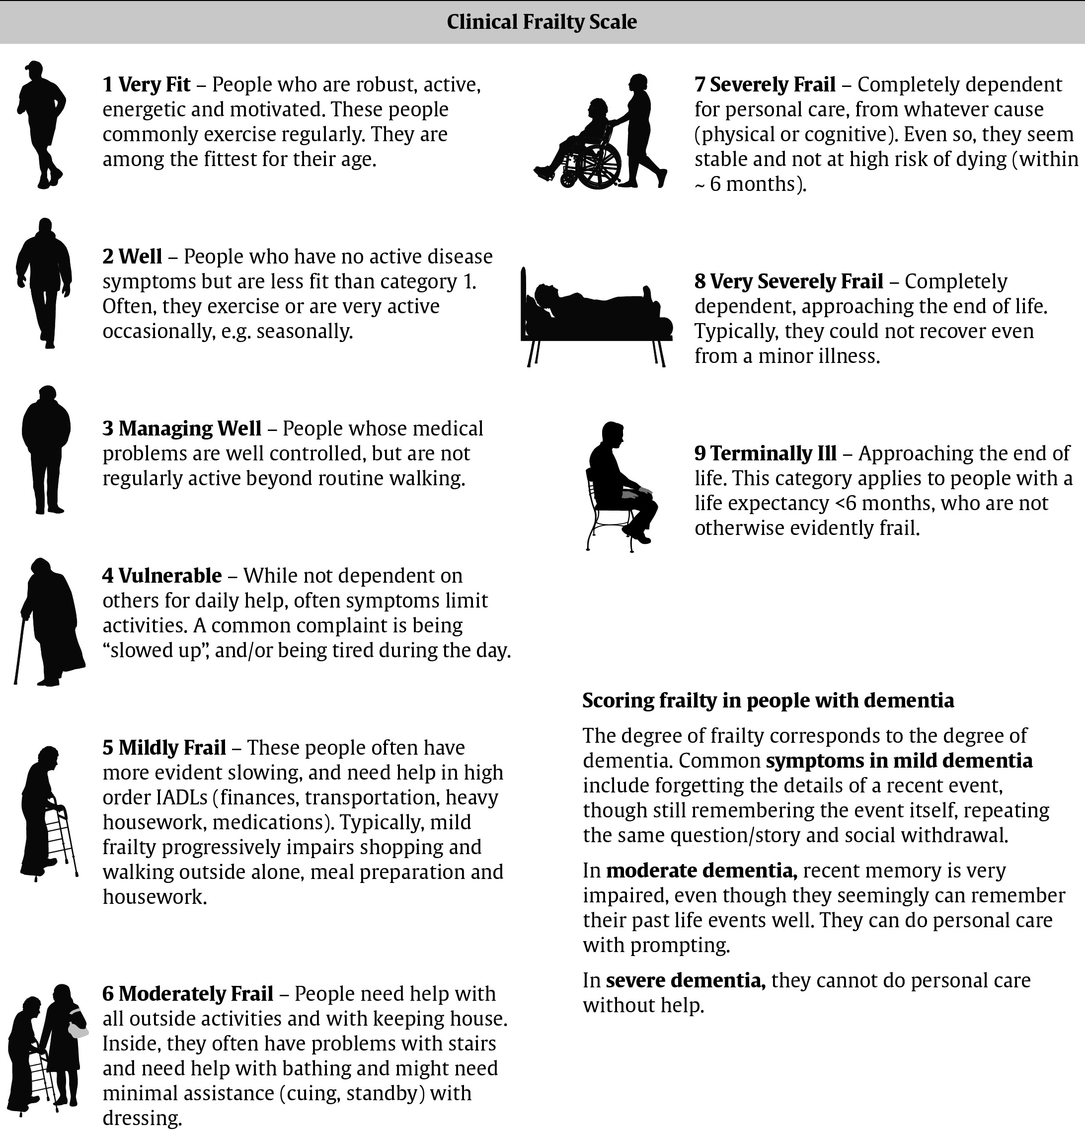
Moorhouse P, Rockwood K. J R Coll Physicians Edinb 2012;42:333-340.
Notes:
23

Slide 24
Recommendations 1-3
2018 Diabetes Canada CPG – Chapter 8. Targets for Glycemic Control
Glycemic targets should be individualized [Grade D, Consensus]
In most people with type 1 or type 2 diabetes, an A1C ≤7.0% should be targeted to reduce the risk of microvascular [Grade A, Level 1A] and, if implemented early in the course of disease, CV complications [Grade B, Level 3]
In people with type 2 diabetes, an A1C ≤6.5% may be targeted to reduce the risk of CKD [Grade A, Level 1A] and retinopathy [Grade A, Level 1A], if they are assessed to be at low risk of hypoglycemia based on class of antihyperglycemic medication(s) utilized and the person’s characteristics [Grade D, Consensus]
CKD, chronic kidney disease; CV, cardiovascular

Slide 25
Recommendation 4
2018 Diabetes Canada CPG – Chapter 8. Targets for Glycemic Control
2018
4. A higher A1C target may be considered in people with diabetes with the goals of avoiding hypoglycemia and over-treatment related to antihyperglycemic therapy, with any of the following: [Grade D, Consensus]
  Functionally dependent: 7.1-8.0%
  History of recurrent severe hypoglycemia, especially if accompanied by hypoglycemia unawareness: 7.1-8.5%
  Limited life expectancy: 7.1-8.5%
  Frail elderly and/or with dementia: 7.1-8.5%
  End of life: A1C measurement not recommended. Avoid symptomatic hyperglycemia and any hypoglycemia

Slide 26
Recommendation 5
2018 Diabetes Canada CPG – Chapter 8. Targets for Glycemic Control
2018
5. In order to achieve an A1C ≤7.0%, people with diabetes should aim for:
  Fasting plasma glucose (FPG) or preprandial PG target of 4.0–7.0 mmol/L and a 2h PPG target of 5.0–10.0 mmol/L [Grade B, Level 2 for type 1; Grade B, Level 2 for type 2 diabetes]
  If an A1C target ≤7.0% cannot be achieved with a FPG target of 4.0-7.0 mmol/L and PPG target of 5.0–10.0 mmol/L, further FPG lowering to 4.0 to 5.5 mmol/L and/or PPG lowering to 5.0–8.0 mmol/L may be considered, but must be balanced against the risk of hypoglycemia [Grade D, Level 4 for FPG target for type 2 diabetes; Grade D, Consensus for FPG target for type 1 diabetes; Grade D, Level 4 for PPG target for type 2 diabetes; Grade D, Consensus for PPG target for type 1 diabetes]

Slide 27
Key Messages
2018 Diabetes Canada CPG – Chapter 8. Targets for Glycemic Control
Optimal glycemic control is fundamental to the management of diabetes
Both fasting and postprandial plasma glucose levels correlate with the risk of complications and contribute to the measured A1C value
Glycemic targets should be individualized based on the individual’s age, duration of diabetes, risk of severe hypoglycemia, presence or absence of hypoglycemia unawareness, frailty or functional dependence and life expectancy

Slide 28
Key Messages for People with Diabetes
2018 Diabetes Canada CPG – Chapter 8. Targets for Glycemic Control
Try to keep your blood glucose as close to your target range as possible. This will help to delay or prevent complications of diabetes
Target ranges for blood glucose and A1C can vary and depend on a person’s age, medical conditions and other risk factors. Work with your diabetes healthcare team to determine what your target A1C, and blood glucose target range (fasting and after meals) should be

Slide 29

Visit guidelines.diabetes.ca

Slide 30


Or download the App

Slide 31
Diabetes Canada Clinical Practice Guidelines
http://guidelines.diabetes.ca – for health-care providers
1-800-BANTING (226-8464)
http://diabetes.ca – for people with diabetes

