Slide 1
Blood Glucose Monitoring: Update 2021

Slide 2
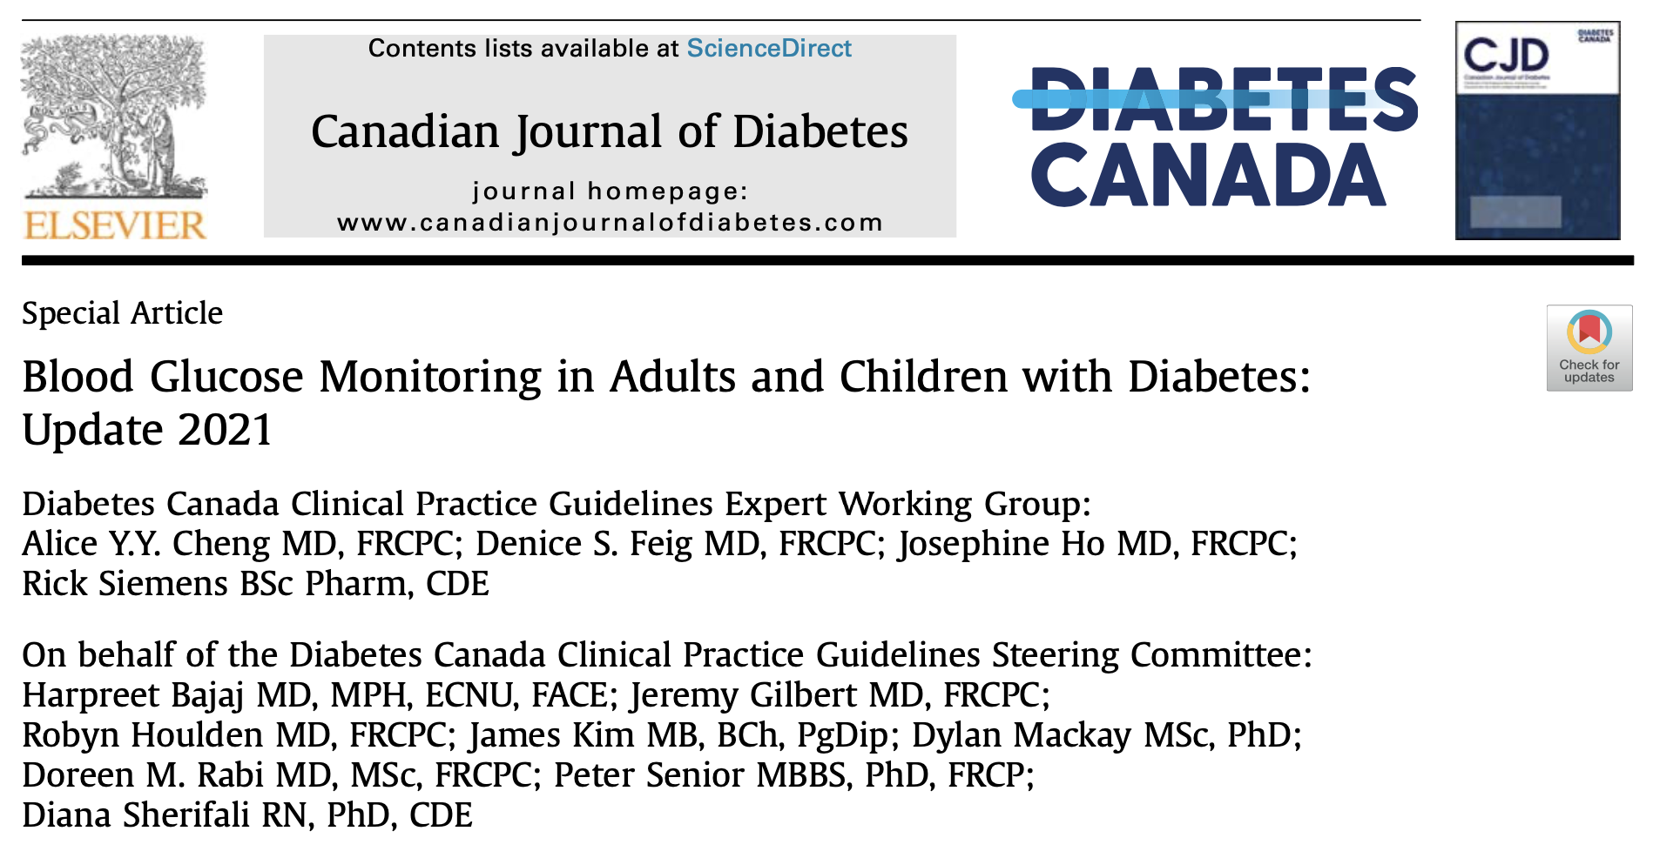

Slide 3
Grading of Recommendations
For simplicity and clarity, Evidence Grades and Level are abbreviated in the following slides
^{A,1} Grade A, Level 1A
^{B,2} Grade B , Level 2
^{C,3} Grade C, Level 3
^{D} Grade D, consensus
New recommendations are highlighted in bold text
Grading reflects the strength of published evidence particularly clinical trials and meta-analyses

Slide 4
2021
Changes in 2021 Update
Update literature review of publications between Nov 2017 and 28 Oct 2020
Consolidated glucose monitoring recommendations for
  Adults
  Children
  Pregnancy
Updated terminology for glucose monitoring technologies
Aligned with “Language Matters”

Slide 5
2021
New Terminology
New Term | Previous Term | Definition
Capillary blood glucose (CBG) | Self-monitored blood glucose (SMBG) | Determination of glucose in the capillary blood using finger sticks
Intermittently scanned continuous glucose monitoring (isCGM) | Flash glucose monitoring (FGM) | Measurement of interstitial fluid glucose via intermittent scanning of sensing device
Real-time continuous glucose monitoring (rtCGM) | Continuous glucose monitoring (CGM) | Measurement of interstitial fluid glucose via a sensing device that is continuously transmitting the data to a device with real-time display for viewing at any time

Slide 6
2021
CGM metrics and targets
* For most non-pregnant adults
Glucose Metric | Target* | Definition
Glucose Management Indicator (GMI) | <=7.0% | GMI may differ from measured A1C as it reflects the period being assessed by CGM (eg last 14 days, etc)
Glycemic Variability | <=36% | Lower %CV associated with reduced hypoglycemia
Time In Range (TIR) 3.9 – 10.0 | >70% | 70% TIR equates to an A1C of about 7.0%. Each 10% TIR equates to about 0.5% change in A1C
Time Below Range (TBR) 3.0-3.8 <3.0 | <3.0% <1.0% | Total % of values <3.9 mmol/L (includes Levels 1 and 2) should be <4% for most individuals
Time Above Range (TAR) High 10.1 – 13.9 Very high >13.9 | <20% <5% | Total % of values >10.1 mmol/L (includes high and very high) should be <25% for most individuals

Slide 7
2021
CGM targets for older/high risk adults
(non-pregnant)
Glucose Metric | Target | Definition
Time In Range (TIR) 3.9 – 10.0 | >50% | 50% TIR equates to an A1C of about 8.0%. Each 10% TIR equates to about 0.5-0.8% change in A1C
Time Below Range (TBR) <3.9 | <1.0% | In older/high-risk individuals using insulin or sulfonylureas, avoiding hypoglycemia is a priority*
Time Above Range (TAR) High 10.1 – 13.9 Very high >13.9 | n/a <10% | Some glucose values between 10.1-13.9 mmol/L are acceptable. Minimizing time >13.9 is preferred
* In individuals NOT using insulin or sulfonylureas, CGM values <3.9 mmol/L may not indicate true or clinically significant hypoglycemia

Slide 8
2021
CGM targets for pregnancy
Glucose Metric | Type 1 diabetes pregnancy | Type 2 diabetes pregnancy or gestational diabetes
Time In Range (TIR) 3.5 – 7.8 | >70% | *Not known
Time Below Range (TBR) 3.0 – 3.4 <3.0 | <3.0% <1.0% | *Not known *Not known
Time Above Range (TAR) >7.8 | <25% | *Not known
See discussion in Battelino et al Diabetes Care 2019;42: 1593e603 suggesting that more stringent targets and greater attention to overnight glucose profiles may be required to normalize outcomes in pregnant women with GDM
Notes:
More data are needed to define the clinical CGM targets for pregnant women with type 2 diabetes, who spend one-third less time hyperglycemic than women with type 1 diabetes and achieve TIR of 90% (58). Because of the lack of evidence on CGM targets for women with gestational diabetes mellitus (GDM) or type 2 diabetes in pregnancy, percentages of time spent in range, below range, and above range have not been included in this report. Recent data suggest that even more stringent targets (66) and greater attention to overnight glucose profiles may be required to normalize outcomes in pregnant women with GDM (63).

Slide 9
2021
#1 In most individuals*
… A1C should be measured approximately every 3 months to ensure that glycemic goals are being met or maintained ^{D}
In some circumstances, such as when significant changes are made to therapy, or during pregnancy, it is appropriate to check A1C more frequently ^{D}
Testing at least every 6 months should be performed in adults during periods of treatment and healthy behaviour stability when glycemic targets have been consistently achieved ^{D}
*including children & adolescents

Slide 10
2021
#2 In individuals using insulin more than once/day
… CBG testing should be used as an essential part of diabetes self-management
T1D adults ^{A1}; T1D children ^{C3} and *T2D ^{C3}
  at least 3 times per day ^{C3}
  include both pre- and postprandial measurements ^{C3}
For *T2D on once-daily insulin plus non-insulin AHA,
  testing at least once a day at variable times is recommended ^{D}
*including children & adolescents

Slide 11
2021
#3 In T2D individuals NOT using insulin
… the frequency of CBG testing should be individualized (considering AHAs, A1c, Hypo risk) ^{D}
When A1C targets are not being reached,
  structured CBG testing should be instituted (including a 7-point profile; every 1-3 months) to improve A1C ^{B} for adults; ^{D} for children
If achieving A1C targets or using AHA not assoc with hypoglycemia
  daily CBG testing is not recommended except during illness or at risk of hyperglycemia (e.g. surgery, steroid treatment) when more frequent testing may be required ^{D}

Slide 12
2021
#4 In all individuals with diabetes
… more frequent CBG testing (4x/day ± overnight) is recommended when
A1C is not at target
There are episodes of hypoglycemia
to identify the safest and most effective clinical approach to improve blood glucose levels ^{D}

Slide 13
2021
#5 In individuals with T1D using BBIT or CSII who are willing & able to use these on a nearly daily basis
rtCGM SHOULD be used to
  Reduce A1C and increase TIR ^{A}
  Reduce duration and incidence of hypoglycemia ^{A}
  improve aspects of diabetes-specific quality of life (in adults^{B})
  increase treatment satisfaction (in adults using CSII^{B})
isCGM may be used to
  increase TIR (adults^{B}; children^{C})
  Reduce frequency and duration of hypoglycemia (TBR adults^{B})
  increase treatment satisfaction ^{C}

Slide 14
2021
#6 In individuals with T1D with impaired awareness of hypoglycemia or recent severe hypoglycemia
rtCGM SHOULD be used to reduce incidence of hypoglycemia and severe hypoglycemic events ^{A} compared with CBG testing
rtCGM is recommended to reduce time in hypoglycemia compared with isCGM ^{B}

Slide 15
#7 In individuals with T2D using BBIT who have not achieved their A1C target who are willing and able to use these on a nearly daily basis
2021
rtCGM may be used to reduce A1C and duration of hypoglycemia (TBR) ^{A}
isCGM may be used as an alternative to CBG testing to reduce frequency and duration of hypoglycemia (TBR) ^{B}

Slide 16
2021
#8 In pregnant women with T1D
rtCGM should be used
  to increase TIR and reduce TAR and
  reduce the risk of LGA infants, neonatal hypoglycemia and NICU admissions >24 hours ^{A}

Slide 17
#9 Women with gestational diabetes or T2D during pregnancy
2021
should be requested to perform CBG testing 4 times daily (fasting and postprandially) for 1 week to assess blood glucose levels and need for pharmacotherapy
  in women who do not require anti- hyperglycemic medications, CBG testing can be reduced to 4 times per day on alternate days ^{B}
  in women who require insulin therapy, CBG testing should be performed 4 times daily, both fasting and postprandially, to improve pregnancy outcomes ^{B}

Slide 18
2021
#10 If CBG meter readings are suspected to be inaccurate or are discordant from A1C
CBG results should be compared with a simultaneous laboratory measurement of venous blood glucose ^{D}

Slide 19
2021
#11 Individuals with T1D should
be instructed to perform ketone testing during periods of acute illness, particularly in the presence of pre-prandial blood glucose levels >14.0mmol/L or in the presence of symptoms of diabetic ketoacidosis (DKA) ^{D}
Blood ketone testing methods may be preferred over urine ketone testing, as they have been associated with earlier detection of both ketosis and response to treatment ^{B}

Slide 20
User Guide FAQs
Clinical wisdom
Can isCGM or rtCGM be used beyond these recommendations?
CGM could be used as an alternative to CBG
  May provide richer information
  Cost:benefit may be high
  PWD should
    “test with a purpose” and
    “know how to interpret/act on data”
Can isCGM be used during pregnancy?
Accuracy is similar to CBG
Trials have not demonstrated improved outcomes yet

Slide 21
User Guide FAQs
Clinical wisdom
What about Libre2? Is it isCGM? or rtCGM?
We are seeing convergence of technologies
  Real time alerts in Libre2 extend function of isCGM
  No clinical trials (yet) have tested the ability of Libre2 to reduce severe hypoglycemia versus isCGM
  Libre2 may be a very sensible alternative if rtCGM is not available

Slide 22
User Guide FAQs
Clinical wisdom
Does my patient need to use rtCGM or isCGM all the time?
Benefits for A1c lowering and protection from hypoglycemia require near continual use
Can I use rtCGM or isCGM intermittently or for short periods?
Sensors are expensive and PWD may save them to use at times of high risk (changes to usual routines / vacations / new treatments)
Can be helpful prior to clinic visits reviewing blood glucose levels
Can be very helpful as a diagnostic tool (eg nocturnal hypo)
Can be very useful as a teaching tool and to inform and motivate behaviour change

Slide 23
User Guide FAQs
Clinical wisdom
Does my patient need to treat all CGM values below 4 mmol/L with glucose?
Some devices may be biased to “over-call” hyopglycemia.
  In the absence of symptoms, confirmatory CBG testing may be advisable
  Considering the context is particularly important
    treatment may not be required for people not using insulin or secretagogues

Slide 24
User Guide FAQs
Clinical wisdom
My patient wants to set a different target range
It is important to check for this – since it will impact TIR (TAR and TBR) metrics – so the AGP summary may be misleading at first glance
Explore why the patient wants to do this?
  ?fear of hypo
  ?exaggerated fear of complications

